Slide 1
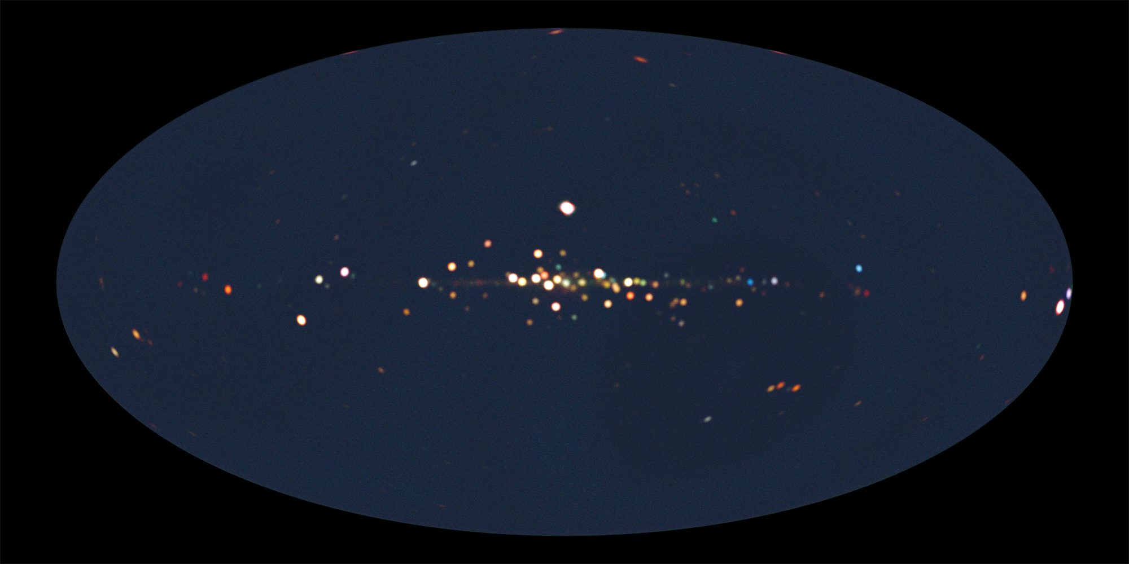
MAXI Highlights The first year of MAXI: Monitoring variable X-ray sources — 4th International MAXI Workshop —
Nobuyuki Kawai (Tokyo Tech)
on behalf of the the MAXI Team

Slide 2
MAXI Team
RIKEN: M. Matsuoka, T. Mihara, M. Sugizaki, M. Suzuki, Y. Nakagawa, T. Yamamoto, T. Sootome
JAXA: K. Kawasaki, S. Ueno, H. Tomida, M. Kohama, M. Ishikawa, K. Ebisawa, H. Katayama
Tokyo Inst. Tech.: N. Kawai, M. Morii, K. Sugimori, R.Usui
Aoyama Gakuin Univ.: A. Yoshida, K. Yamaoka, T. Kotani, S. Nakahira
Osaka Univ.: H. Tsunemi, M. Kimura
Nihon Univ.: H. Negoro, M. Nakajima, H. Ozawa, F .Suwa
Kyoto Univ.: Y. Ueda, N. Isobe, S. Eguchi, K. Hiroi
Miyazaki Univ.: M. Yamauchi, A. Daikyuji
Chuo Univ.: Y. Tsuboi, A.Uzawa, T.Matsumura,
K.Yamazaki

Slide 3
Outline
Mission and Instruments
X-ray sources seen by MAXI
Science highlights
Black hole candidates
Binary pulsars
Active galactic nuclei
Stellar flares
Gamma-ray bursts
Others

Slide 4
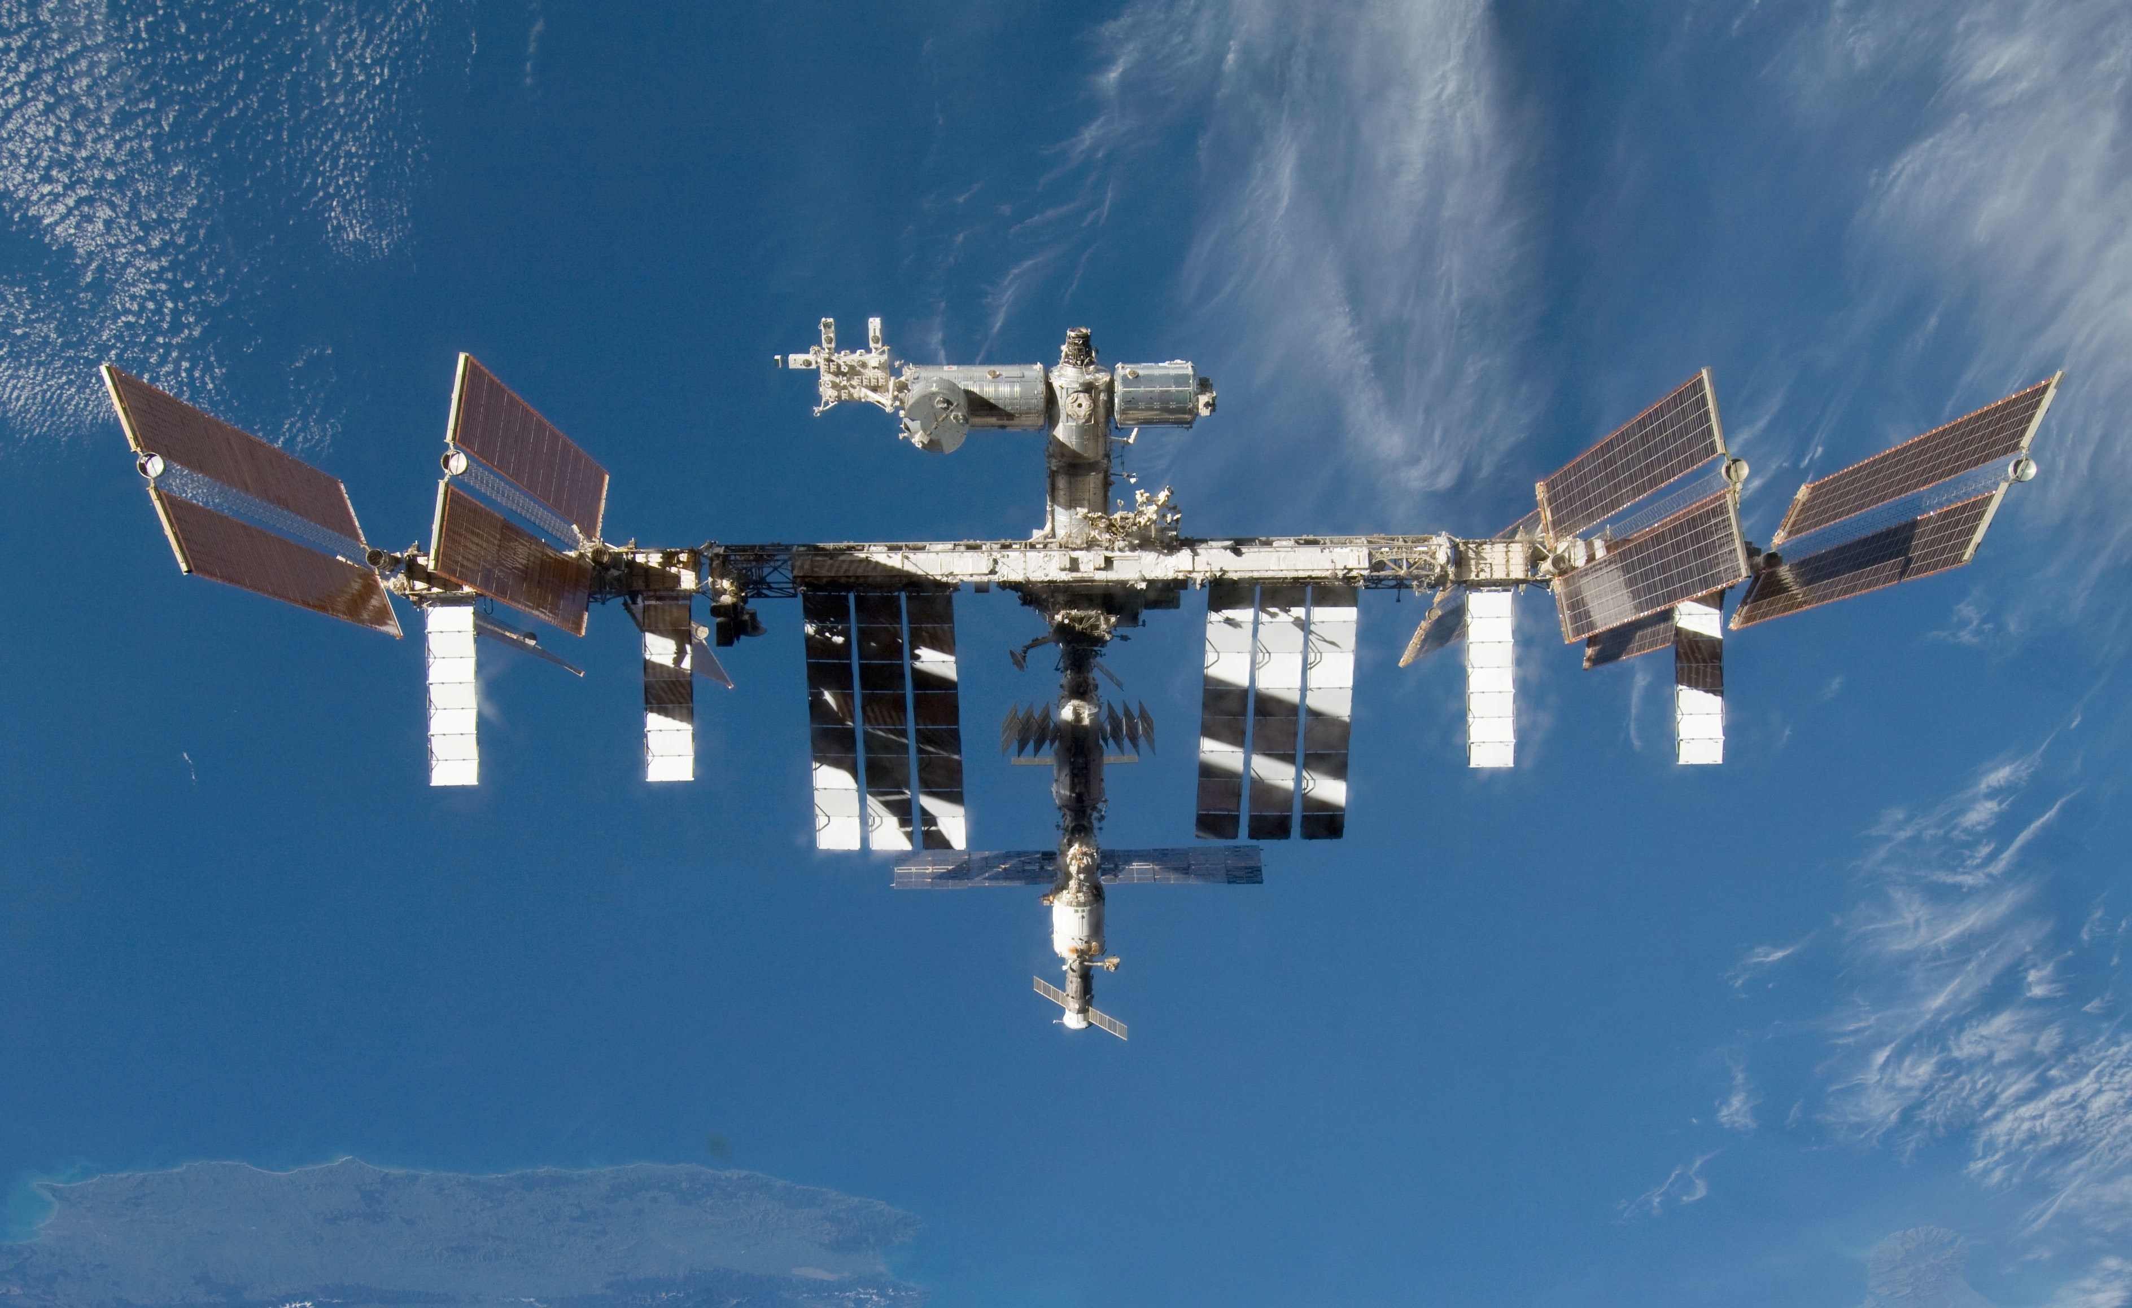
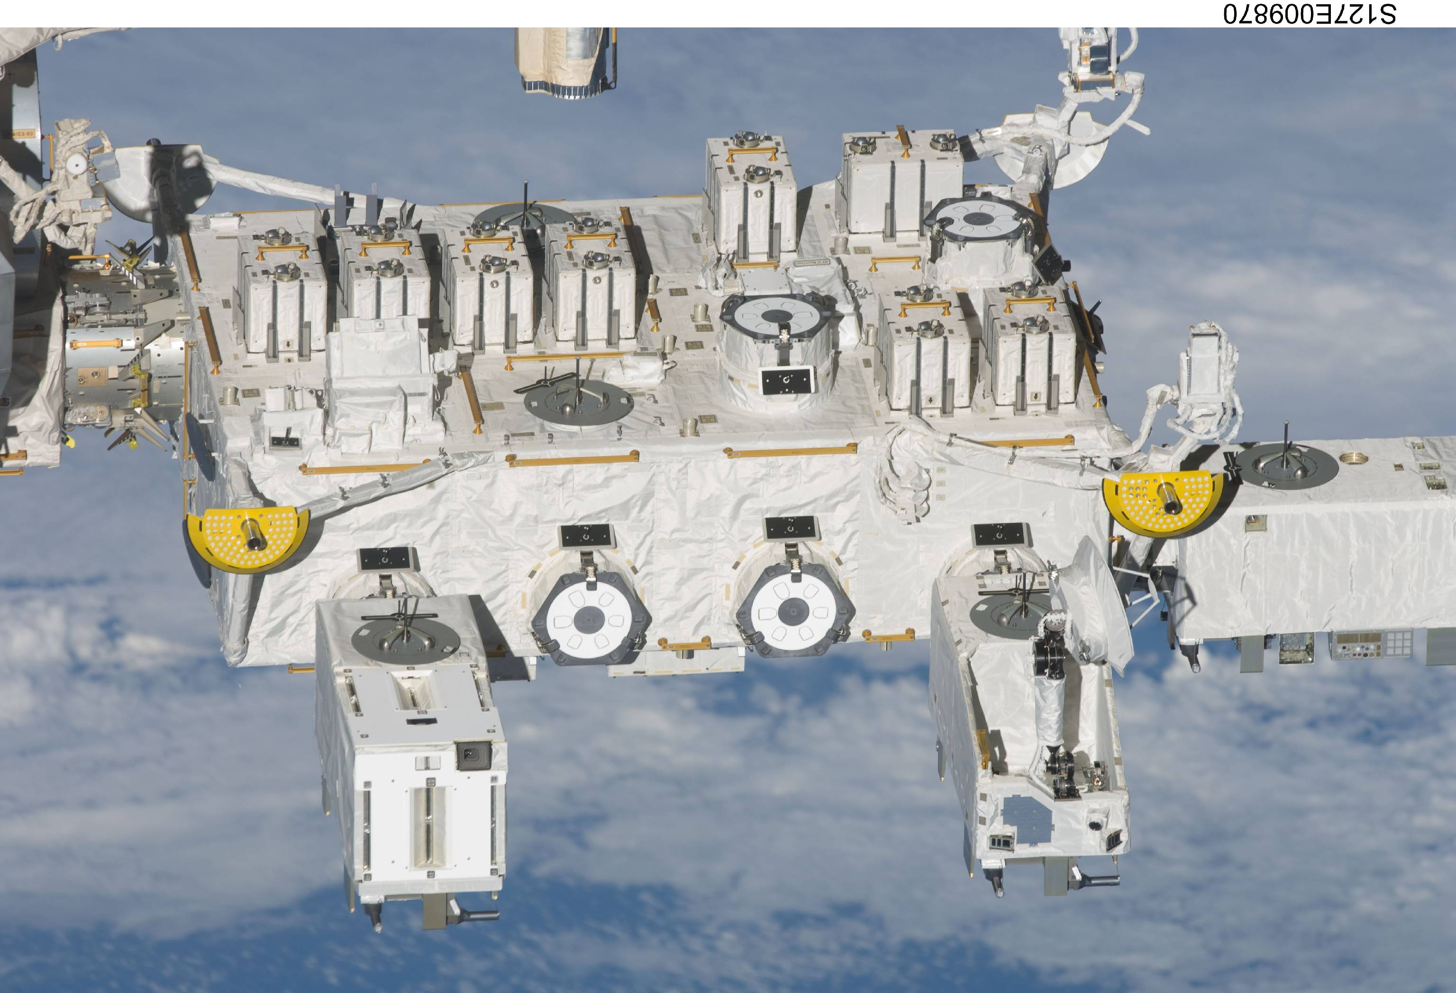
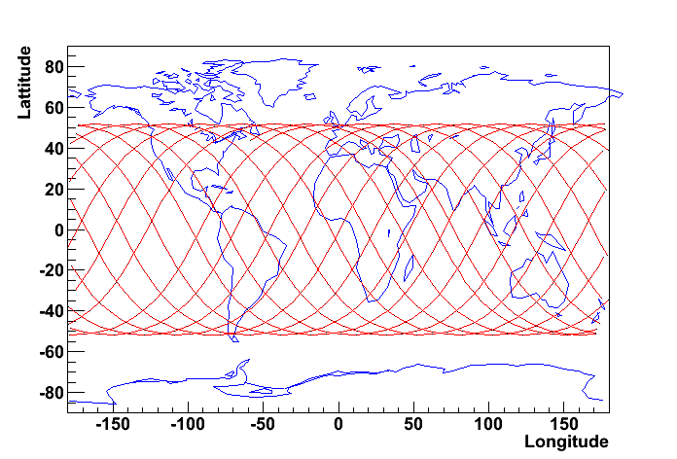
MAXI (Monitor of All-sky X-ray Image) on ISS
Direction of Motion
MAXI
JEM EF
The first astronomical mission on ISS
Transported by Space Shuttle (Endeavour) on July16, 2009
Installed on JEM (Japanese Experimental Module, KIBO) EF (Exposed Facility) on July 23.
First Light on August 15.
inclination = 51.6 deg.
Notes:
Lets start intruducion of MAXI mission
MAXI is the all sky X-ray monitor on board international space station.
The figure shows the MAXI module on the ISS.
The picture was taken by the space-shuttle clews.
The module was placed at the front of the ISS moving direction.,
It is the first astronomical mission carried out on ISS.

Slide 5
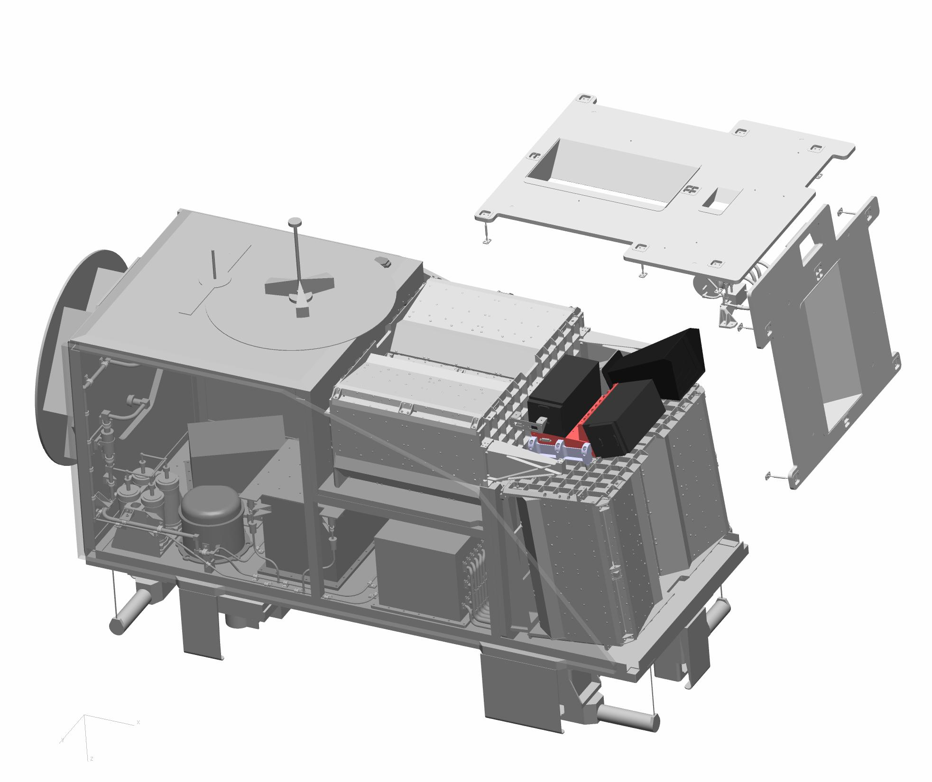
MAXI Instruments
FOV of 6 cameras
Gas Slit Cameras (GSC)
Xe-filled proportional counter
2—30 keV; 5350 cm²
SSC-HZ
Ｘ-ray CCD 16 chipsｘ２ cameras
GSC-Z
80cm
107cm
H
185cm
FOV of 6 cameras
160 deg
ISS motion
1.5deg (FWHM)
Notes:
5
two kind of slit camera
GSC and SSC
both has a one-dimensional field of view.
These slit camera scans the all-sky due the rotation coupled with the orbital motion of 90-minute period.

Slide 6
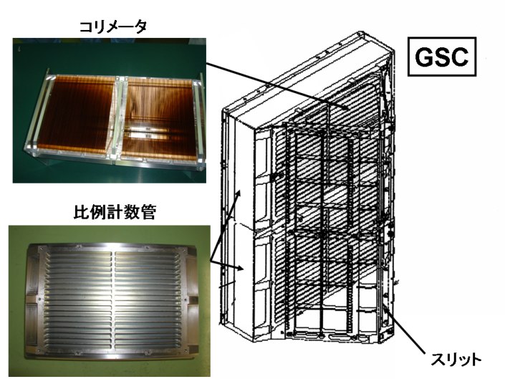
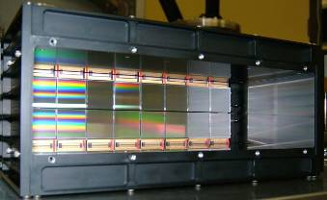
Detectors
 | GSC (X-ray Gas Camera) | SSC (X-ray CCD Camera)
Detector | Gas(Xe) prop. counter x12 | CCD 16 chips x 2 camera
Energy range (Q.E.>10%) | 2－30 keV | 0.5－12 keV
Energy resolution (FWHM) | 15.7%(at 8.0keV) | < 2.5%(150eV) (at 5.9keV)
Time resolution & accuracy | ＜200μsec | ～6 sec
Instantaneous sky coverage | 2.4 % of the whole sky (160 deg x 3 deg x 2 sets) | 1.4% of whole sky (90 deg x 3 deg x 2 sets)
Point Spread Function | 1.5 degree | 1.5 degree
sensitivity | 2 mCrab (week) | 5 mCrab (week)
collimator
SSC
proportional counter
slit
Notes:
The two kinds of slit camera, GSC and SSC, employ the differect detector.
GSC use Xe Gas counter and SSC uses the CCD imager.
They work complementarily.

Slide 7
GSC All-Sky Scan Movie
Red: 2-4 keV, Green: 4-10keV, Blue: 10-20 keV.
Raw data. Exposure not corrected.
Not cleaned for background variation, sun-light leak, and solar-paddle reflection.

Slide 8
GSC All-sky map for the first 10 months
2009/8/15 – 2010/6/16
Red: 2-4 keV, Green: 4-8 keV, Blue: 8-16 keV (exposure not corrected)
About 300 sources were detected.

Slide 9
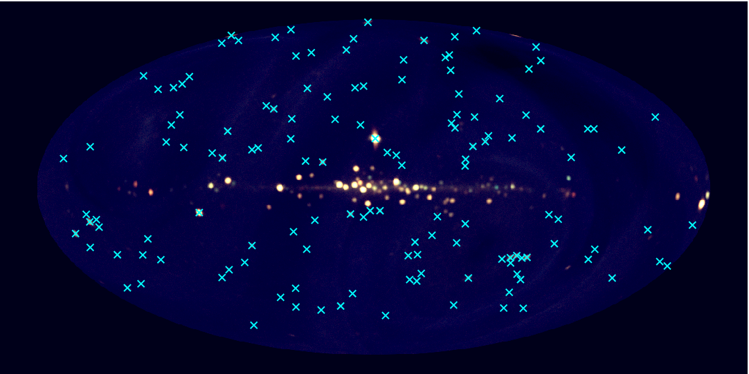
MAXI 7-month catalog
MAXI/GSC
4–10 keV
Poster by Hiroi et al.
Talk by Ueda
136 sources (>7 σ, |b|>10°)
position error < 0.3°
(systematic < 0.05°)

Slide 10
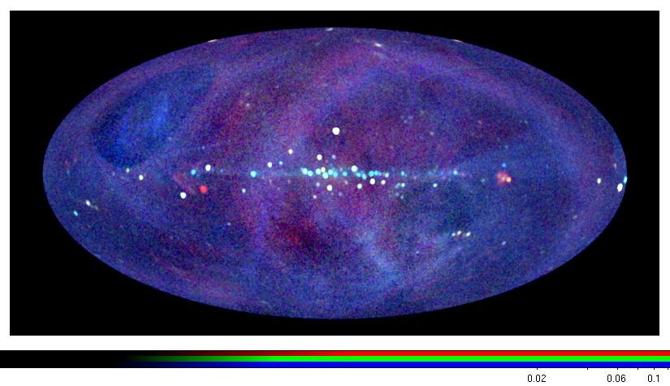
SSC 1-year all-sky map
0.7-1.7keV
1.7-4.0keV
4.0-7.0keV
O-18 Kimura

Slide 11
ATEL with MAXI/GSC
< 2010 > 7/10 RX J1709.5-2639 Outburst
7/1 Cyg X-1 State transition ?
6/29 4U 1954+319 Outburst
6/28 Short X-ray transient (RS-CVn?)
6/14 Cir X-1 Recurrent outburst
5/25 Cyg X-3 State transition
5/10 Cir X-1 Outburst
3/31 LSV +44 17 Outburst
3/30 Short X-ray transient (XRF?)
3/12 Short X-ray transient (X-ray burst?)
3/3 4U 1608-22 Flare
2/18 Mrk 421 Flare 2/10 V0332+53 Recurrent outburst 2/6 4U 1711-34 Flare 2/3 Short X-ray Transient (X-ray burst?) 1/26 Cyg X-3 State Transition 1/24 HR 1099 Flare 1/23 4U 1323-619 Outburst 1/23 XTE J1752-223 State Transition 1/10 GX 339-4 Flare 1/ 9 H 1743-322 State Transition 1/5 V0332+53 Recurrent outburst 1/5 Mrk 421 Flare
< 2009 >
12/31 H 1743-322 Flare 12/31 4U 1630-47 Flare 12/28 NGC6440 Outburst 12/9 Swift J1753.5-0127 State transition? 12/2 Short X-ray Transient (XRF?) 11/15 GX 304-1 Outburst 10/31 A0535+26 Recurrent outburst 10/29 4U 2206+54 Flare 10/25 XTE J1752-223 New source
Black-Hole Candidates
Binary X-ray Pulsars
Low-Mass X-ray Binaries
Stars
AGNs
Unknown (XRF?)
Notes:
9 sources
11

Slide 12
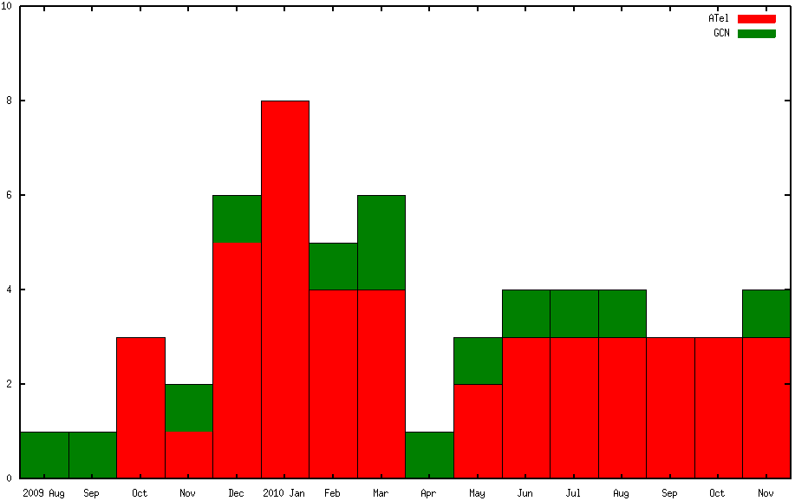
ATEL with MAXI/GSC
< 2010 > cont.
11/22 XTE J1946+274 Outburst
11/10 GT Mus Flare
11/09 AX J1841.0-0536 Outburst
10/31 Short X-ray transient
10/25 A0535+26 Outburst
10/20 MAXI J1409-619 Outburst
9/25 MAXI J1659-152 Outburst
9/13 Short X-ray transient
9/09 TWA-7 Flare
8/07 GX 304-1 Outburst
8/02 GRO J1008-57 Outburst
7/23 A0535+26 Outburst
45 Atel
12 GCN
GCN
ATEL
Aug 2009
Nov 2010
P-63 Suwa
Black-Hole Candidates
Binary X-ray Pulsars and HMXB
Low-Mass X-ray Binaries
Stars
AGNs
Unknown (XRF?)
Notes:
9 sources
12

Slide 13
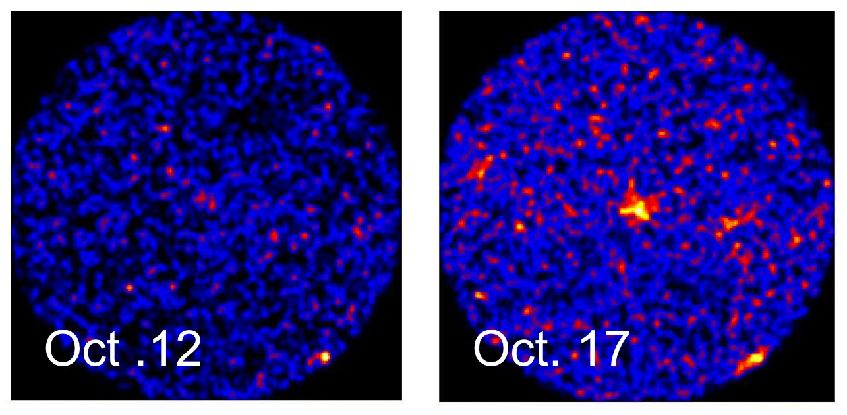
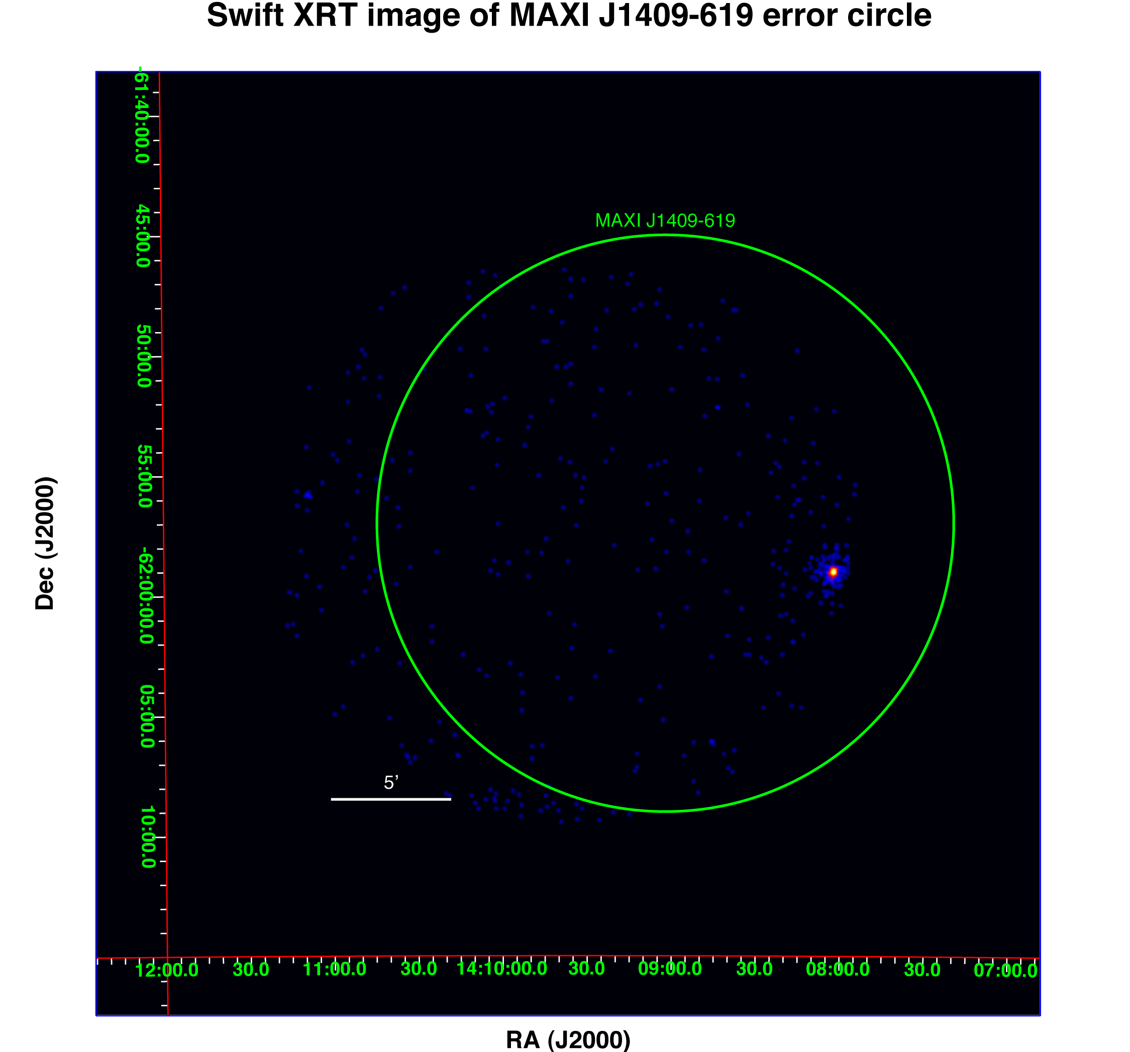
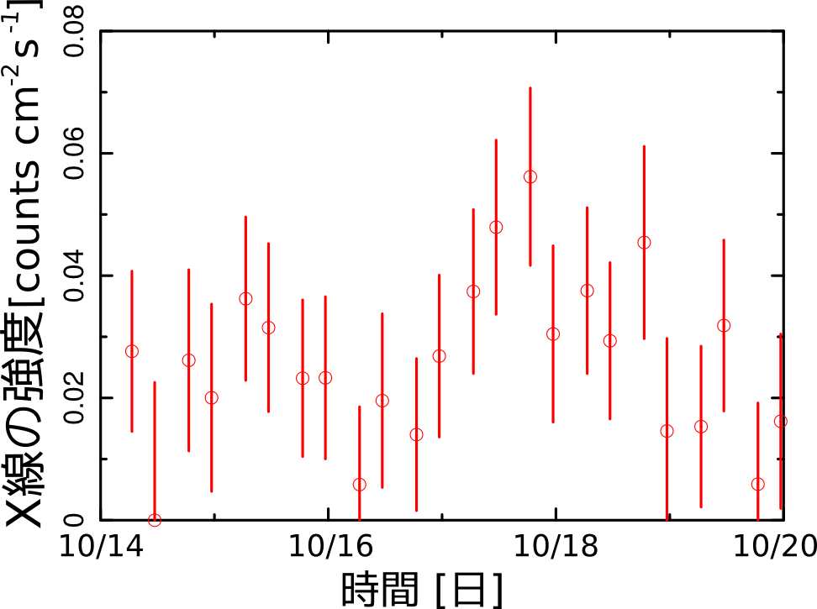
MAXI J1409-619 confirmed and accurately localized by Swift
Swift XRT Oct. 21
MAXI detection of outbursts
X-ray count rate
Date
O-07 Kennea

Slide 14
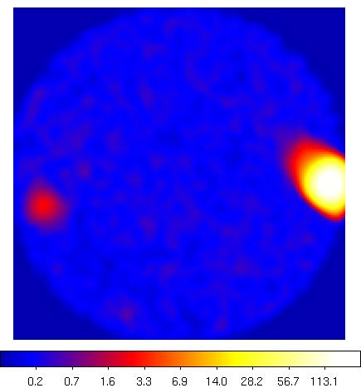
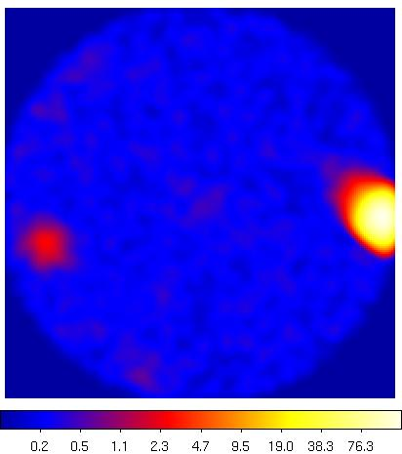
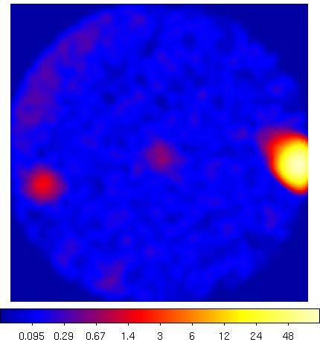
Discovery of MAXI J1659-152
MAXI/GSC triggered
(Negoro+ ATel 2783)
Swift/BAT triggered
(Mangano+ GCN 11296)
as GRB 100928A
O-06 Negoro

Slide 15
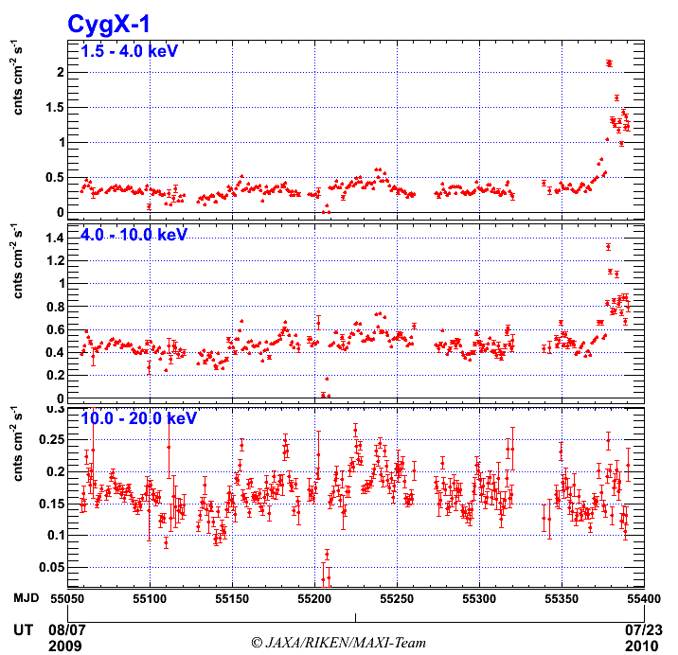
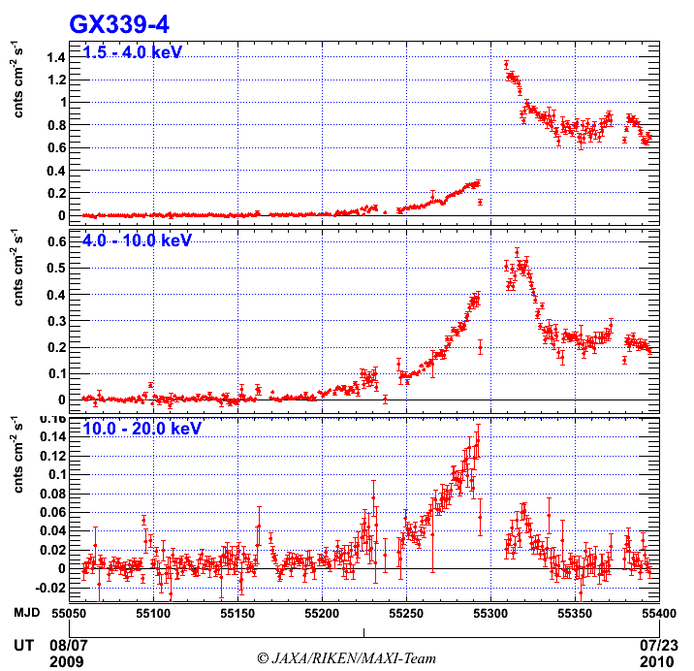
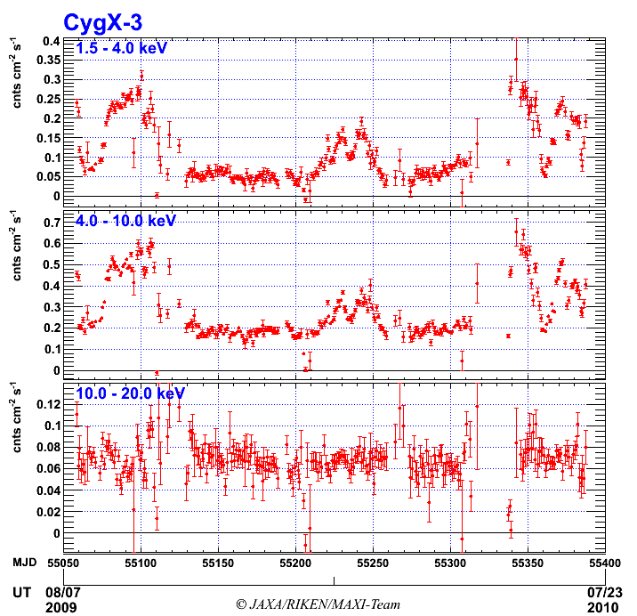
Black hole candidates New Activity, Spectral Transition
ATEL#2711
Soft X-ray increase
ATEL#2380
Beginning of new activity
ATEL#2404, #2635
State transition
Cyg X-1
GX 339-4
Cyg X-3
2-4 keV
4-10 keV
10-20 keV
~ 1yr
O-07: Negoro, YO-04amaoka, P-01 Nakahira, P-07Shidatsu

Slide 16
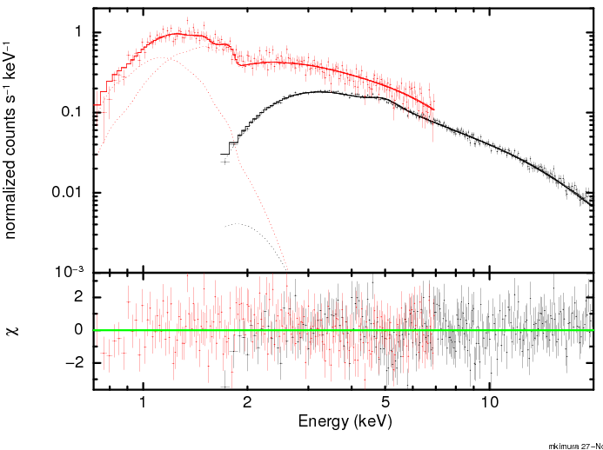
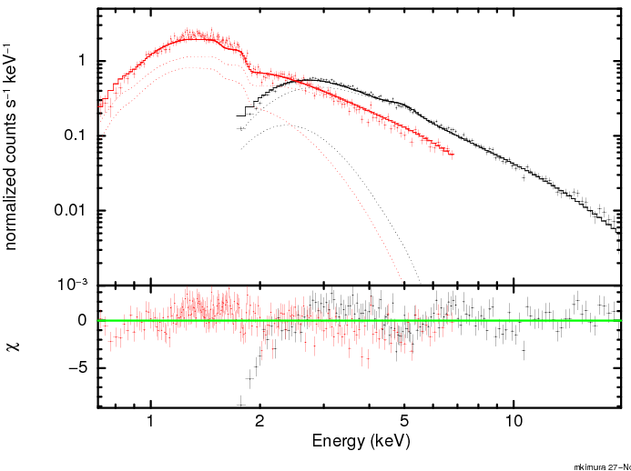
Cyg X-1 spectra
hard state
soft state
SSC
SSC
GSC
GSC
diskbb(0.4keV)+PL
diskbb(0.2keV)+PL
P-60 Tomida et al.

Slide 17
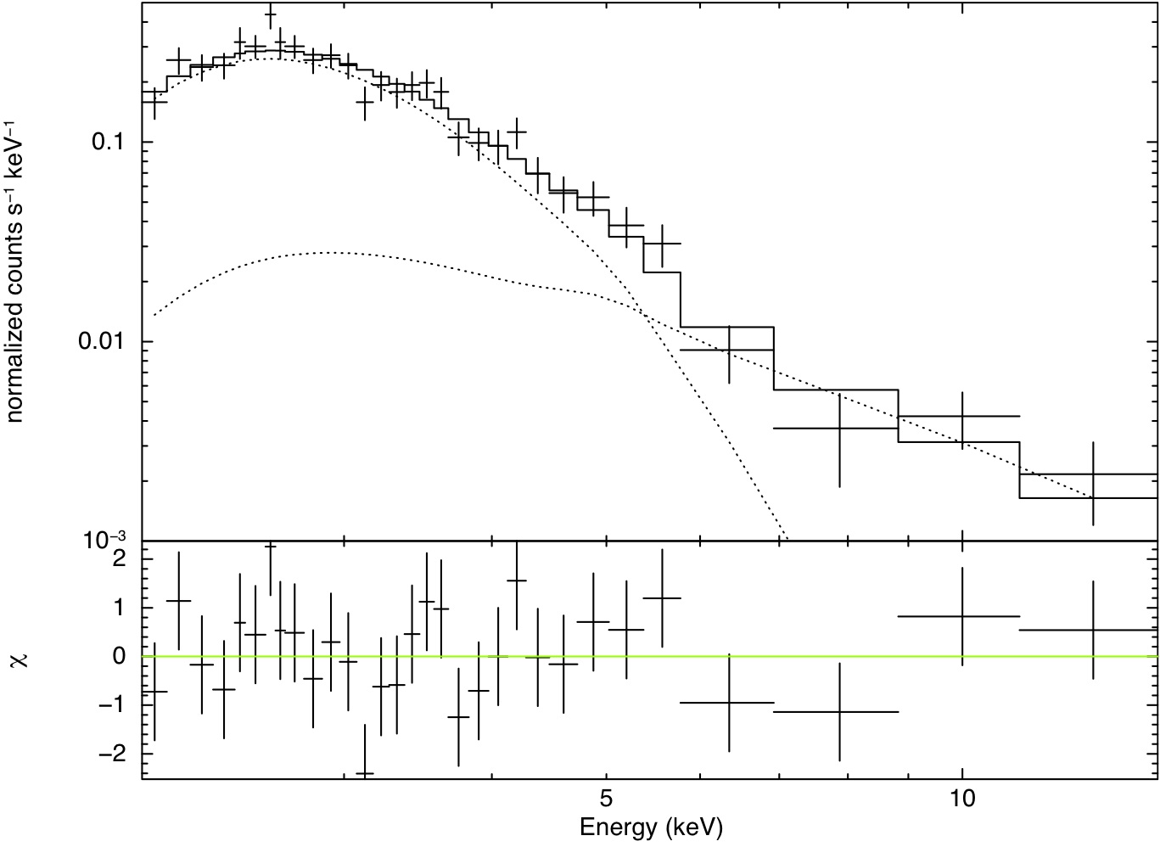
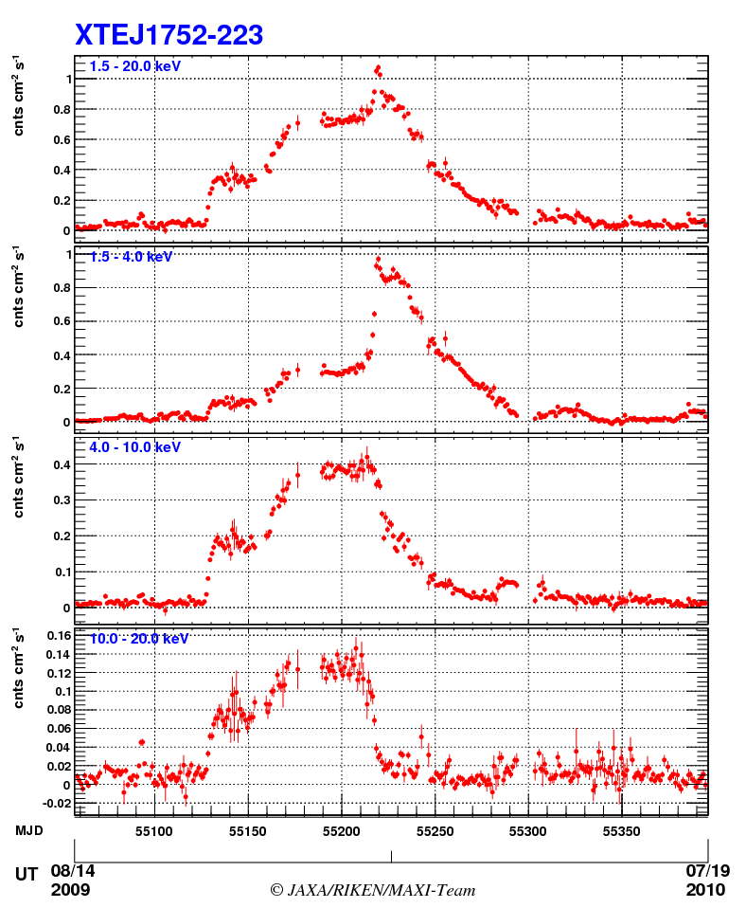
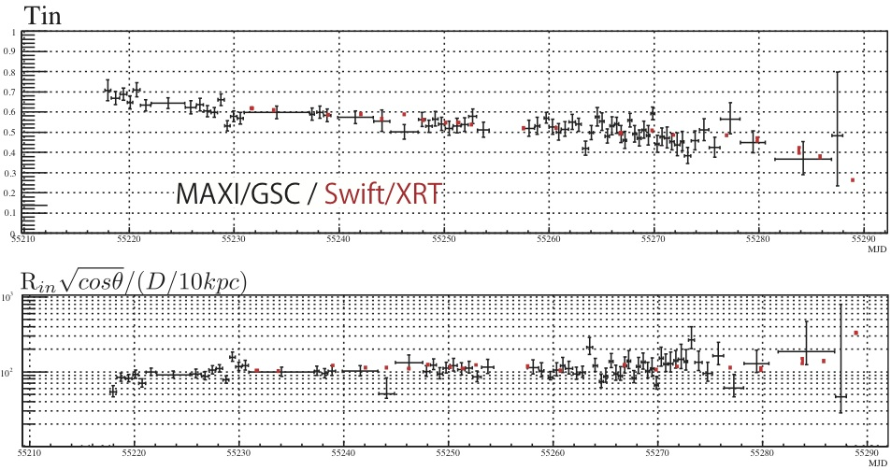
Continuous spectral monitoring of XTE J1752-223
Nakahira+ 2010, PASJ
Two stable hard states
soft state
decreasing disk temperature
Constant disk radius
P-01 Nakahira, Talks: Yamaoka, Shaposhnikov, Curran,

Slide 18
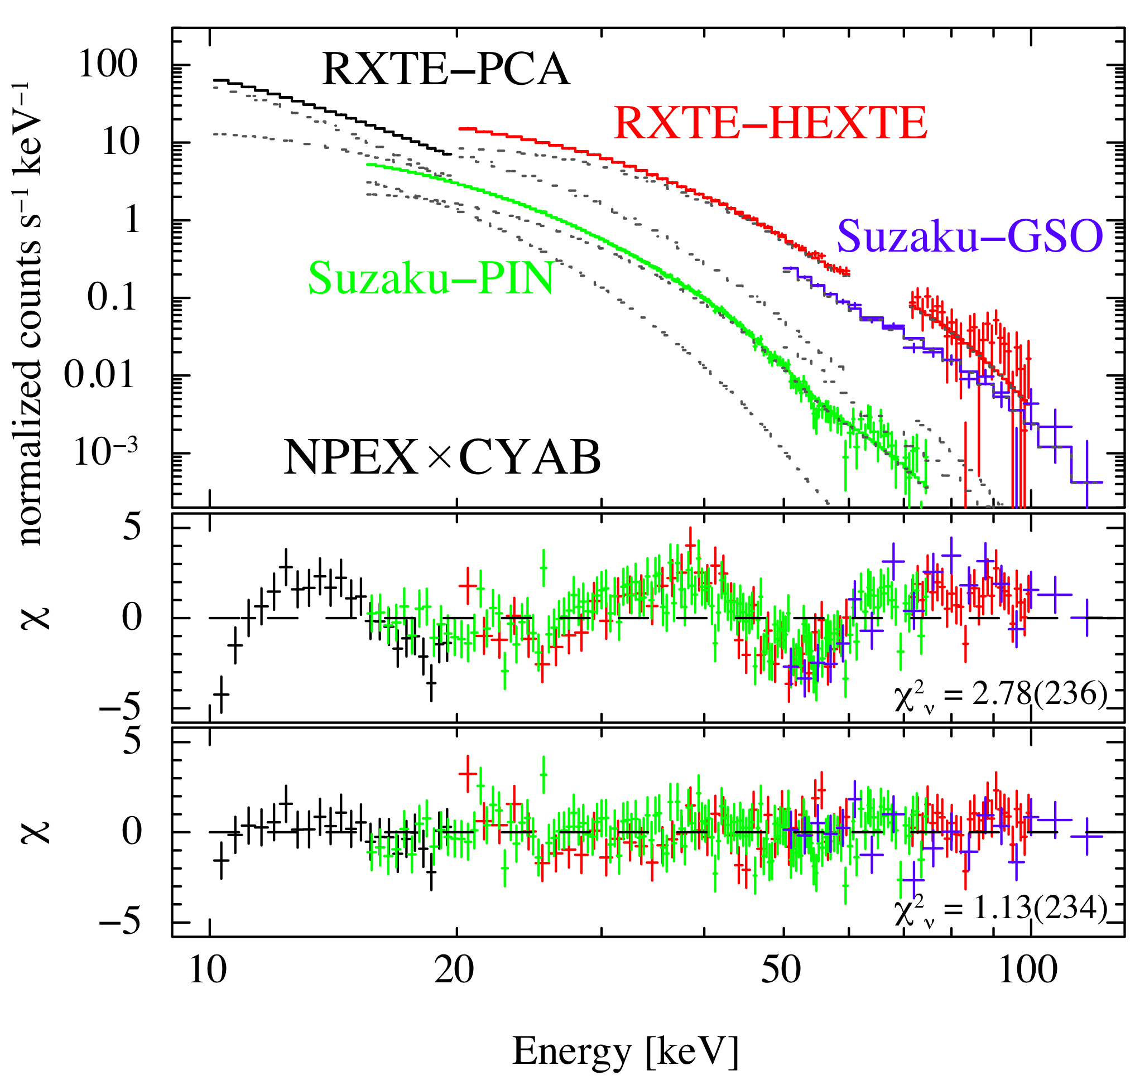
GX 304–1 Accreting X-ray pulsar with a Be star companion
MAXI detection of outbursts
Discovery of cyclotron line by Suzaku/RXTE follow-up observations
P-13 Yamamoto et al.
O-24 Mihara

Slide 19
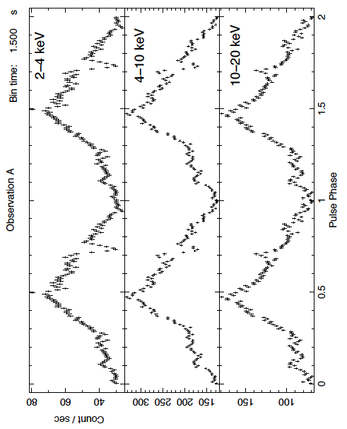
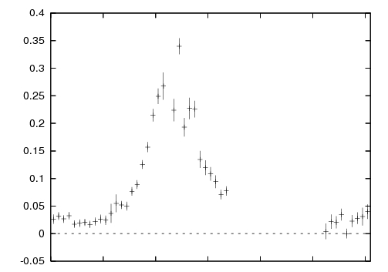
LS V +44 17 Accreting X-ray pulsar with a Be star companion
Dip
RXTE
4/6, 12, 15
3/31
MAXI ATel
Swift
4/1, 3, 21
count s⁻¹ cm⁻²
2010/3/15
4/4
4/24
5/15
MAXI detection of outbursts followed up by Swift and RXTE
Pulse profile (2 cycles) by RXTE follow-up observation reveals absorption dip by accretion column
P-18 Usui et al.

Slide 20
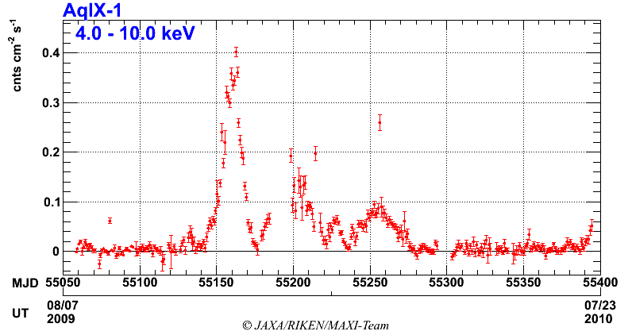
Low-Mass X-ray Binaries
Monitoring activities of bursts and jets.
Aql X-1
4U 1608-22
Cir X-1
4U 1323-619
4U 1954+319
RX J1709.5-2639
NGC 6640 X-2
(SAX J1748.9-2021)
Sco X-1
GX 17+2
…..
Beginning of new activity (ATEL#2742)
Aql X-1
Type-I bursts
4-10 keV
O-19 In ‘t Zand
O-20 Altamirano, O-21 Linares
~ 1yr

Slide 21
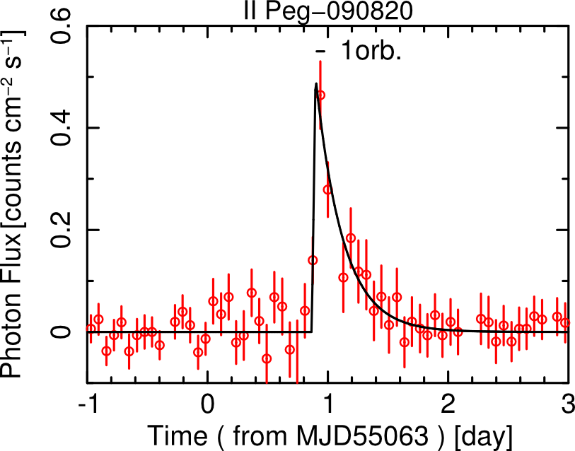
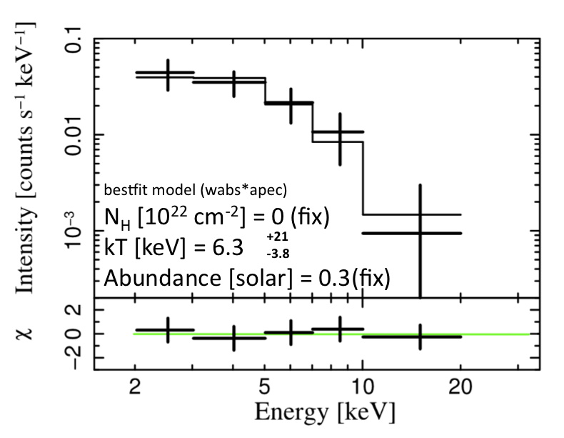
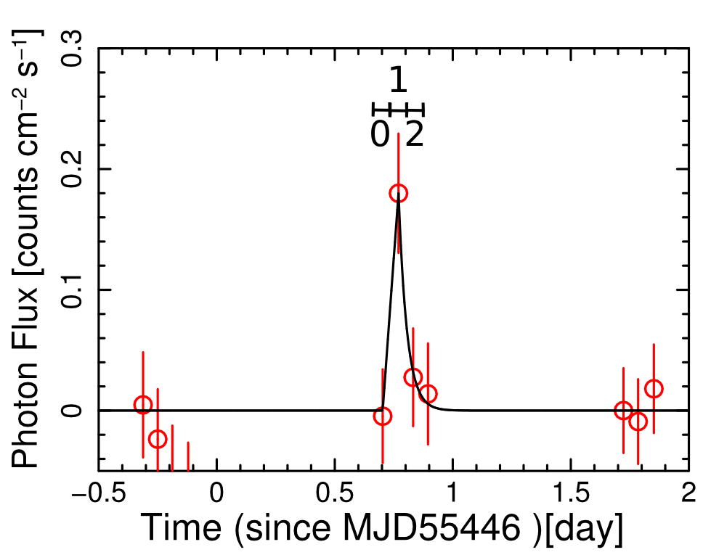
Active Stars (RS CVn, YSO, …)
RS CVn: 14 flares from 7 sources
II Peg
AR Lac
UX Ari
HR1099
SZ Psc
…
YSO (T Tauri)
TWA-7
Lx = 4.8 × 10³³ ergs/s
Historical brightest flares from these sources
Lx = 1.2 × 10³³ ergs/s
P-34: Uzawa et al
O-17: Tsuboi

Slide 22
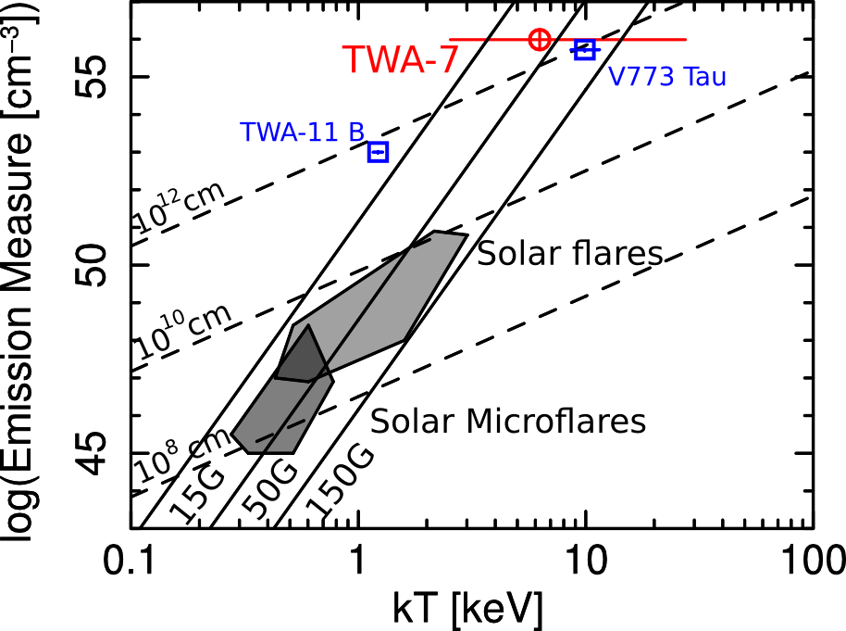
Active Stars (RS CVn, YSO, …)
Scalable from solar flares with constant magnetic field
P-34: Uzawa et al
O-17: Tsuboi

Slide 23
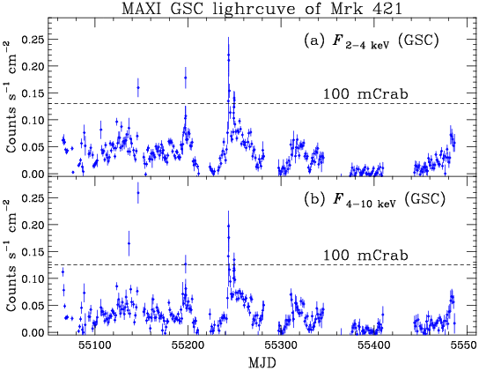
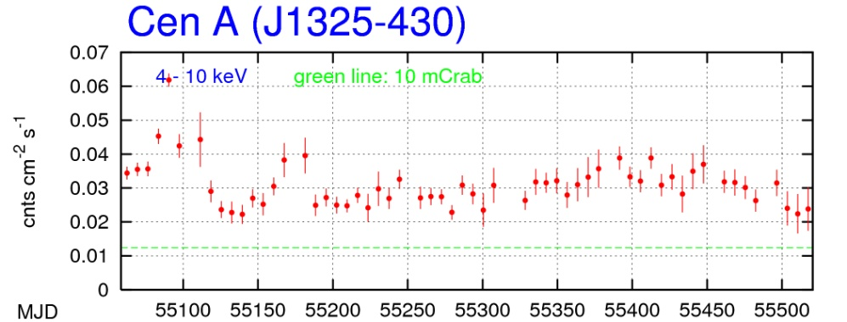
Active Galactic Nuclei
Mrk 421
3C 273,
Cen A,
NGC 4151
IC 4329A
…
Monitoring
Large flare events
Long term variation
P-37: Ueno et al., O-36: Isobe, O-37 Madejski, O-38 Wagner

Slide 24
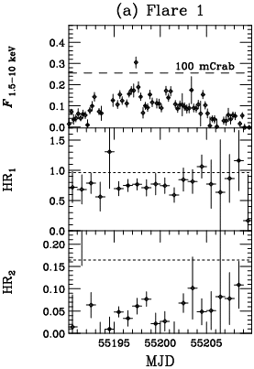
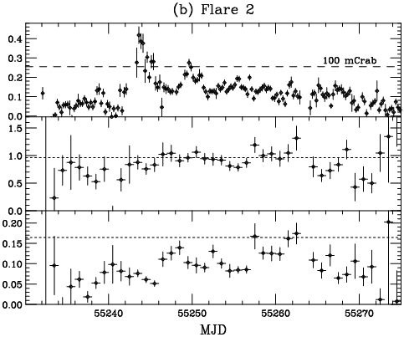
Two Flares from Mrk421
Jan. 1, 2010
~120 mCrab.
Feb. 16, 2010
~164 mCrab.
MAGIC flare
VERITAS ATel #2443
MAXI
2 – 4 keV
(6 hour)
F_{4-10 keV}
F_{2-4 keV}
F_{15-50 keV}
F_{2-4 keV}
O-36: Isobe, O-37 Madejski, O-38 Wagner
Isobe et al. 2010, PASJ

Slide 25
Gamma-ray bursts and X-ray flashes
16 events in 16 months
GRB 09026B
GRB 091230
GRB 091012
GRB 090831
GRB 091120
* Swift / Fermi
091201
* Fermi / IPN
* Fermi
* INTEGRAL
2009
2010
100327
100911
101030
XRF 100315A
XRF 100616A
GRB 100415A
XRF 100701A
XRF 101117A
GRB 100510A
GRB 100823A
* Swift
* 5 are simultaneously detected by other satellites
O-31: Serino

Slide 26
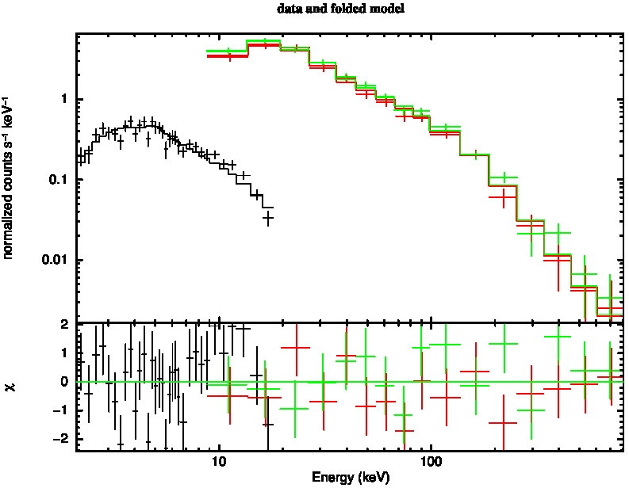
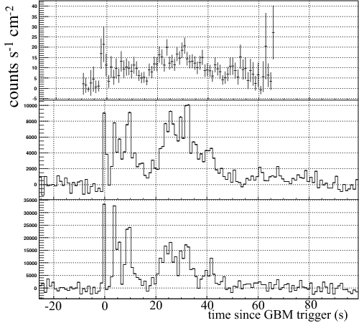
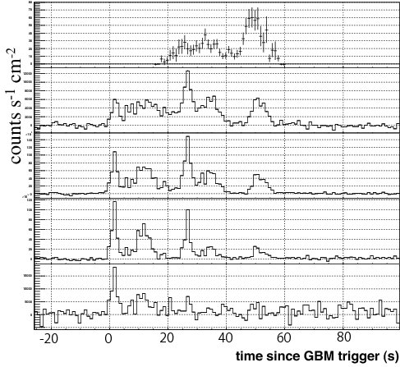
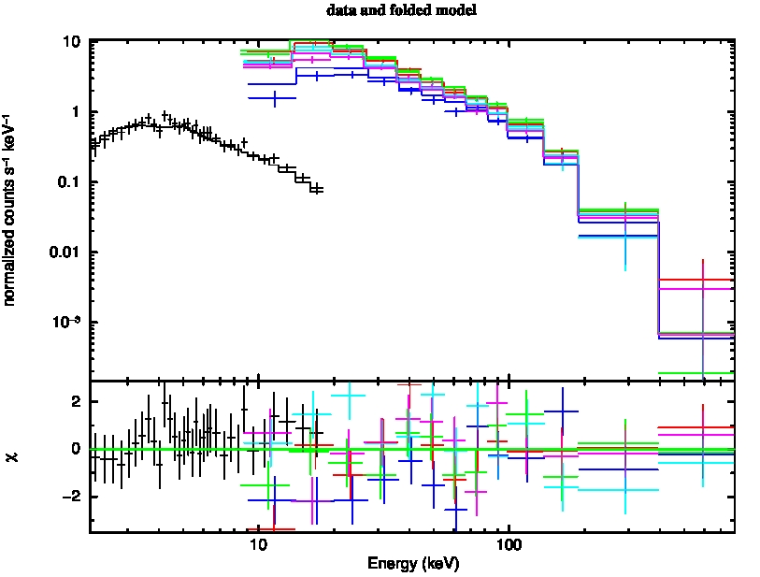
GRB: MAXI-Fermi/GBM Combined Analysis
GRB090831A
MAXI/GSC
1.5-20keV
Fermi/GBM
MAXI/GSC
Fermi/GBM
15-50keV
NH ~ 1.0E22 cm⁻²
50-500keV
Preliminary
GRB091120
MAXI/GSC
1.5-20keV
Fermi/GBM
Fermi/GBM
8-20keV
MAXI/GSC
20-100keV
NH ~ 0.7E22 cm⁻²
100-300keV
300-1000keV
O-31: Serino

Slide 27
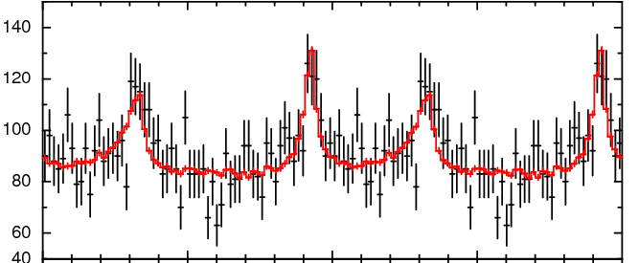
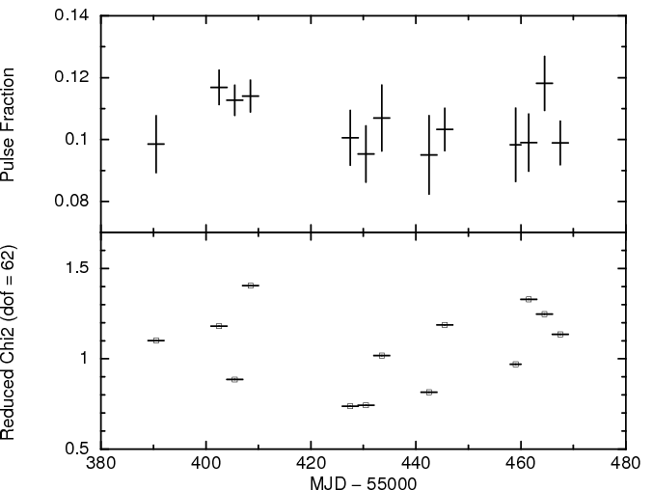
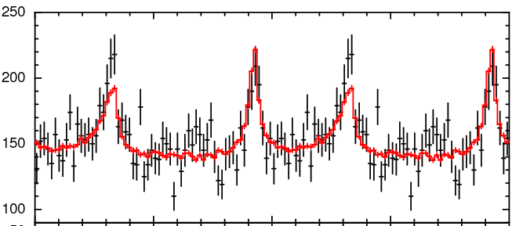
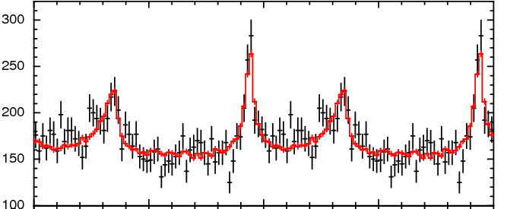
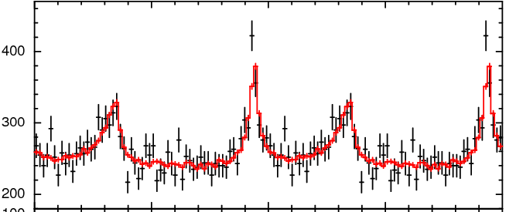
Crab Pulsar
Gamma-ray Flare
Pulse Fraction
Reduced Chi2 (dof=62)
No significant variation in the pulse fraction during the gamma-flare in September 2011
P-28: Morii et al.

Slide 28
Summary
MAXI is detecting variable X-ray sources of all classes.
MAXI provides continuous monitoring of light curves and spectra for outburst episodes.
Follow-up and multiwavelength observations are tremendously valuable
Need better understanding of instruments and data analysis

