Slide 1
Discovery and Evolution of a
New Galactic Black Hole Candidate
XTE J1752-223
N. Shaposhnikov^{1,2,3}, J. Swank³, C. Markwardt^{1,2,3}, H. Krimm^{2,3,4}
The Astrophysical Journal, 723, 2,1817
¹University of Maryland, Astronomy Department
²Center for Research and Exploration in Space Science & Technology (CRESST)
³NASA/Goddrd Space Flight Center
⁴Universities Space Research Association
4th MAXI Workshop 2010, Tokyo, November 29, 2010
Notes:
Good morning! Today I will report on the discovery and observations of a new galactic black hole candidate XTE J1752-223. The source was discovered during routine RXTE/PCA bulge scan and subsequently monitored by RXTE and Swift. I will review the spectral and variability evolution and will also present preliminary mass and distance estimates based on the RXTE data analysis.

Slide 2
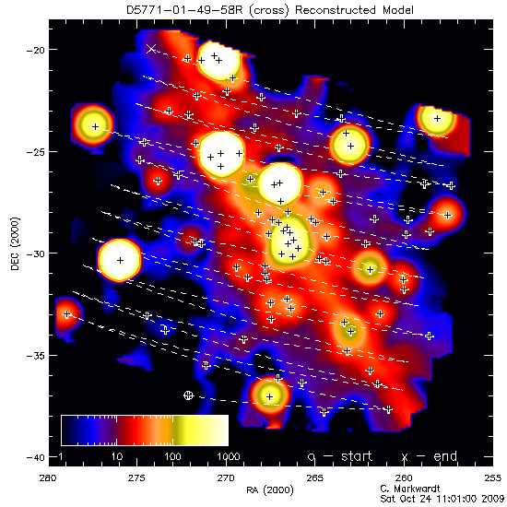
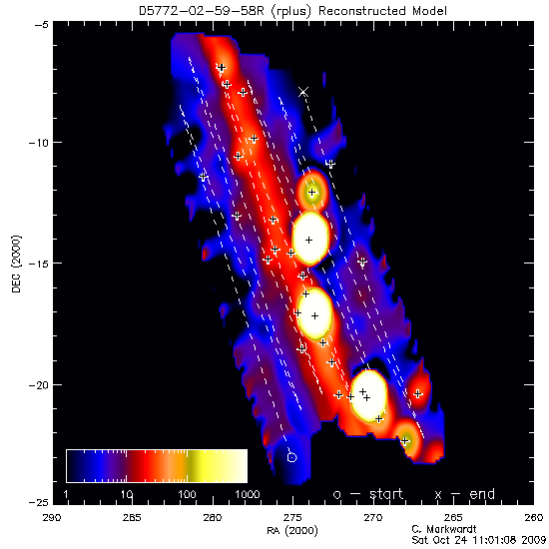
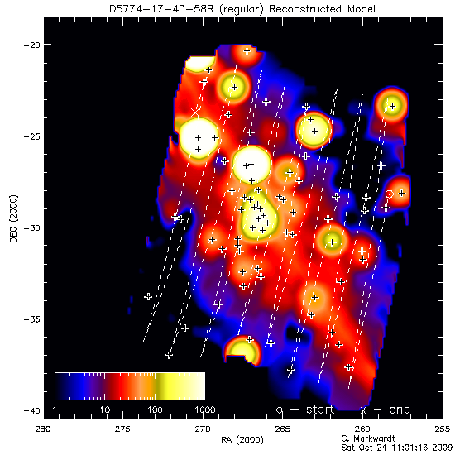
Discovery and Evolution of a New Galactic Black Hole Candidate XTE J1752-223
Discovery
October 20, 2009
XTE J1752-223
RXTE/PCA Galactic Bulge Scans showed an unidentified new source on October 21, 2009. Scans on October 23 fully confirmed a new source (Atel #2258)
Subsequent Swift/XRT observation showed bright point source with very hard non-thermal spectrum with index Γ = 1.2 and N_{H} =0.47×10²² cm⁻² (Atel #2261)
October, 21 2009
October, 23 2009
Shaposhnikov, Swank, Markwardt &Krimm
4th MAXI Workshop 2010, Tokyo, November 29, 2010
Notes:
This new source was identified by the RXTE/PCA bulge scanning program. Within this program the Galactic ridge is scanned by PCA every few days and a X-ray map of the region is reconstructed. A new bright source is clearly seen at the upper part of the scan map on October 23 , which was not present on the October 20. Close examination of the Galactic ridge scan on October 21 shows that the source in fact had already appeared on the sky. Therefore, it emerged from quiescence sometime in between these two scans.

Slide 3
XTE J1752-223 Evolution
Discovery and Evolution of a New Galactic Black Hole Candidate XTE J1752-223
Hardness – Intensity Diagram
Shaposhnikov, Swank, Markwardt &Krimm
Notes:
As soon as it was fully recognized that we have a new bright transient source, the monitoring program of the source was scheduled. After initial short rise the source entered a plato, during which it was in completely frozen state, exhibiting spectral and variability properties consistent with the extreme low-hard state such as shown by for example Cygnus X-1 and GX 339-4. In fact RXTE energy and power spectra observed during this plato are almost indistinguishable from each other. This kind of behavior is actually unheard of. Sun observational constrains did not allow RXTE to observe the source between December 21 2009 and January 18 2010. On January 19 of this year, RXTE was finally able to observe and the first observation showed spectrum consistent with the hard intermediate state and a quasi-periodic signal at 2 Hz suggesting that the source is in transition phase. The following observation one day later showed softer less variable source with stronger thermal component and QPO at 4 Hz. The source was going through a very fast transition. On the January 24 the source reached a peak in soft flux and a decay in the hard flux started to level off indicating the source entered the high soft state.

Slide 4
RXTE Data Spectral Analysis
Discovery and Evolution of a New Galactic Black Hole Candidate XTE J1752-223
Data modeling:
Energy spectral model
Comptonization (BMC)
Gaussian for the iron line at ~6.5 keV
Modified by interstellar absorption (measured by Swift/XRT)
High energy cutoff
Power Density Spectra
Power law or broken power law for the broad band variability
Loretzians for QPOs
QPO
Shaposhnikov et al. ApJ,2010
Shaposhnikov, Swank, Markwardt &Krimm
4th MAXI Workshop 2010, Tokyo, November 29, 2010
Notes:
We model the combined HEXTE/PCA energy spectrum for each RXTE observation. We used the generic Comptonization model, which assumes that a part of the input thermal spectrum is reprocessed in a Comptonizing plasma or corona. We also add the gaussian to account for the iron emission line at 6.4 keV. We modify the lower part of the spectrum by interstellar absorption with the NH column fixed at the value determined by Swift/XRT and the high energy part by high energy exponential cutoff. On this figure I show the evolution of the spectral model parameters. Again, we see surprisingly constant spectrum over the initial 30 day period.
The only recognizable change is a decrease in the energy of the input black body from 0.7 to 0.6 keV. The index of the power-law component is 1.4 in the low-hard state and increases to 2.2 in the high soft state.

Slide 5
XTE J1752-223 Variability Evolution
Discovery and Evolution of a New Galactic Black Hole Candidate XTE J1752-223
LHS
HIMS
SIMS
HSS
IS
LHS
Shaposhnikov, Swank, Markwardt &Krimm
4th MAXI Workshop 2010, Tokyo, November 29, 2010
Notes:
On this plots I show representative energy and power spectra for each state. In complete agreement with classical picture of the state evolution in BH candidates pattern the source shows spectral softening, decay of the variability power in the aperiodic components of Fourier Power Spectra, the appearance of quasi-periodic oscillations in intermediate state and their disappearance in the high-soft state. All this phenomenology strongly indicates that XTE J1752-223 is a new galactic black hole candidate. On the bottom diagrams I the correlation between spectral parameters and rms variability level. The bpttom left figure shows the spectrum normalization versus comptonized fraction f. it should not be surprising that this diagram looks exactly like the hardness-intensity diagram. Here bmc normalization serves as a proxi for the luminosity and comptonized fraction f corresponds to the spectral hardness. In the middle bottom figure I show the normalization versus rms percentage. Interestingly, the histerysis, when the luminosity observed during the hard-to-soft transition is much less that during the decay soft-to-hard state transition. The effect is much less for the rms-comptonized fraction correlation, which indicates that the variability more closely related to the power law spectral component than to the disk thermal component.

Slide 6
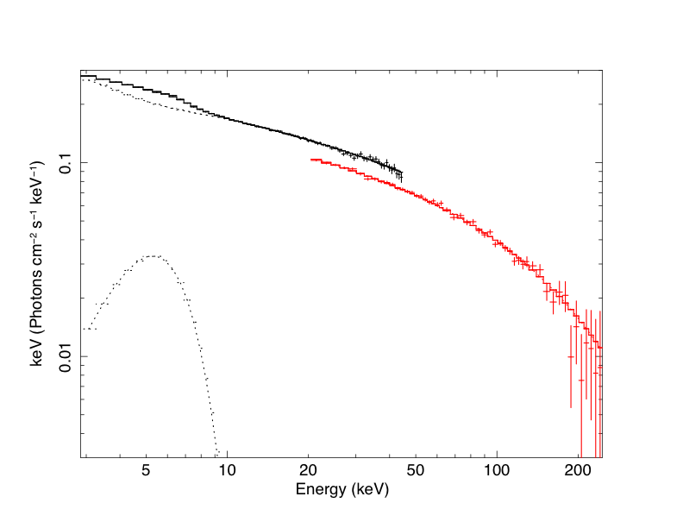
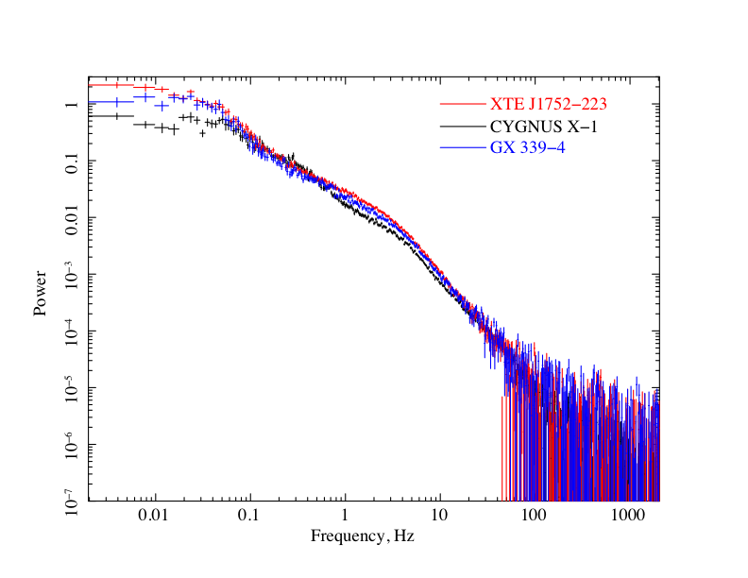
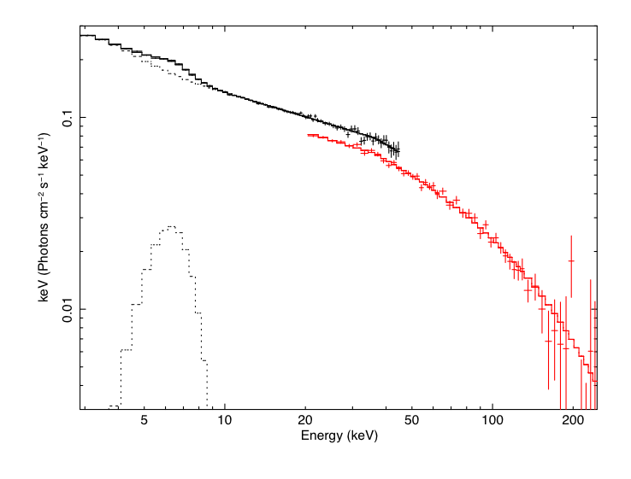
Low Hard State in XTE J1752-223
Discovery and Evolution of a New Galactic Black Hole Candidate XTE J1752-223
XTE J1752-223
Power Spectra
GX 339-4
Shaposhnikov, Swank, Markwardt &Krimm
4th MAXI Workshop 2010, Tokyo, November 29, 2010
Notes:
Lte us consider in more detail the properties of the source during the initial long extreme hard state.
On this plot I compare power density spectra for XTE J1752-223, GX 339-4. I also chose one the hardest state from Cygnus X-1 and presented it on this plot. They are strikingly alike! We can also look at the energy spectra. They also look like twin brothers. This fact illustrates that accreting black holes are, in fact, governed by the same spectral formation mechanisms both in energy, as well as in timing domain. Any consistent physical picture of accretion process onto black hole has to address this highly reproducible properties, as well as state evolution pattern. To get more insight into the phenomenology of the low hard state shown by the source, we utilize the instrumentation of the Frequency resolved analysis.

Slide 7
Fourier Resolved Spectroscopy (FRS)
Discovery and Evolution of a New Galactic Black Hole Candidate XTE J1752-223
Low Hard State
GX 339-4
XTE J1752-223
Shaposhnikov, Swank, Markwardt &Krimm
4th MAXI Workshop 2010, Tokyo, November 29, 2010
Notes:
Most observers are interested in energy spectrum or Fourier power spectrum. However, RXTE data, due to its combined spectral and timing capabilities allow more sophisticated and informative analysis. For example, about ten years ago a group lead by Revnivtsev proposed method of spectral analysis of variability components called Fourier Resolved Spectroscopy. In the core of the method is the idea to normalize the amplitude of the signal in a detector channel by the fractional root-mean-square variability in this channel. When we select a particular frequency range to calculate the rms, we obtain an analog of the energy spectrum of a particular Fourier spectrum component. While a full scale spectral analysis is possible, in this talk I only consider the ratios of the FRS spectra to the total spectrum. It shows the contributions of the variabie component in total spectrum and still allows some very interesting qualitative conclusions to be made. In this slide I present the Fourier resolved spectra for extreme low hard state of XTE J1752 and compare it with similar state of GX 339-4. As you can see the RMS spectra for XTE J1752 is strikingly uniform with respect to energy. The same analysis of GX 339-4 show that rms level significantly decreases with energy. I.e. the higher energy photons are less modulated. In fact, analysis of other BH sources in low hard state shows that the low hard state in XTE J1752 is quite unique in showing such a uniform variability. All other sources show rms dropping with energy. I will discuss the implications of this observational effect later.

Slide 8
Fourier Resolved Spectroscopy (continued)
Discovery and Evolution of a New Galactic Black Hole Candidate XTE J1752-223
State Transition
HIMS
SIMS
Lowest QPOs during the beginning of the transition are softer than the time averaged spectrum. As the transition evolves they quickly become harder (Sobolewska & Zycki 2006). QPO spectrum is always harder that the broad band noise.
Shaposhnikov, Swank, Markwardt &Krimm
4th MAXI Workshop 2010, Tokyo, November 29, 2010
Notes:
Here I present the Fourier resolved spectra for the XTE J1752 during the hard to soft state transition which we were lucky to observe right after the source emerged from behind the Sun. This the the data for four consequitive observations taken approximately one per day during the transition. On the upper panels I show familiar Power Density Spectrum.
On the lower panels I show the corresponding rms ratios for three frequency ranges corresponding to QPO feature in red, low frequency noise in blue and total rms from 0.001 to 64 Hz. The first notable thing is that the first observation in hard intermediate state shows rms ratios decreasing with energy for all three frequency ranges. Then, as the sources
Progresses through the transition, the corresponding fourier resolved spectra become harder and harder with respect to the total spectrum. This was already shown by Sobolewska & Zycki. 2006. What is new, however, is the fact that the QPO spectrum is consistently harder than the spectrum of the broad band noise.

Slide 9
Fourier Resolved Spectroscopy (HIMS)
Discovery and Evolution of a New Galactic Black Hole Candidate XTE J1752-223
FRS normalized by total spectrum
FRS normalized by the non-thermal spectral component
Disk black body spectral component is stable!
RMS ratio normalized on the power law component alone is decreasing from the level of 50% (LHS!).
(Shaposhnikov et al. 2010)
Shaposhnikov, Swank, Markwardt &Krimm
4th MAXI Workshop 2010, Tokyo, November 29, 2010
Notes:
On this slide I show the analysis from our recent paper that may shed some light on the nature of the behavior of the rms spectra for different variability components that I mentioned on the previous slide. Namely, on the left plot I show the total rms spectrum in the 2-15 keV energy range, which is normalized by the total time averaged spectrum, while on the right figure I show the same data nut normalized by the non-thermal power law part of the spectrum. As we already saw on the previous slide the rms ratio to the total spectrum is becoming harder during the transition. However, if we remove the thermal black body disk part from the normalizing spectrum we see that the shapes shown by the rms spectra are much more consistent. Based on this evidence we can make several important conclusions. First is, that the variability is introduced within power law component and the thermal disk component Is not variable, at least on the timescales below 0.01 Hz. Second, but not less important conclusion is that the variability within the non-thermal part of the spectrum is decreasing with energy from the level of about 50% consistent with the low-hard state variability. Therefore, this is may be a standard level of variabilyt associated with thermal Comptinization in turbulent plasma in thermal corona.

Slide 10
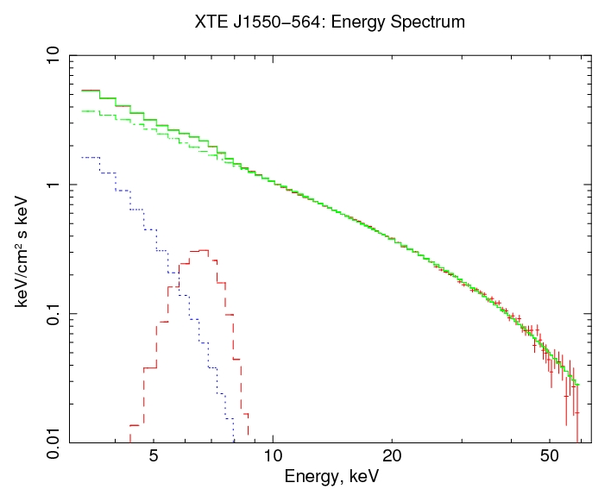
What can we learn from spectral data? Nature of the power law
Discovery and Evolution of a New Galactic Black Hole Candidate XTE J1752-223
-α
Thermal Comptonization:
E
,
(Rubicki & Lightman, 79)
Bulk Motion Comptonization:
(S & Titarchuk, 2009)
(Laurent & Titarchuk 2010)
Shaposhnikov, Swank, Markwardt &Krimm
4th MAXI Workshop 2010, Tokyo, November 29, 2010
Notes:
Now we will try to understand the nature of the observed correlation from basic physical principles. First, the power law component is a result energy exchange between electrons and photons through multiple Inverse Compton scattering. Statistically this process can be described by two parameters: mean energy gain during one scattering eta and a average number of scatterings N. It can be easily shown that the resulted spectral index alpha of the power law component is expressed as an inverse of their product. If the energy of the electrons is thermal in nature than the number of scatterings and eta has the form well known from any textbook on high energy radiative processes, for example rubicki and lightman.
Specifically, in this case index is a strong function of both opacity and temperature. Observations of stellar BHs show that in HSS spectrum is dominated by a quasi-thermal component presumably from the inner accretion disk with a stable temperature about 0.5-1.0 keV. Opacity, however,being roughly proportional to the mass accretion rate, can change dramatically. Therefore, in the situation of the dynamically changing source spectral state Comptonization on thermal electrons is not able to produce the saturation effect.

Slide 11
Thermal versus Bulk motion Comptonization
Discovery and Evolution of a New Galactic Black Hole Candidate XTE J1752-223
XTE J1550-564 (1998 ouburst)
Index vs Luminosity
BMC
Thermal
High Energy Cutoff Evolution
XTE J1550-564
BMC
Thermal
(S & Titarchuk 2010)
Shaposhnikov, Swank, Markwardt &Krimm
4th MAXI Workshop 2010, Tokyo, November 29, 2010

Slide 12
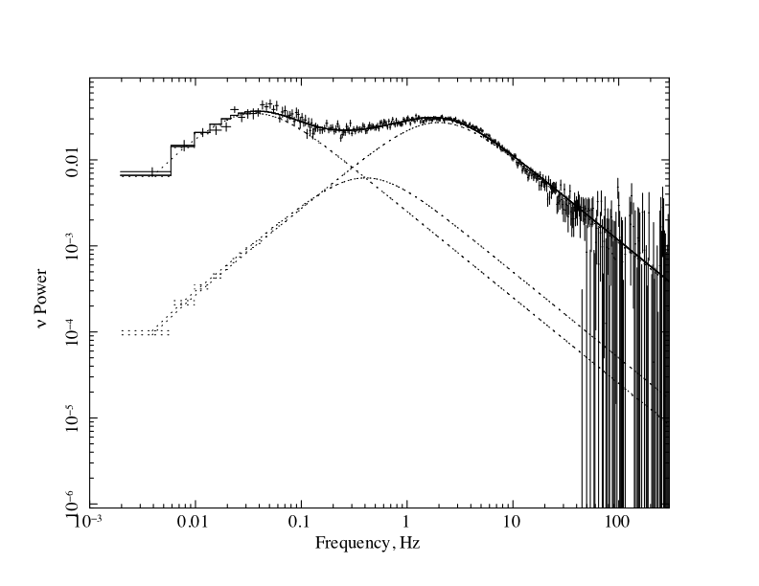
On the Nature of the Extreme LHS
Discovery and Evolution of a New Galactic Black Hole Candidate XTE J1752-223
Power Spectrum
Energy Spectrum
RMS Spectrum
PDS response to an exponential shot:
Source of modulation is located outside the X-ray forming region and the response to the modulation is the same for all energies
Generic Comptonization (BMC XSPEC model)
t* - perturbation diffusion time
Perturbation propagation in a bounded medium:
f_{c} – Comptonized fraction
(Lyubarskii,1997)
C(v’,v) – Green’s function
(Titarchuk, S & Arefiev, 2007)
B(v) – black body
Shaposhnikov, Swank, Markwardt &Krimm
4th MAXI Workshop 2010, Tokyo, November 29, 2010
Notes:
It not a main goal of this presentation to give such a physical picture. Here I just touch on the general idea one can start from in attempt to disentangle a puzzle of the black hole accretion states, and specifically the extreme low hard state. On the right I show power density spectrum and the unfolded energy spectrum on the left. While in the extreme low hard state more than 80 per cent of the radiation is Comptonized, the power density spectrum shows almost 50 percent of rms variability. Therefore, the spectral and timing properties are formed in the same physical environment. PDS is also a sum of lorentzans. Lorentzian is a Fourier PDS of an exponential, which is in turn is a response of a bounded configuration to a perturbation. It is not only natural, but unavoidable to associate this bounded configuration where these perturbations propagate with the Compton cloud. We can conclude then, that while the energy spectrum is a result of the photon reprocessing in the Componizing corona, the observed power spectrum is a result of the perturbation propagation in the same physical configuration. Low frequency lorentzian is most probably related to perturbation propagated from the outer boundary of the corona. Interpretation of the broader lorentzain is less clear. Disscussion of this matter is out of scope of this talk, but hopefully I can address this in the forthcoming paper.

Slide 13
On the behavior of RMS spectrum
Discovery and Evolution of a New Galactic Black Hole Candidate XTE J1752-223
LHS
HIMS
Thermal Comtonization is variable, BM Comptonization is not!
Shaposhnikov, Swank, Markwardt &Krimm
4th MAXI Workshop 2010, Tokyo, November 29, 2010

Slide 14
Correlation scaling: BH mass estimate
Discovery and Evolution of a New Galactic Black Hole Candidate XTE J1752-223
Scaling Laws
GX 339-4 vs XTE J1752-223
GRO J1655-40 vs XTE J1752-223
s_{v} = 0.88 s_{n}=0.41
GX 339-4:
M=12.5 M ,d=5.7 kpc
(S & Titarchuk 2009)
M₁₇₅₂≅11M d≅3.5 kpc
s_{v} = 1.5 s_{n}=0.96
GRO J1655-40:
M=12.5 M, d=5.7 kpc
(Hjellming & Rupen 1995)
M₁₇₅₂≅9.5M d≅3.8 kpc
S & Titarchuk 2009, ApJ
Shaposhnikov, Swank, Markwardt &Krimm
4th MAXI Workshop 2010, Tokyo, November 29, 2010
Notes:
Finally, we can estimate BH mass using the data from spectral transition which we obtained right after the source have emerged from the Sun. For the details on the correlation scaling mass-distance measurement method I direct you to the our resent paper Shaposhnikov&Titarchuk 2009, where we applied this method to spectral transition data from nine galactic BH sources. The core of the method is the simple idea that for a particular accretion regime or spectral state, the QPO frequencies are set the BH mass. Scling in the normalization domain also allows rather reliable estimates of the source distance. The index is used as a source state indicator. We scale the index-QPO frequency and index- normalization correlation from XTE J1752-223 versus data from GX 339-4 and GRO J1655-40. In both cases we obtain the source mass of about 10 solar masses and the distance of 3.5 to 4 kpc.

Slide 15
MAXI J1659-152
Discovery and Evolution of a New Galactic Black Hole Candidate XTE J1752-223
Evolution
Hardness-Intensity Diagram
Index – QPO Frequency during
the rise episode
s_{v} = 1.62 +/- 0.04
GX 339-4:
M=12.5 M ,d=5.7 kpc
(S & Titarchuk 2009)
M₁₆₅₉≅20+/-3 M
Shaposhnikov, Swank, Markwardt &Krimm
4th MAXI Workshop 2010, Tokyo, November 29, 2010
Notes:
Finally, we can estimate BH mass using the data from spectral transition which we obtained right after the source have emerged from the Sun. For the details on the correlation scaling mass-distance measurement method I direct you to the our resent paper Shaposhnikov&Titarchuk 2009, where we applied this method to spectral transition data from nine galactic BH sources. The core of the method is the simple idea that for a particular accretion regime or spectral state, the QPO frequencies are set the BH mass. Scling in the normalization domain also allows rather reliable estimates of the source distance. The index is used as a source state indicator. We scale the index-QPO frequency and index- normalization correlation from XTE J1752-223 versus data from GX 339-4 and GRO J1655-40. In both cases we obtain the source mass of about 10 solar masses and the distance of 3.5 to 4 kpc.

Slide 16
SUMMARY
Discovery and Evolution of a New Galactic Black Hole Candidate XTE J1752-223
On October 21 RXTE discovered a new X-ray transient source XTE J1752-223
Spectral and variability properties and the evolutionary pattern are consistent with other Galactic BH candidates
XTE J1752-223 exhibited a uniquely stable prolonged low-hard state
RXTE data allows spectral, timing analysis and Fourier resolved spectroscopy revealing a new phenomenology. This helps to identify sources of different types of variability (noise, QPOs). QPO seems to be produced in the Compton Corona.
Bulk Motion Comptonization in the converging flow provides a very promising framework for explaining different observational aspects of accreting BHs
We estimated BH masses in XTE J1752-223 and MAXI J1659-152 of about 10 and 20 solar masses correspondingly
The presented results are entirely due to unique RXTE capabilities, large collection area, high time and moderate spectral resolution and unmatched monitoring capabilities.
Shaposhnikov, Swank, Markwardt &Krimm
4th MAXI Workshop 2010, Tokyo, November 29, 2010

