Slide 1
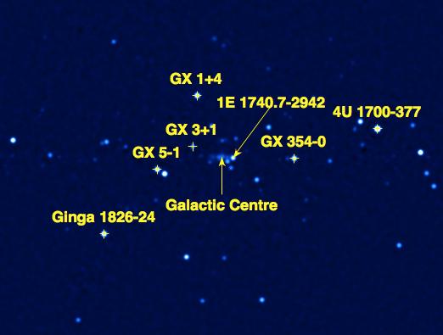
The INTEGRAL Galactic bulge monitoring program:
An unshrouded view of
our lively Galactic bulge
& MAXI J1659-152
An update...
Erik Kuulkers
ESA/ESAC
Spain
Maxi (マキシ, Makishi, also written as 真喜志)
was a wandering pirate from Shuri in the Ryūkyū Kingdom
(present-day Okinawa)…
Julia Alfonso-Garzón, Volker Beckmann, Tony Bird, Søren Brandt, Jérôme Chenevez, Thierry Courvoisier, Melania Del Santo, Albert Domingo, Ken Ebisawa, Carlo Ferrigno, Peter Jonker, Peter Kretschmar, Craig Markwardt,Tim Oosterbroek, Katja Pottschmidt, Ada Paizis, Celia Sánchez-Fernández & Rudy Wijnands
Photo: Brad Templeton

Slide 2
INTEGRAL (International Gamma-Ray Laboratory)
IBIS – The gamma-ray Imager:
15 keV-10 MeV
(ISGRI/PICsIT)
12’ FWHM imaging
<30” source location
IBIS, SPI, Jem-X: coded mask
Jem-X - The Joint Euro-pean X-ray Monitor:
3-35 keV; 3’
SPI – The gamma-ray Spectrometer:
20 keV – 8 MeV
E/DE ~ 500
1.3° source location
OMC – Optical Monitor Camera:
500-600 nm

Slide 3
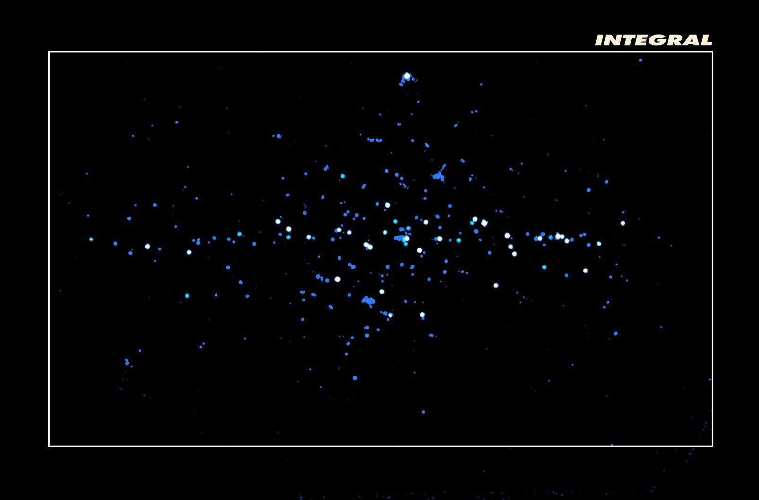
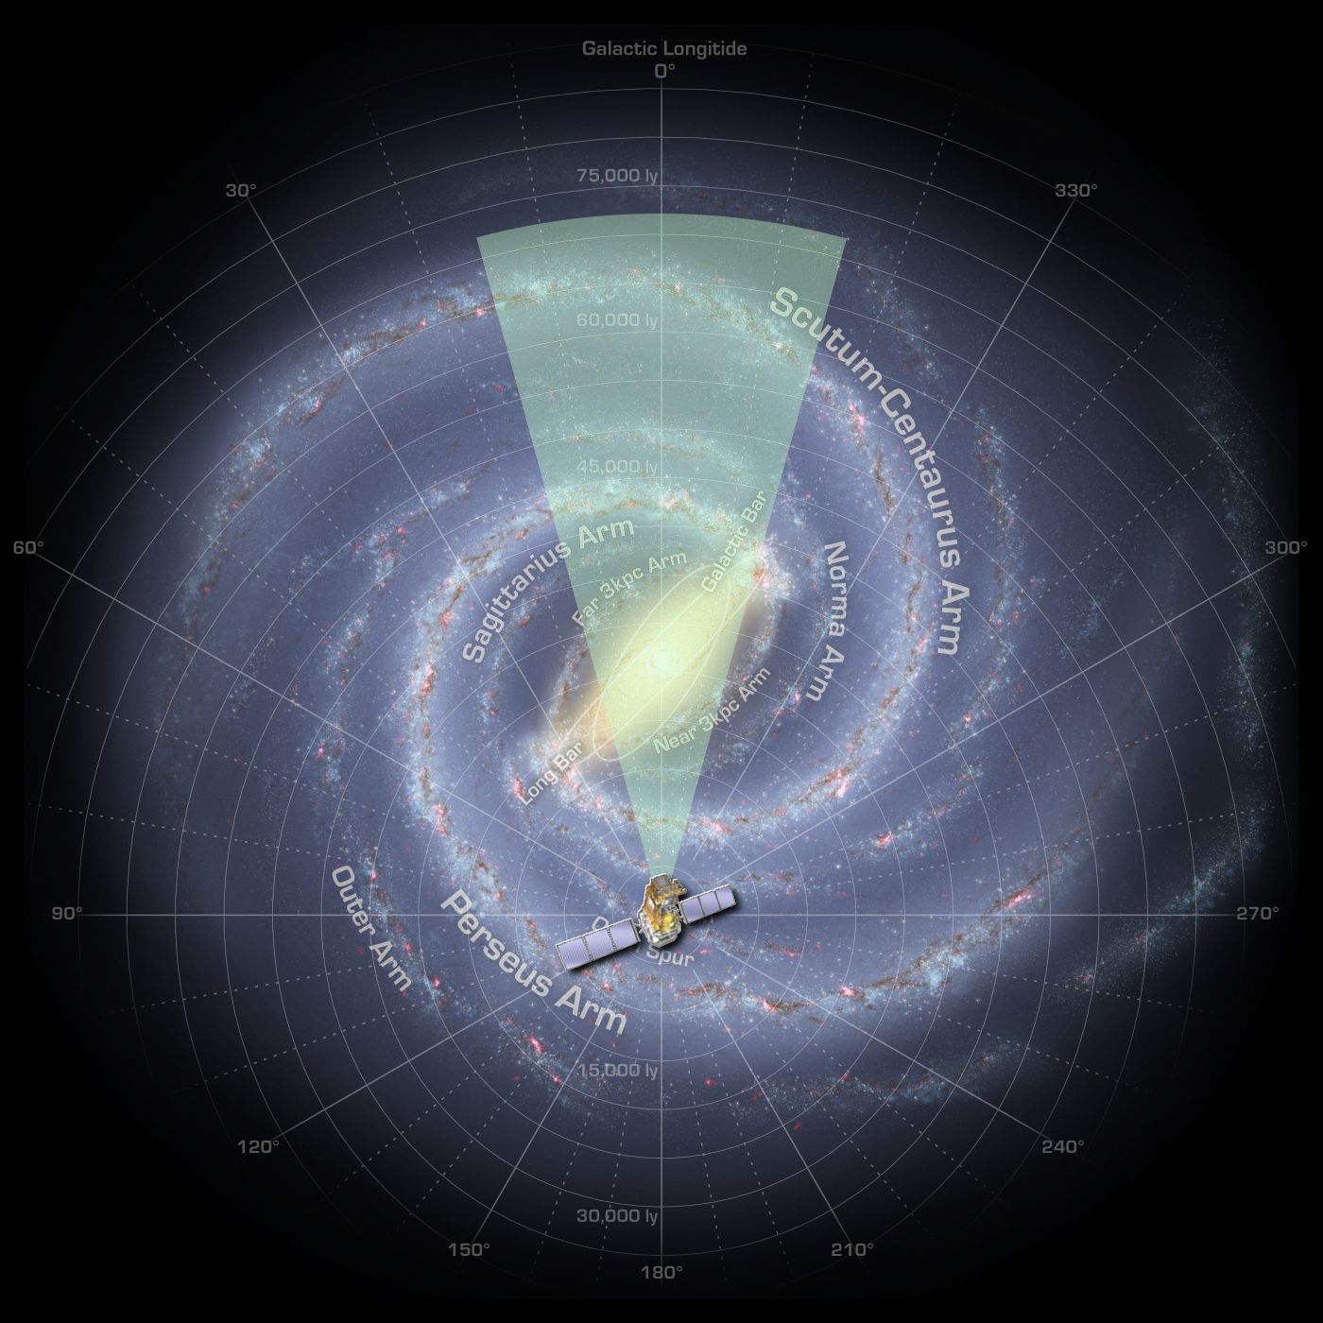
Hard X-ray sky
IBIS/ISGRI
Sensitivity ~1 mCrab
(20-60 keV)
Hard X-ray sky:
point sources
Galactic latitude
Cover 1/2
L/HMXB
population
20°
Galactic longitude
Lebrun et al. 2004

Slide 4
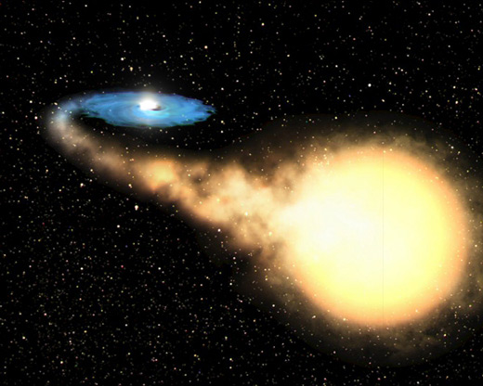
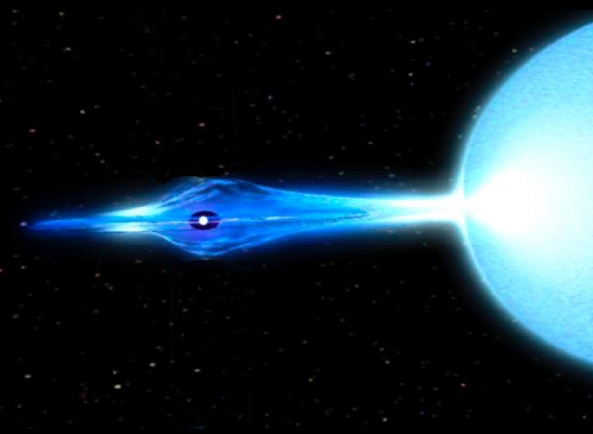
The high-energy source ZOO
Low-mass X-ray binaries:
- persistent with ns (e.g., GX 5-1, GX 3+1)
- X-ray bursters (e.g., GS 1826-24, GX 354-0)
- X-ray pulsars (GX 1+4, 2S 1822-371)
- transient with ns (e.g., MXB 1730-335)
- persistent with bh (e.g., 1E 1740.7-2942)
- transient with bh (e.g., GRO J1655-40)
High-mass X-ray binaries:
- X-ray pulsars (e.g., OAO 1657-415)
- highly absorbed IGRs (e.g., IGR J17252-3616)
- e.g., 4U 1700-377
SGRs (e.g., SGR 1806-20)
Cataclysmic variables (e.g., V2400 Oph)
AGN (e.g., PKS 1830-211)
About 1/2 the
population of
L/HMXBs in the Galactic bulge!

Slide 5
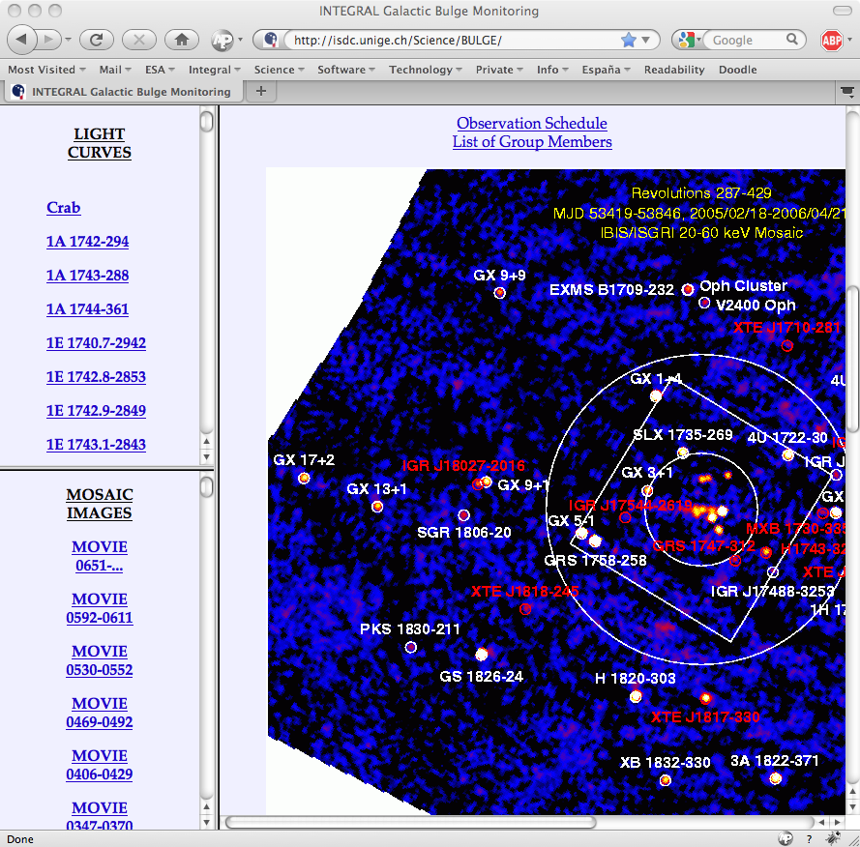
Monitoring Program
Since February 2005:
Every INTEGRAL orbit (~3 days): 7 × 1800 sec in hexagonal dither pattern
Results publicly available within a day:
http://isdc.unige.ch/Science/BULGE/
2 visibility windows per year (2 months each)
Simultaneous monitoring in soft and hard X-rays
All sources in one go (typically 15-20 seen each time)
Similar sensitivity throughout mission
Source variability & transient activity on time scales of hrs-days-weeks-months-yrs
Learn about accretion rate/state changes in BH(C) vs NS
Any news ➠ ATel

Slide 6
Monitoring Program - 2
Results are made publicly available:
- Jem-X: 3-10 & 10-25 keV light curves + images
- IBIS/ISGRI: 18-40 keV & 40-100 keV
light curves + images
- Permanent monitoring of ~90 known sources
IBIS/ISGRI & Jem-X sensitivities:
~5-20 mCrab (few 10³⁶ erg/s @ 8kpc) per hexagonal dither; depends on:
- source position (in fully or partially coded FOV)
- background (systematics, solar activity)
- nr of exposures (some are lost)
- energy (instrument response)
Results on 1st 3 seasons: Kuulkers et al. 2007, A&A
Currently: 12 seasons; >2 Msec of GB monitoring available

Slide 7
Other monitoring campaigns
Similar dedicated campaings:
GRANAT/SIGMA (35-100 keV) - 1990-1998 - e.g. Churazov et al. 1994
BeppoSAX/WFC (3-35 keV) - 1996-2002 - e.g. in ‘t Zand 2001
RXTE/PCA (2-10 keV) - 1996-? - e.g. Swank & Markwardt
SuperAGILE (18-60 keV) - 2007-? - e.g. Feroci et al. 2008
Similar long-term (hard) X-ray light curves:
MIT/OSO-7 (15-40 keV) - 1971-1973 - e.g. Markert et al. 1979
CGRO/BATSE (20-100 keV) - 1991-2000 - e.g. Harmon et al. 2004
Swift/BAT (15-50 keV) - 2005-? - e.g. Krimm et al.2006

Slide 8
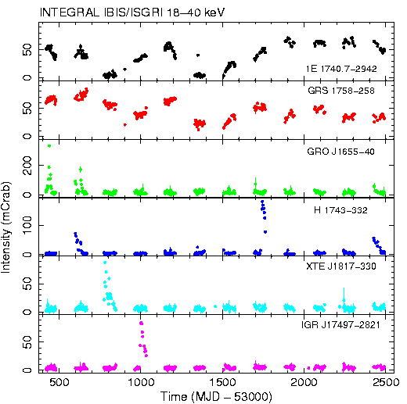
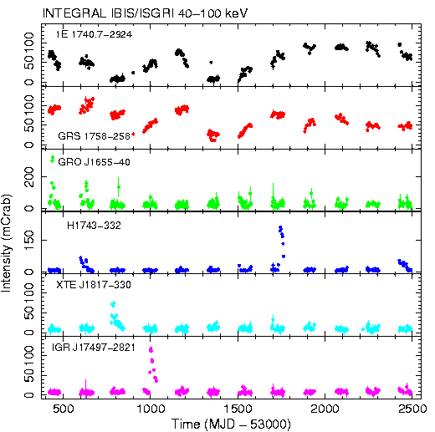
Long-term light curves - BHC
18-40 keV
12 seasons
40-100 keV
On average per revolution: down to S/N = 5 (7)
~20 (15) sources at 18-40 keV & ~6 (5) sources at 40-100 keV

Slide 9
Galactic Centre – The Movie
Source variability in the GC region
Averages over ~3.5 hr every ~3 days from Feb 2005 to October 2010

Slide 10
MAXI J1659-152 & IGBMP*
10 September
26 September
6 October
* IGBMP = INTEGRAL Galactic bulge monitoring program

Slide 11
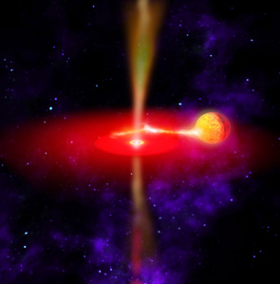
MAXI J1659-152: a black hole transient living to the max?
Erik Kuulkers
ESA/ESAC
Spain
Angela Bazano, Tomaso Belloni, Marion Cadolle Bel, Jérôme Chenevez, Maria Diaz Trigo, Aitor Ibarra, Elisabeth Jourdain, Chryssa Kouveliotou, Teo Muñoz Dariaz, Jan-Uwe Ness, Arvind Parmar, Andy Pollock, Jerome Rodriguez, Celia Sánchez-Fernández, Pietro Ubertini, Alexander van der Horst & Chris Winkler + et al.

Slide 12
Overview
☞ MAXI J1659-152 in a nutshell
☞ XMM-Newton & INTEGRAL TOO + et al.
☞ System parameters
☞ Conclusions & Outlook

Slide 13
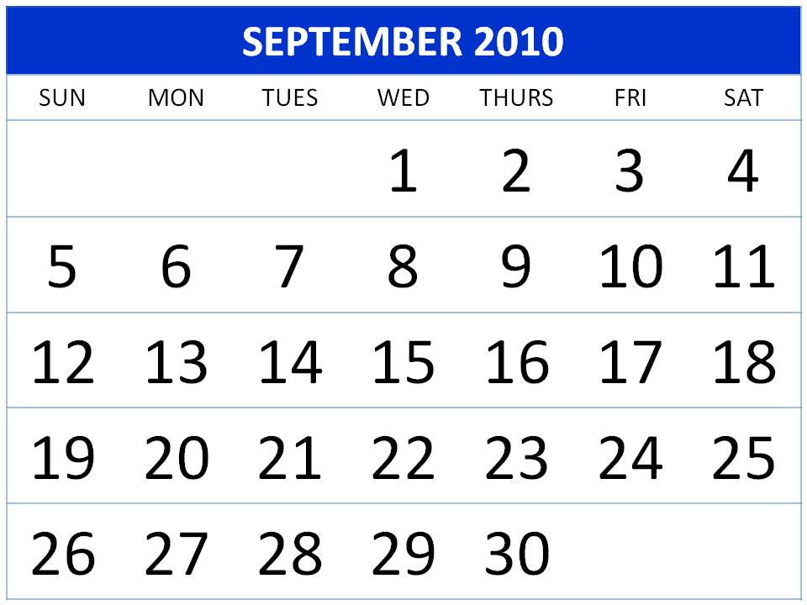
MAXI J1659-152 in a nutshell
25 Sep 13:55 Continuing strong X-rays + near Galactic bulge (l,b = 5.5, +16.6) -> local peculiar XRF or new Galactic source? [GCN Circ #11299]
25 Sep 08:45
GRB 100925A:
Swift detection
[GCN Circ #11296]
25 Sep 16:12
MAXI/GSC detection of new hard X-ray transient: MAXI J1659-152, consistent with GRB 100925A [Atel #2873]
26 Sep 00:44 Galactic origin from SED analysis [GCN Circ #11303]
26 Sep 09:25
ESO/VLT X-shooter: H, He-lines, with z=0, double peaked:
X-ray binary [GCN Circ #11307]
28 Sep 13:04
Swift/XRT localization & dips/eclipse? [Atel #2877]
28 Sep 17:38
RXTE/PCA power spectra: stellar-mass black-hole candidate [Atel #2881]

Slide 14
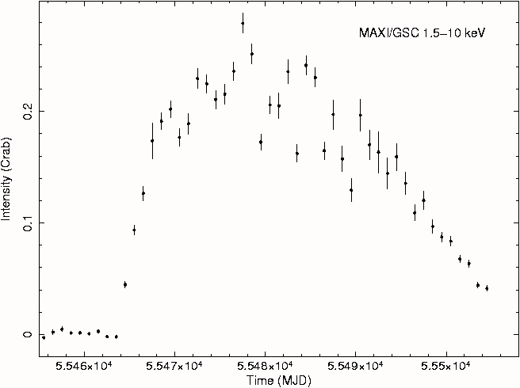
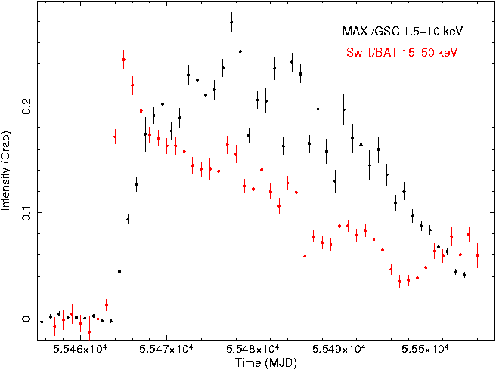
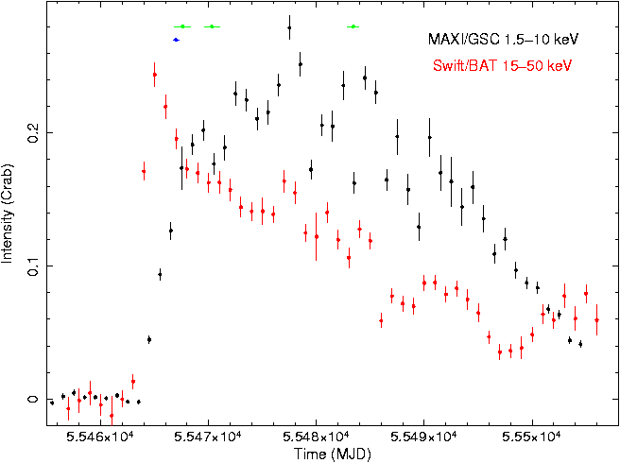
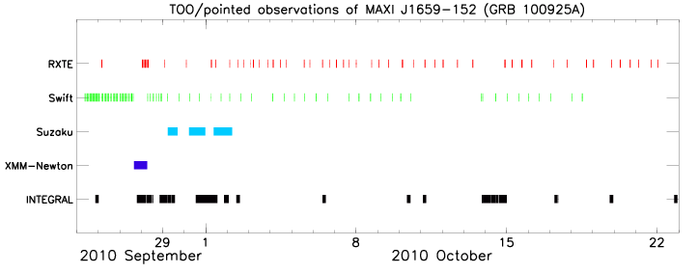
Twinkle, twinkle, little star…
Sep 25
XMM-Newton & 1st INTEGRAL observation: simultaneous!
53 days
Notes:
Any attempts to match those guys with the project scientists is at your own risk!

Slide 15
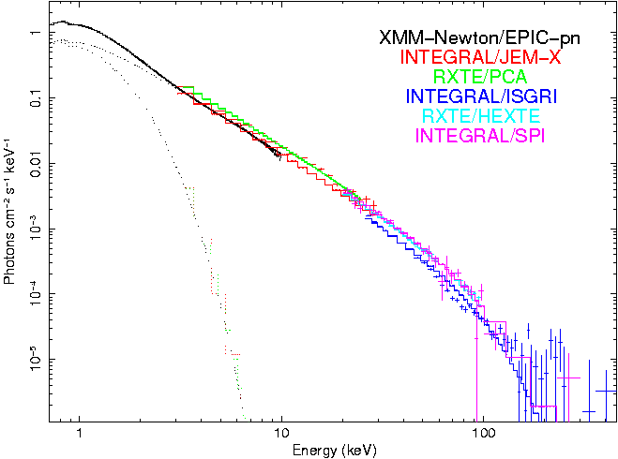
XMM-Newton & INTEGRAL TOO + et al.

Slide 16
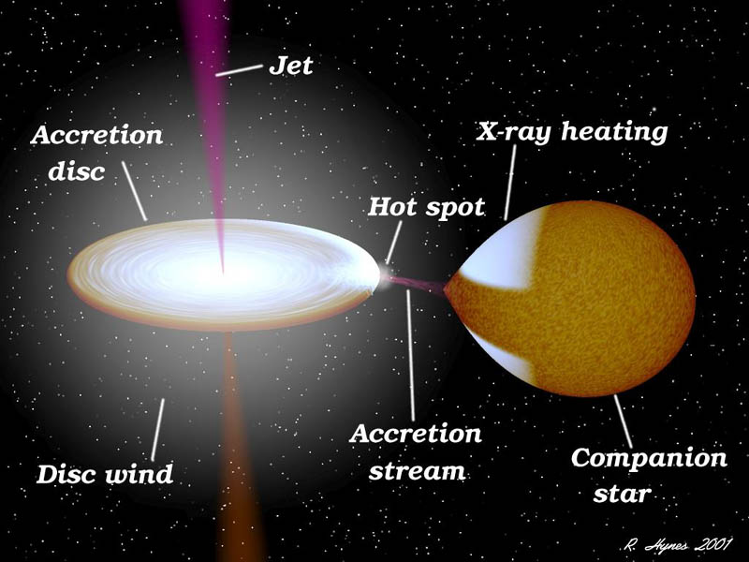
Watch those dips!
0.9 days
In analogy with other systems:
☞ Recurrent: orbital period
☞ Due to (partial) obscuration of inner disk by outer disk
ATel #2912
2.4 hrs
ATel #2926

Slide 17
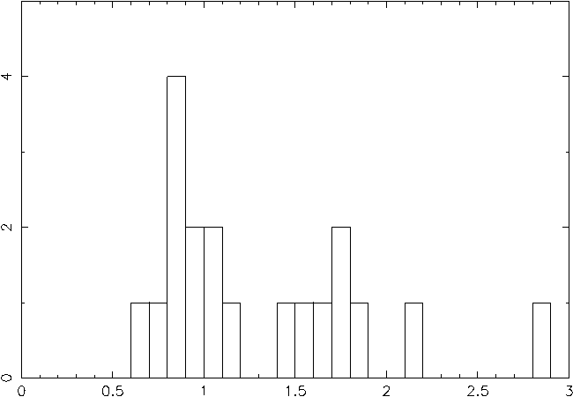
Empe- rical relation- ships So what?
Dips ☞ binary inclination 60°-75°
XMM-Newton:
P_{orb} =
2.411 ± 0.004 hours
RXTE (15-day baseline): P_{orb} = 2.4139 ± 0.0005 hours
M_{V,max} α Porb ☞ M_{V,max} =5.1;
with V_{max}=16.5 and A_{V}=1 this gives d = 3kpc
Number of BH binaries
The shortest P_{orb} among BH binaries!
Black hole:
M_{x} > 3M ☞
q=M₂/M_{x}<0.05 ☞ a > 1.35R
MS-star: M₂αP_{orb}, R₂αP_{orb} ☞ M₂=0.15M, R₂=0.25R
ΔV α Porb ☞ with V_{max} this gives V_{min} = 27.5 (faint when off!)
¹⁰log(Orbital period (hours))

Slide 18
Conclusions & Outlook
High-energy emission up to a few 100 keV
Shortest orbital period for a black-hole binary (transient)
Small system, somewhat larger than Sun
TBD:
Refine spectral modeling
Work on system parameters
Write paper!

Slide 19
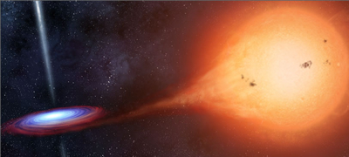
MAXI J1659-152:
a black-hole transient living to the max!
min
Special thanks to
XMM-Newton and INTEGRAL Science Operations Centres
for their promptTOO scheduling
(5 resp. 9 hrs between
trigger and start of observation!)

Slide 20
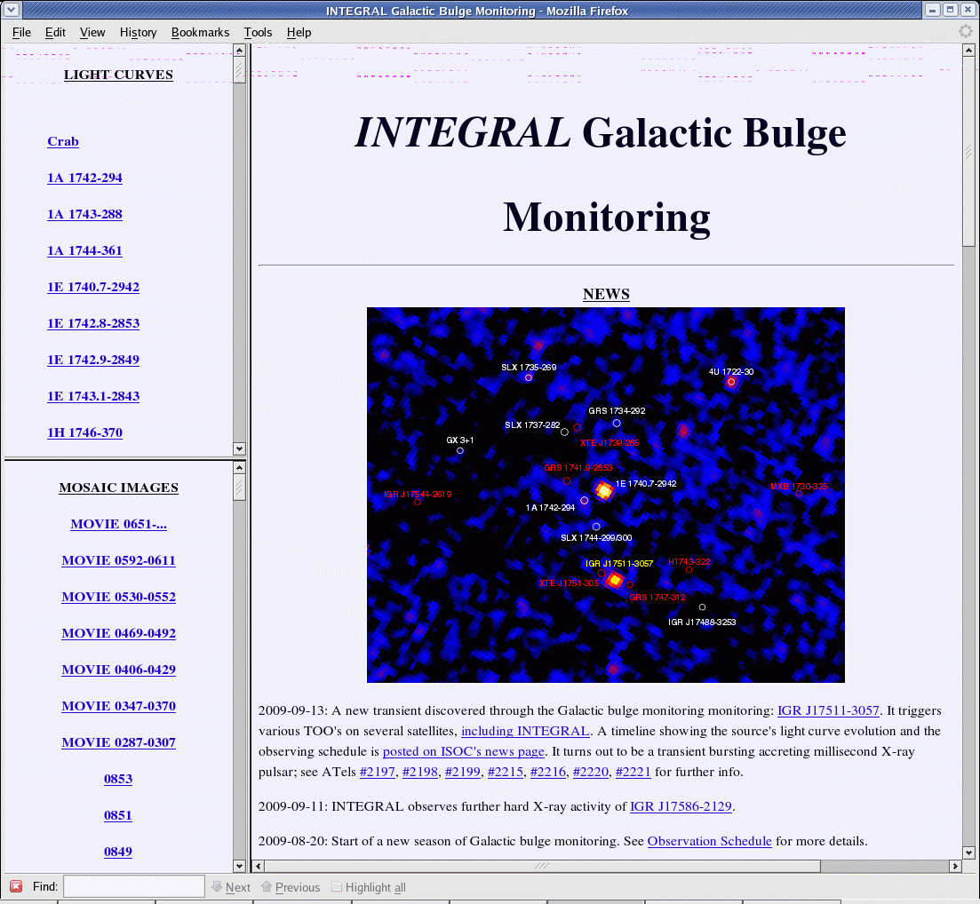
Watch this space
Galactic bulge monitoring program continues in 2011 (AO-8):
Note: in AO-8 only program to look at bulge!
Data public!
See
http://isdc.unige.ch/Science/BULGE
or e-mail us at:
isdc-gb-group@
unige.ch

