Slide 1
The first year result of MAXI/SSC
Masashi Kimura, Hiroshi Tsunemi,
Hiroki Kitayama (Osaka Univ.)
Hiroshi Tomida, Masaru Matsuoka (JAXA)
Arata Daikyuji (Miyazaki Univ.)

Slide 2
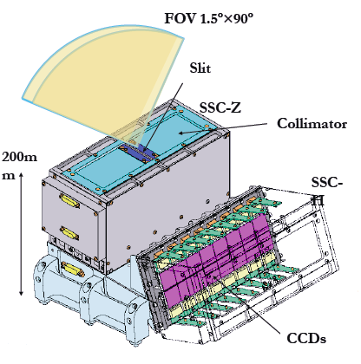
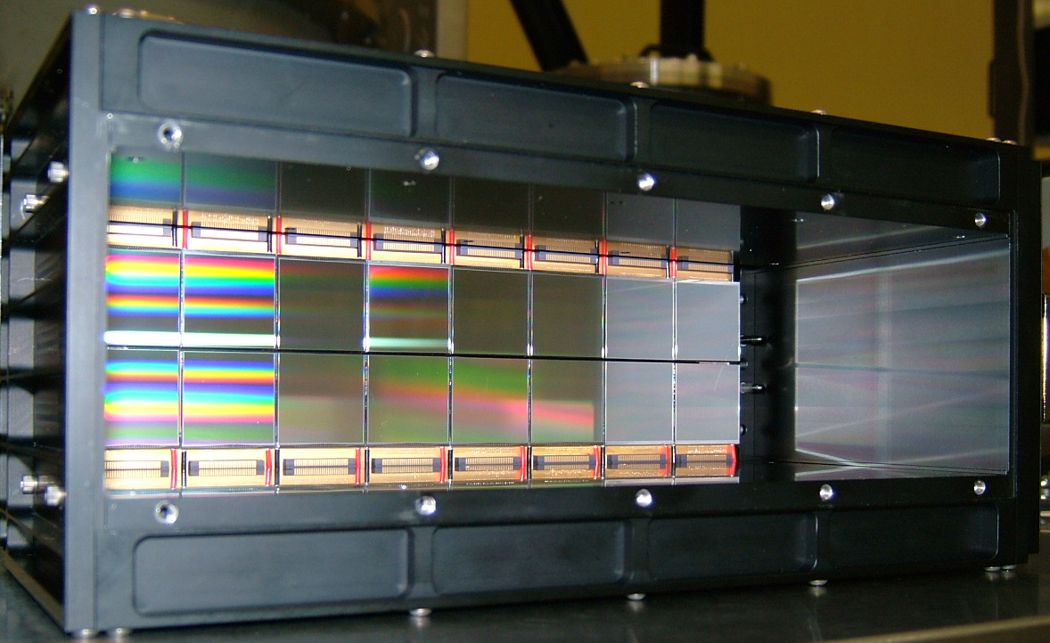
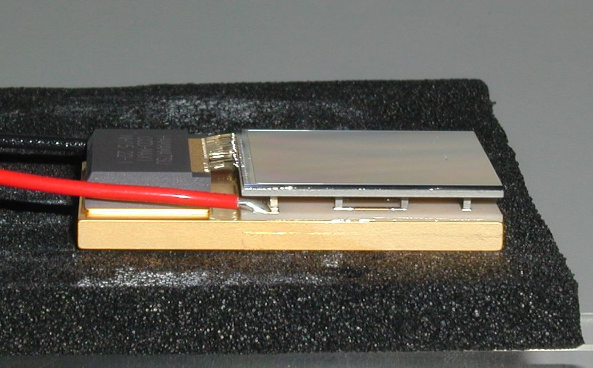
Solid-state Slit Camera : SSC
SSC is CCD camera
SSC consists of 2 units (horizontal and zenithal)
Each unit includes slit (2.7mm width), collimator (2.1mm pitch), and
16 CCDs (32 CCDs in total)
Slit and collimator system
(bottom view)
collimators
slit
20cm
20cm
CCDs in the flight camera
Notes:
CCD just like Suzaku/XIS
Al coating to stop visible& infrared light

Slide 3
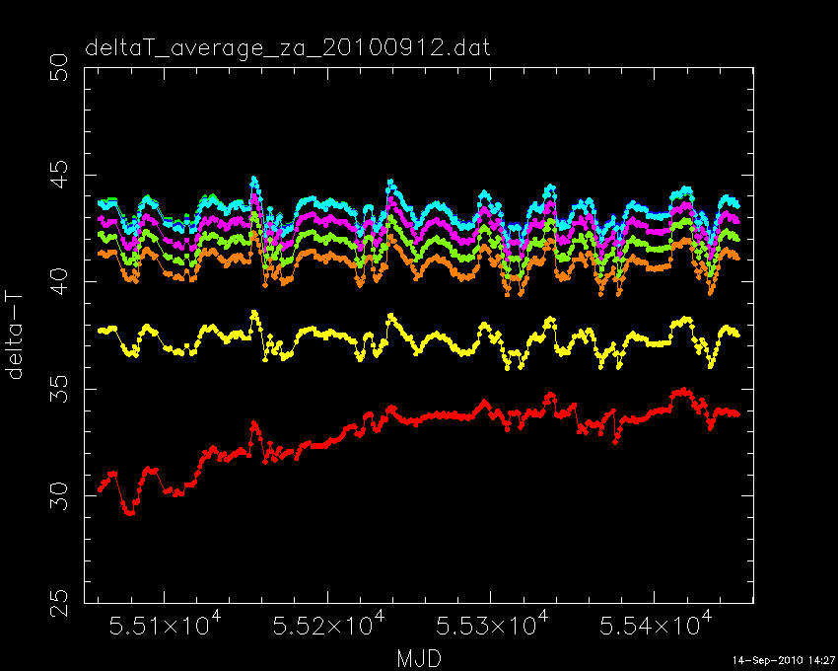
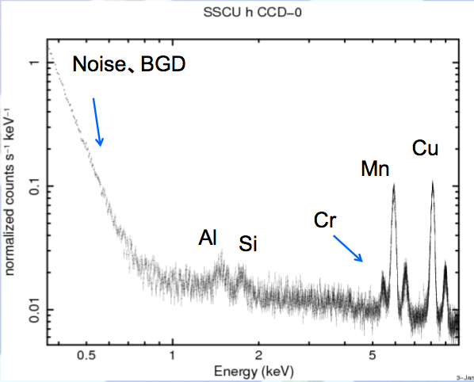
SSC Status
All 32 CCD are operational. Raw images are taken once a month for performance check.
Temperature of all 32 CDDs are as designed, except for 1 CCD.
Performance is as expected. The energy resolution is about 150eV@5.9keV (FWHM) at the beginning of the MAXI operation.
45°
ΔT
30°
Days
Notes:
Frame image is taken for performance check
Delta T is the temperature difference of ssc body and ccd so it tells as performance of peltier
Does’t show any degration

Slide 4
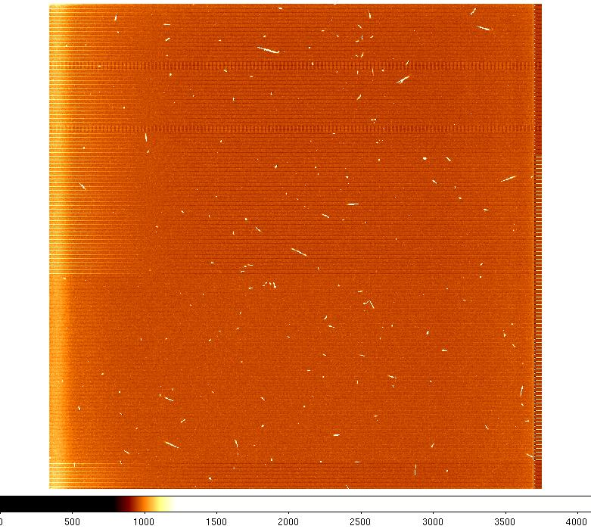
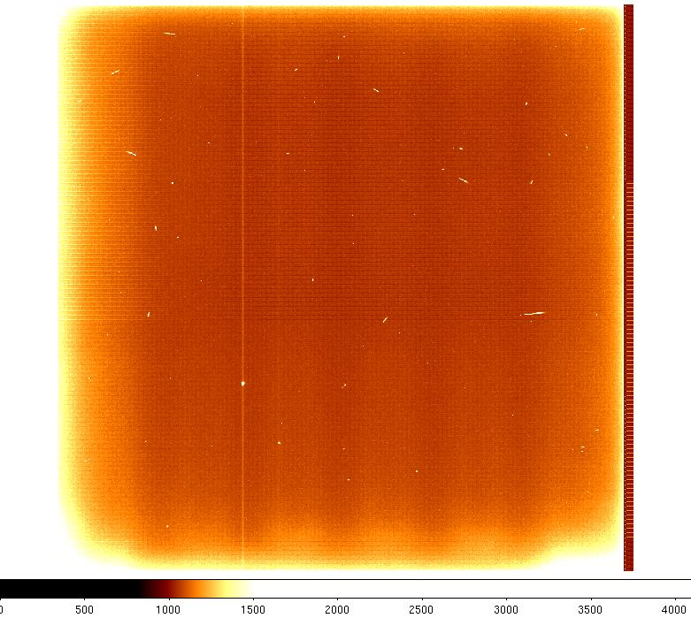
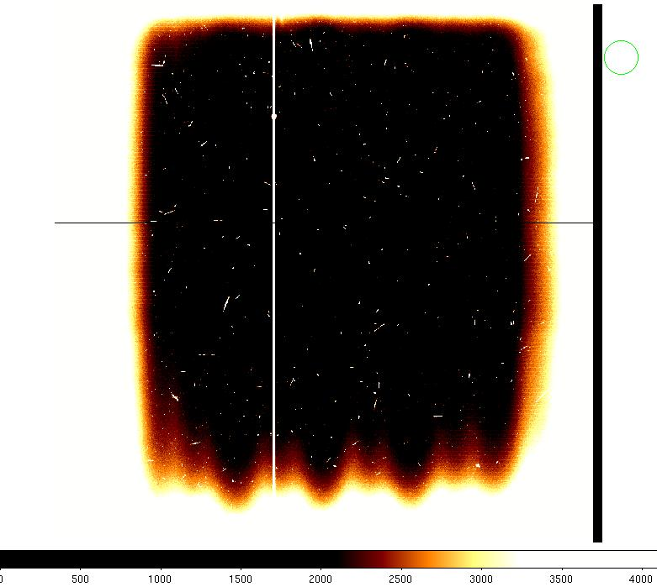
Problem : Light leak
Night
Sunset
(near night)
daytime
Infrared light contaminate the CCD images...
Notes:
Influenced design of Astro-H/SXI

Slide 5
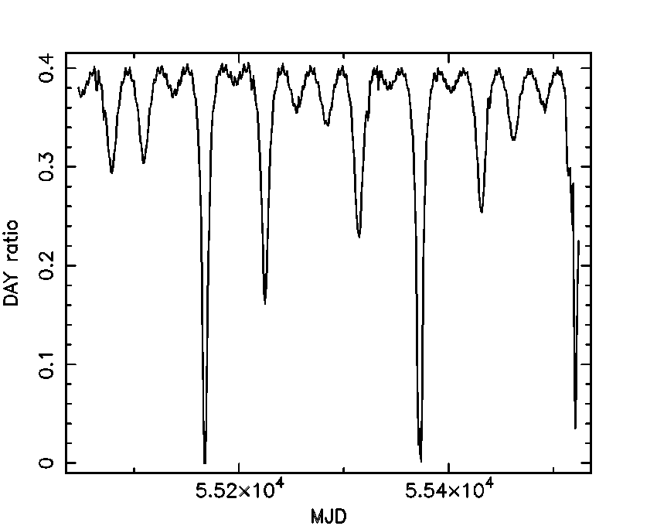
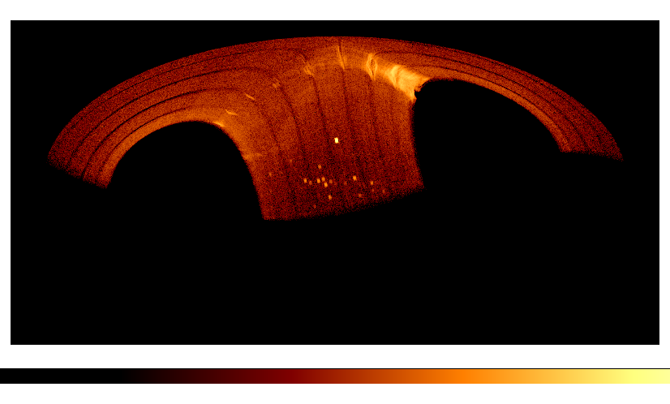
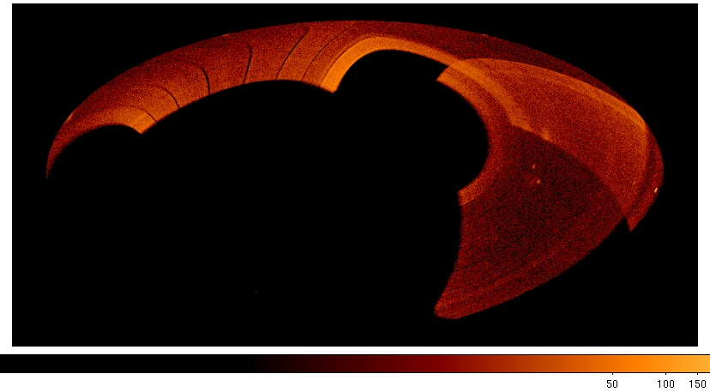
Observation Status
Normal Observation during night-time
Low gain observation during sunset
The all-sky coverage is ~40% in one-day observation. It takes a half year to cover the whole sky.
The observation efficiency (night ratio) is ~40%
sensitivity : 50mCrab for one-day observation
position accuracy : 0.1-0.2°
Night ratio (450days)
One day image
2009/8/3
2010/11/24
Notes:
Eventully we will see the busy part of out

Slide 6
Current status
Normal Observation during night-time
Low gain observation during sunset
CCDs are turned off during day-time & SAA
Monthly observation efficiency of normal/low gain observation are:
2009/11 : 38.4%
2009/12 : 36.4%
2010/01 : 41.2%
Sensitivity : 50mCrab for one-day observation
Position accuracy : 0.1-0.2°

Slide 7
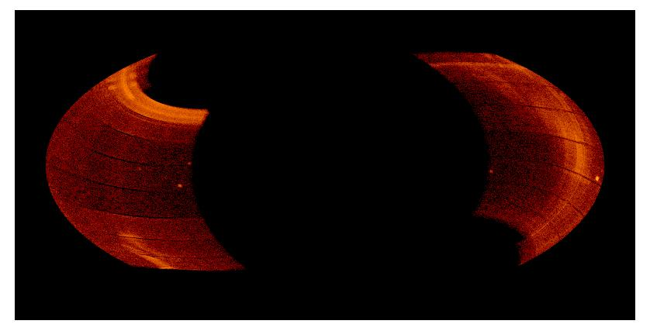
Calibration & BGD
Gain & QE calibration (Kitayama et al. [P-62])
Cu line is used for Calibration
Gain depends on the CCD temp, preamp temp
QE cal is done by fitting Crab spectrum
BGD study (Daikyuji et al. [P-61])
moon light, anomalous aluminum emission line
thermal noize(SSC-Z/CCDID=0)
Even at the ISS night time, moon light contaminates the CCD image in the low energy region
particle
moon light

Slide 8
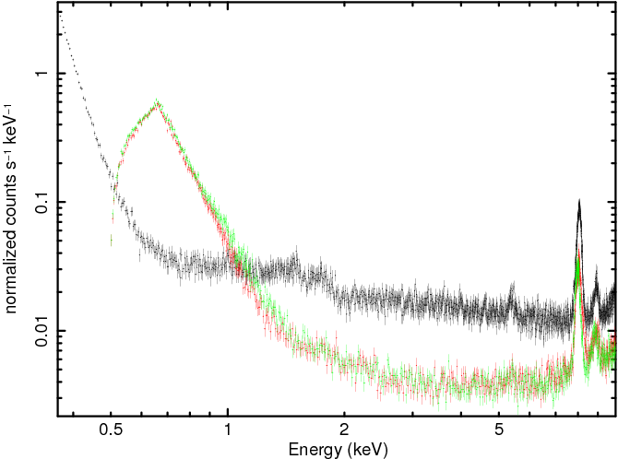
BGD
G0
G012
SSCH CCD-4のスペクトル
Grade 0: Single event
Grade 1: Split event
Grade 2: Split event
X
X
X
X
X
uCu-K
Al
Si
Cr
Notes:
The shape of BGD is different each day
We use different Grade criteria between low/high energy

Slide 9
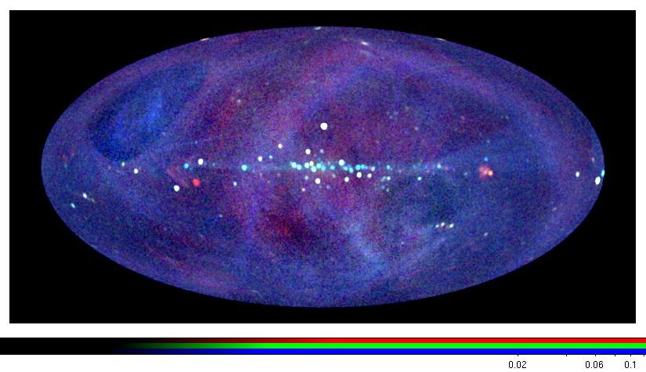
All sky map
0.7-1.7keV
1.7-4.0keV
4.0-7.0keV
Sco X-1
Cas A
Vela SNR
Crab
Cyg Loop
LMC
Notes:
Unclean background remains

Slide 10
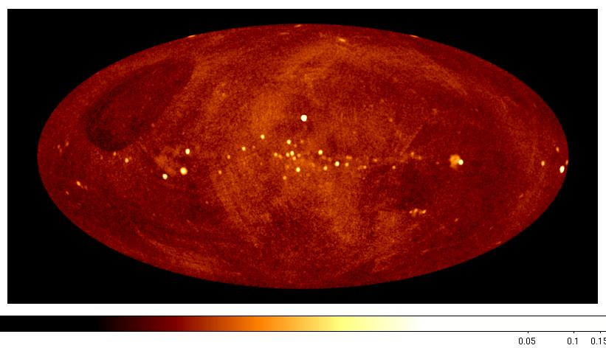
Low band image (0.7-1.7keV)

Slide 11
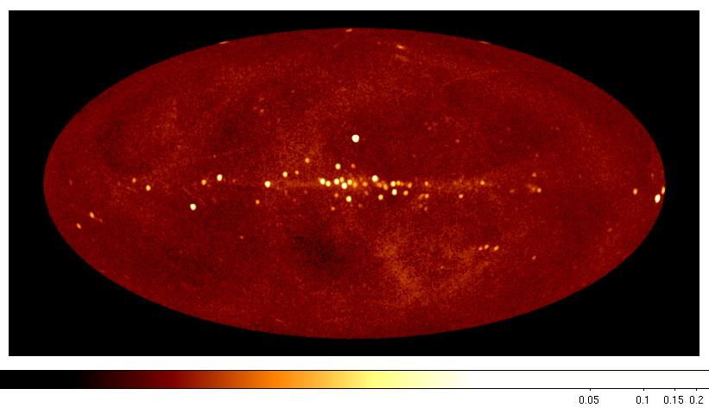
Mid band image (1.7-4.0keV)

Slide 12
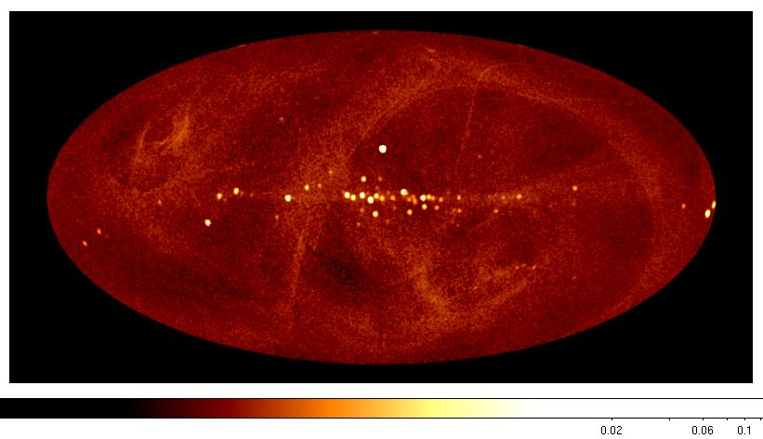
High band image (4.0-7.0keV)

Slide 13
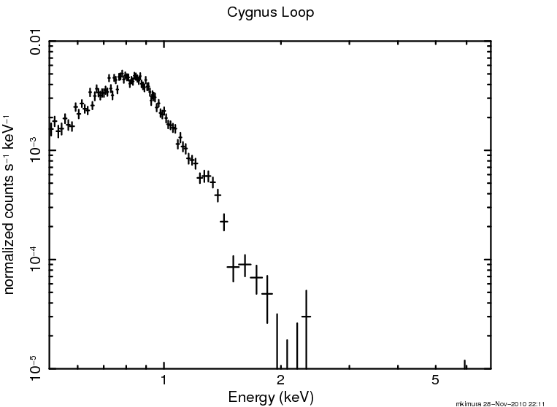
Cygnus Region
Cyg X-3 EXO 2030+375
Cyg X-1 4U 1954+319
XTE J1946+274
Cygnus Super Bubble
Cyg X-2
Notes:
Just like I said you can see emission around 0.5keV but you have to becareful

Slide 14
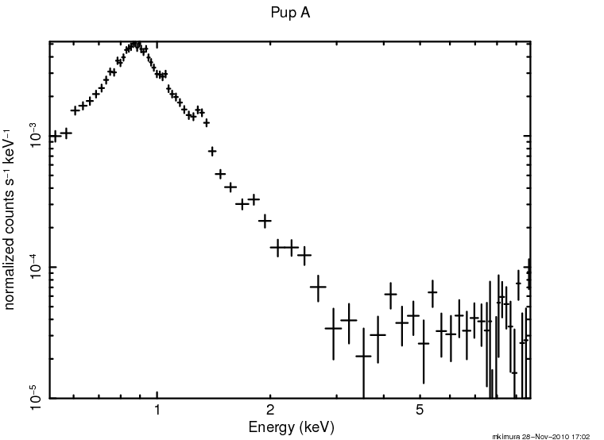
Vela & Pup A SNR
Vela X-1
Vela Jr
Pup A

Slide 15
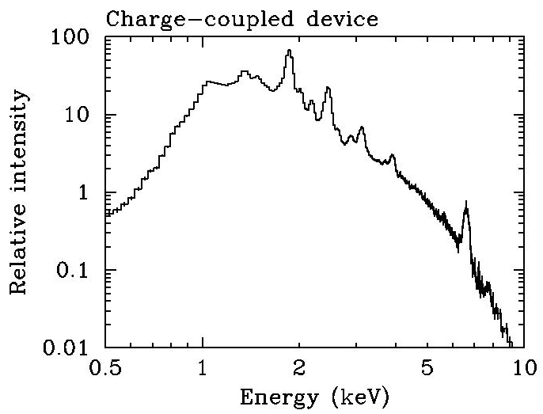
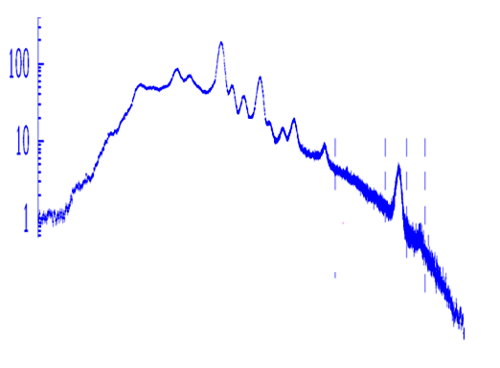
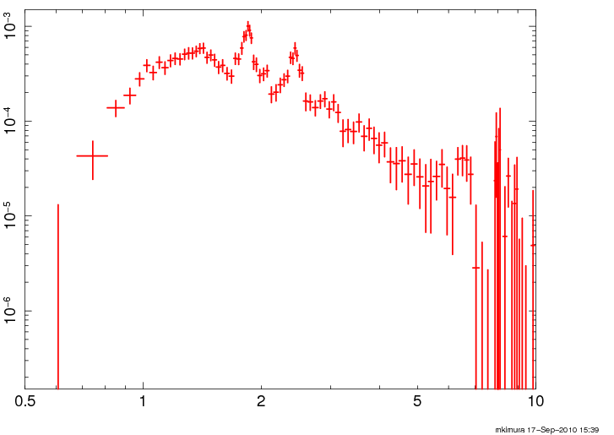
Cassiopeia-A spectrum by CCD
Satellite Launch Camera Dep. Chip size number
ASCA 1993 SIS 30um 12mm X 12mm X 8
Suzaku 2005 XIS 70um 25mm X 25mm X 4
MAXI 2009 SSC 75um 25mm X 25mm X 32
MAXI-SSC
Suzaku-XIS
ASCA-SIS

Slide 16
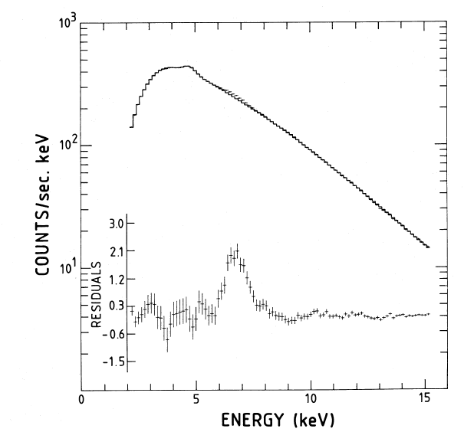
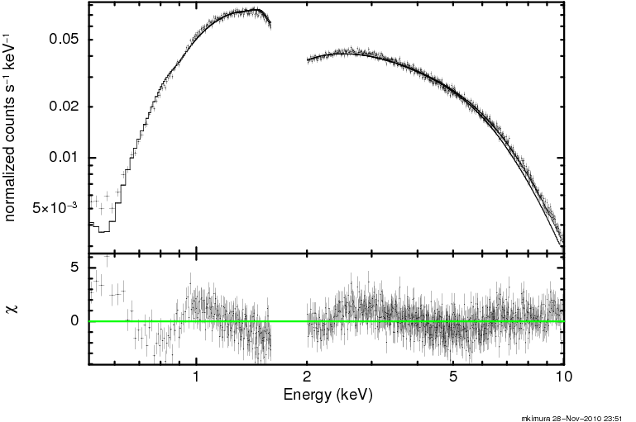
Sco X-1
EXOSAT/GSPC spectrum
MAXI/SSC spectrum
Si-K edge is not used because of calibration issue
White et al. 1985
Notes:
モデルはbobdy+powerlaw、、両方ともパラメータは似通ているが、Feの様子は違う
Si edge付近はフィットが会わないから消した、、on going calibrationとかいってごまかす。

Slide 17
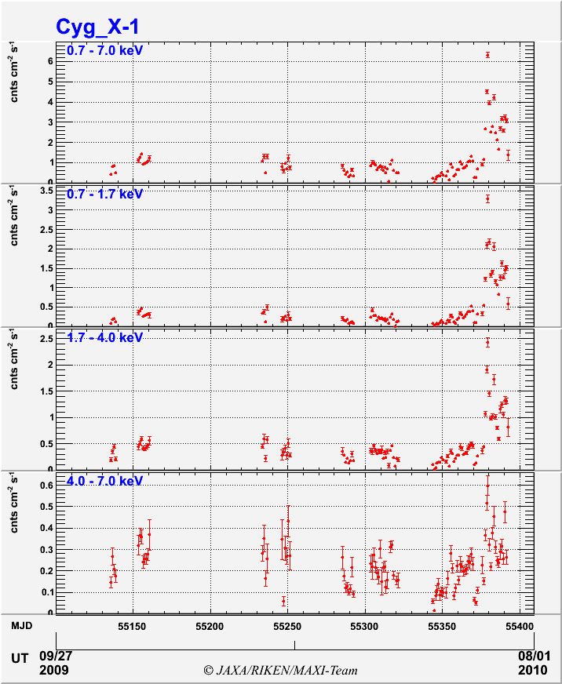
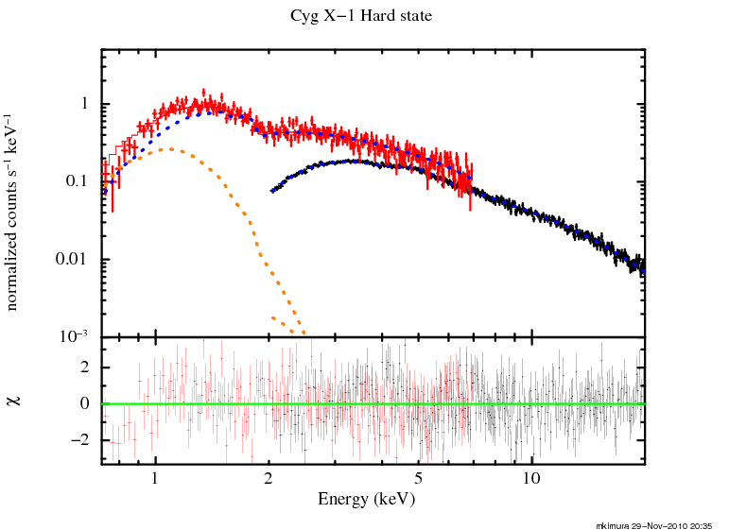
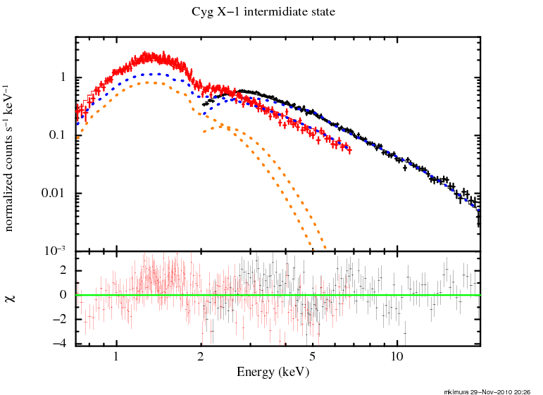
Cyg X−１
Hard state
Intermidiate State
powerlaw + diskbb
Hard State: Tin 0.19keV Γ=1.66
Soft State: Tin 0.43keV Γ=2.35
Notes:
We probably need more complicated model and timing analysis for intermidiate state
But just to illustrate what SSC can do, SSC can constrain the disk component lot more then using
GSC alone
Hard state : Tin 0.19keV ベキ 1.66
Soft state : Tin 0.43 ベキ 2.35
Wabs 0.6
7/15日sscのFOVから外れ、soft stateは観測できなかった。

Slide 18
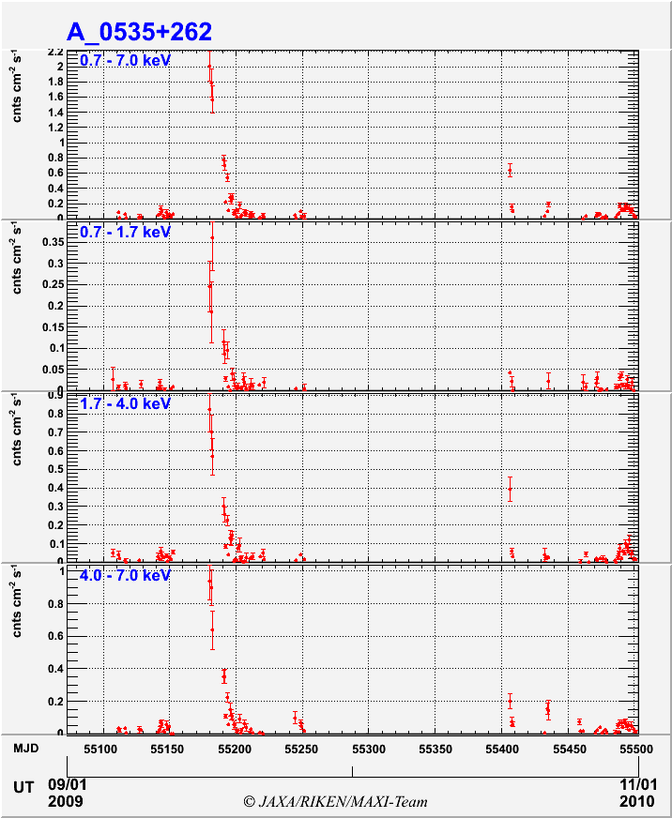
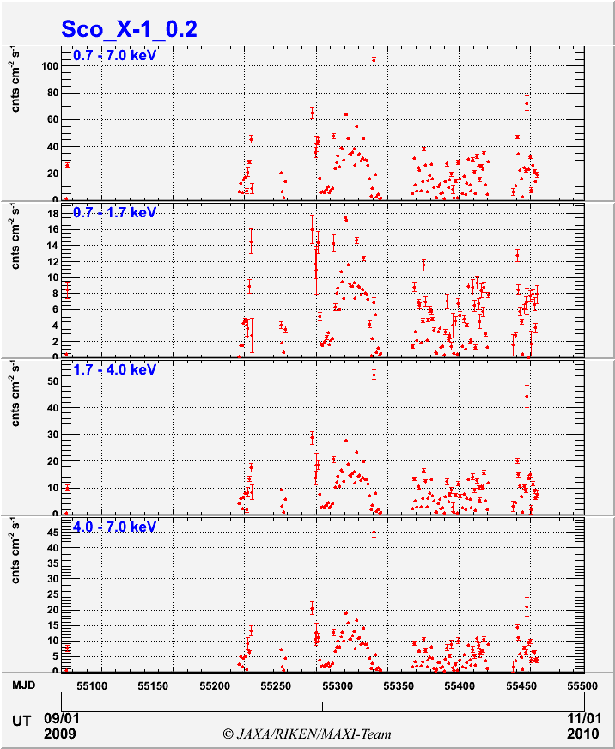
Data release
Light curves will be released through
http://maxi.riken.jp
Notes:
ライトカーブは公開予定、、天体によって、視野に入ってたり、入ってなかったり、するので注意。

Slide 19
Summary
All of 32 CCDs are operational
More then 70 sources are detected
Lightcurve will be available at
http://maxi.riken.jp
See posters [P-60] [P-61] [P-62] for other SSC results

Slide 20
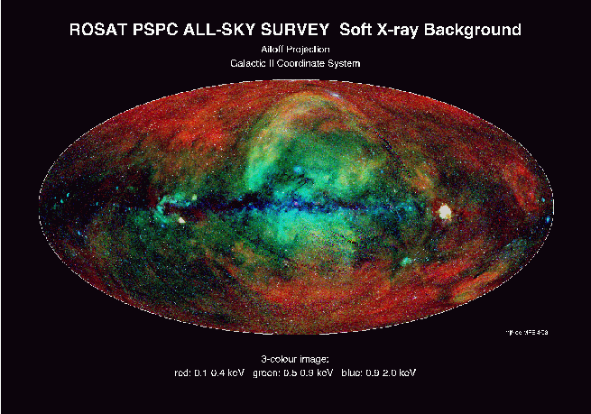

Slide 21
Γ is 2.1 of NH 3.8 ×10 ²¹ cm−2 .

Slide 22
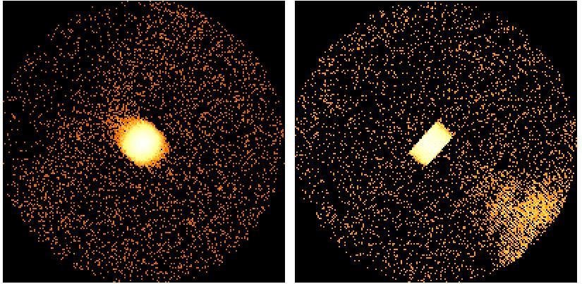
scan
scan
GSC 4-10keV
anode#2-5
SSC full band

