Slide 1
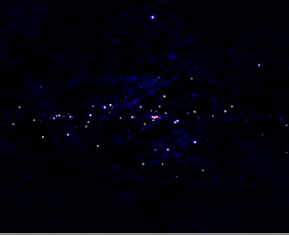
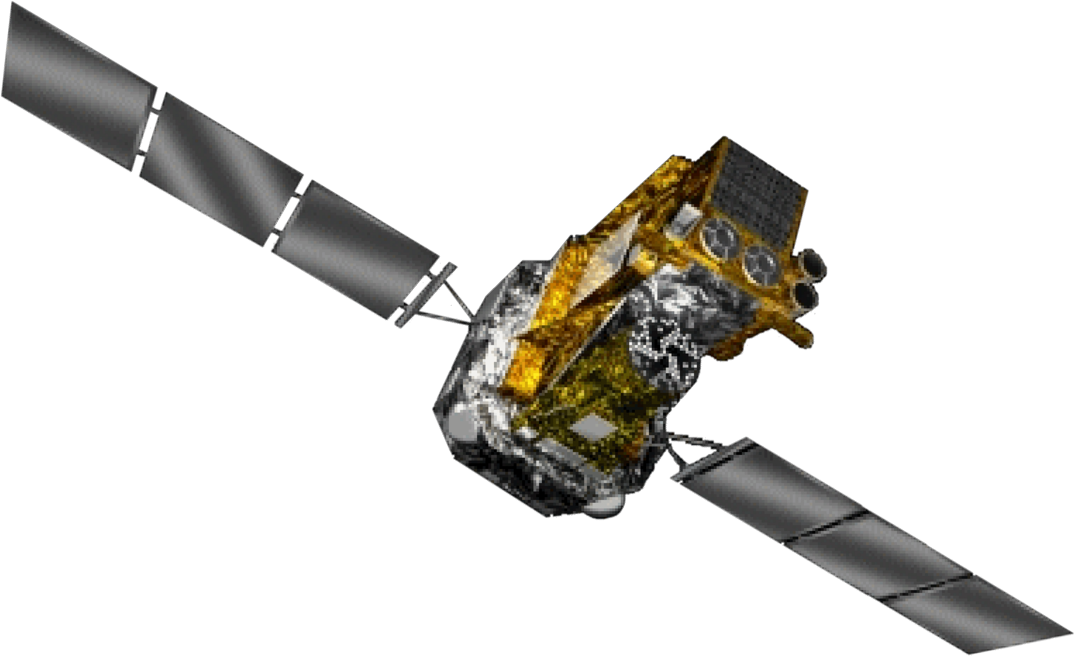
INTEGRAL review of HMXBs: SFXTs
I wish to congratulate the MAXI Team for the great firt year results and thank organisers for the kind invitation to the SOC and for the talk b
INTEGRAL extended till 2014!!
→ 4 years common operations
P. Ubertini, INAF/IASF – Rome, Italy

Slide 2
IBIS Survey Catalogs
Cat | Exposure (Ms) | Dates | Sources
1 | 5 | Feb 03 – Oct 03 | 120
2 | 10 | Feb 03 – June 04 | 209
3 | 40 | Feb 03 – Apr 06 | 421
4 | 70 | Feb 03 – Apr 08 | 723
? | ? | ? | ?
Exposure
>1000 sources now!!
Sources
A catalog every ~ 2 years so far, with each time an approximate doubling of exposure.
Cat4 saw a big increase in source numbers due to a more robust search for transient sources (bursticity!)
Right now, we have 59200 scw archived, compared to 41400 used in cat4 production, an increase of >40% so lots more to be found…

Slide 3
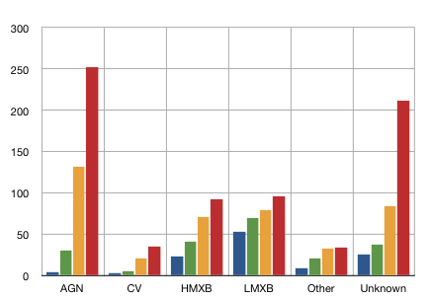
Lesson learn
Many interesting features:
Early LMXB discoveries biased by heavy Galactic Bulge exposures
HMXB population climbing faster – are HMXBs intrinsically more obscured?
AGN and CV populations both benefitting from cat3 and cat4 being more ‘all-sky’, now rising fast.

Slide 4
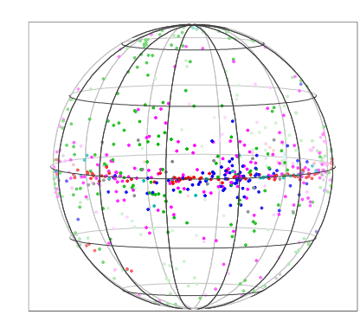
The Cat4 sources in the sky
HMXB
LMXB
AGN
CV
Unknown
Other
GC

Slide 5
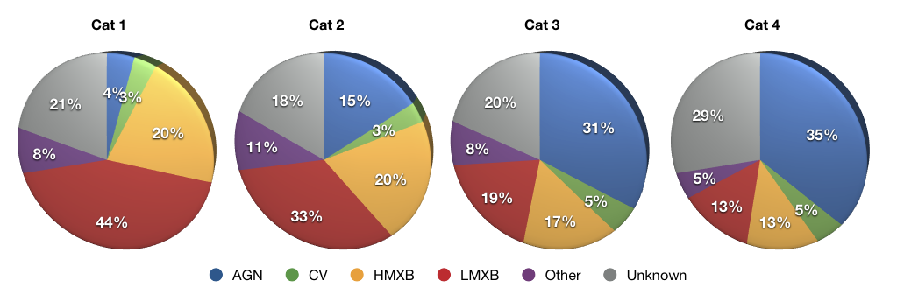
IGRs/unknowns through Cats 1-4
Unknown sources are at 20-30%, but sources move in (new discoveries) and out (source identifications/classifications) of this category all the time
Note the an IGR tag means that INTEGRAL was the first to observe and recognize the source as an X-ray emitter.

Slide 6
Evolution of `IGR’ numbers
By cat4, more than half the sources are IGRs: INTEGRAL discoveries at hard X-ray energies
27/123
(22%)
56/209
(27%)
168/421
(40%)
378/723
(52%)

Slide 7
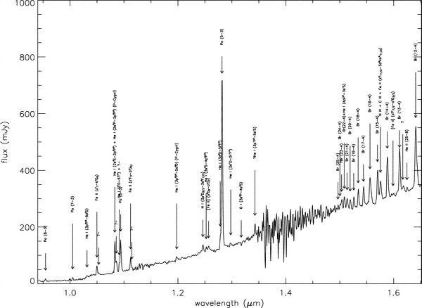
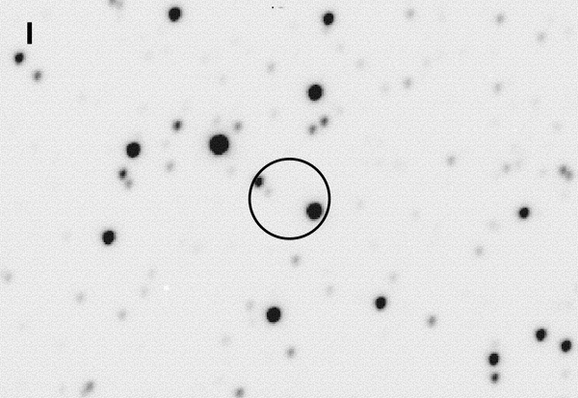
The source identification process
Hard X-ray characteristics
Global properties
Correlation with other catalogs
Archival soft X-ray data
Targeted soft X-ray observations
Optical spectroscopy
FIR/NIR spectroscopy
IGR J16318-4848: an X-ray binary with Sg B[e] star in the Norma arm of the Galaxy (Filliatre & Chaty 2004)
NTT/SofI NIR spectrum
XMM
circle

Slide 8
Summary of IR/Opt IDs
Up to August the optically (+NIR) identified nature of INTEGRAL sources are the following:
11 LMXBs (among which 3 SyXBs and 1 MXP);
21 Be/X HMXBs (often obscured);
17 HMXBs with supergiant companion (often fast transients);
96 ‘nearby’ (z ~ 0.006 – 0.422) AGNs (53 Sy1, 41 Sy2, 2 LINERs);
4 XBONGs
4 high-z blazars (z > 0.5)
3 BL Lacs
19 CVs (of which, 17 are definitely or likely of magnetic type)
4 Symbiotic stars
1 active star (possibly a RS CVn)
So, 156 sources of the four IBIS surveys and 23 other sources detected with INTEGRAL have been optically identified….with a long difficult work..!

Slide 9
Some more infos
4th IBIS/INTEGRAL survey:
442 known objects:
209 AGNs (47%);
174 X-ray Binaries (39%);
of these, 52% are LMXBs and
48% are HMXBs;
35 CVs (8%);
24 others (6%).
Opt-NIR identified IGR sources
179 objects:
106 AGNs (59.2%);
49 X-ray Binaries (27.4%);
of these, 22% are LMXBs and
78% are HMXBs;
23 CVs (12.8%)
1 active star (0.6%).
HMXBs are over-represented in the opt/NIR sources – obscured population
4th International MAXI Workshop, Aoyama, Tokyo, Japan - 2010, December 1 N. 9

Slide 10
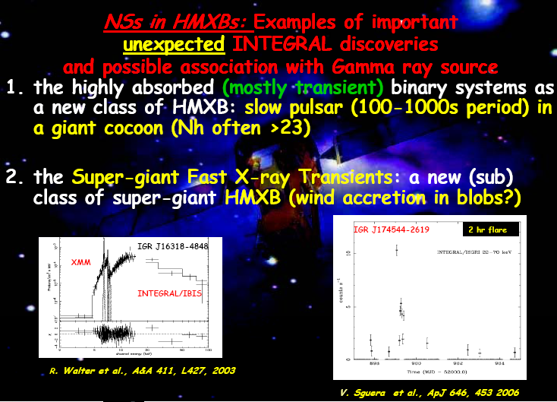

Slide 11
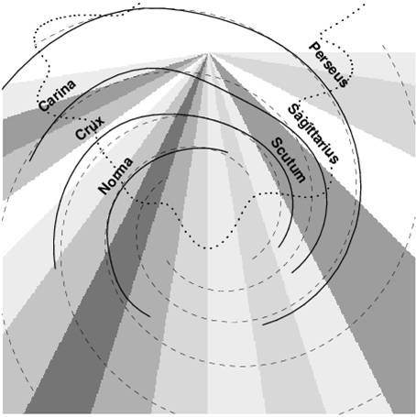
face-on view of the Galaxy and the HMXBs distribution
several new IGRs
identified
with HMXBs
are located
in the direction
of the
Norma Arm
Lutovinov et al. 2008
4th International MAXI Workshop, Aoyama, Tokyo, Japan - 2010, December 1 N. 11

Slide 12
The SFXTs Sample
To date, in just a few years
10 firm SFXTs reported in the literature
6 SFXTs are newly discovered sources by INTEGRAL
The remaining 4 SFXTs were previously observeed by other X-ray satellites (ASCA, BeppoSAX, RXTE), however INTEGRAL detected several fast outbursts unveiling or strongly confirming their fast X-ray transient nature
Now MAXI will discover more of them…see MAXI J1409-619 INTEGRAL UL 0.2 mCrab in 20-40 keV (~2.3 Ms), →dynamic range >150. Inside agile 0.5 deg error circle of one day Musca MeV transient (ATel #1394).

Slide 13
General Characteristics of SFXTs
X-ray Binaries composed of a Blu Supergiant companion and a compact object (mosty NS)
short (a few hours), sporadic and hard X-ray flares
X-ray Luminosity of a 10 ³⁶⁻³⁷ erg/s at peak
High dynamical range : 3-5 orders of magnitude with respect to the quiscent emission (10 ³² erg/s) greater than that of classical persistent variable supergiant HMXBs (< 20)
X-ray spectral properties reminescent of accreting X-ray Pulsars
A few display X-ray pulsations
A few dispaly recurrent flaring activity
X-ray Binaries composed of a Blu Supergiant companion and a compact object (mosty NS)
short (a few hours), sporadic and hard X-ray flares
X-ray Luminosity of a 10 ³⁶⁻³⁷ erg/s at peak
High dynamical range : 3-5 orders of magnitude with respect to the quiscent emission (10 ³² erg/s) greater than that of classical persistent variable supergiant HMXBs (< 20)
X-ray spectral properties reminescent of accreting X-ray Pulsars
A few display X-ray pulsations
A few dispaly recurrent flaring activity

Slide 14
Summary of SFXTS Characteristics
SFXT Porb(day) spin rate dynm range N_{H} (cm⁻²)x 10²²
IGR J08408-4503 35? 10⁴ 0.1
IGR J11215-5952 165 187s >10³ ~1
IGR J16465-4507 30.3 228s 30-80 (int. SFXT) 60
IGR J16479-4514 3.3 3.5x10³ 4-10
XTE J1739-302 51.5 10³ 3-38, 4.2 recent
IGR J17544-2619 4.9 10⁴ 1.2-4.3
SAX J1818.6-1703 30 3x10³ ~6
AX J1841.0-0536 4.7s 10³ ~6
AX J1845-0433 10² ~2
IGR J 18483-0311 18.5 21s 1.2 x10³ 7.7
Candidate SFXT
AX J161929-4945 4-12
IGR J16328-4726 >170 8.1
IGR J16418-4532 10
XTE J1743-363
IGR J17536-2339
IGRJ 11321-5311?

Slide 15
We do not know the SFXT evolutionary path
Supergiant HMXBs may originate from WR-binaries
Alternatively, some blue supergiant HMXBs may also originate from “Be-like systems”, because Several “Be/XRBs” in fact harbor an Oe star:
e.g.: X Per is a O9.5Ve star, and also the companion of
A0535 is an OVe star (these may have evolved from relatively
lower-mass binaries, e.g.: (14 +10)Msun ).
These stars may evolve into Blue supergiants that rotate faster than those originating from WR binaries.
The stellar winds of these supergiants may be strongest in their equatorial plane, while the winds from the “classical” massive
supergiant HMXBs (like Vela X-1) might be spherically symmetric.
This explanation would support an intermediate “Be-like” model
for the SFXT systems, as suggested e.g. by Chaty and Sidoli.

Slide 16
Evolutionary history of
a typical B-emission
X-ray binary up till the
formation of a double
neutron star
(e.g.: Tauris and van den
Heuvel 2006)
For supergiant systems
a similar model, with more
massive progenitors
(e.g. (20+12) or
(25 + 15)Msun) applies.
Survival of the CE phase,
however, requires a WIDE
Supergiant HMXB orbit!
,
,
,
,
,
,
Be/X phase

Slide 17
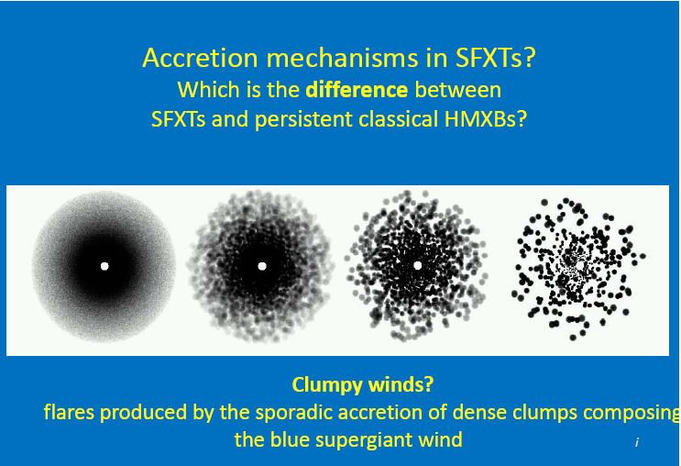

Slide 18
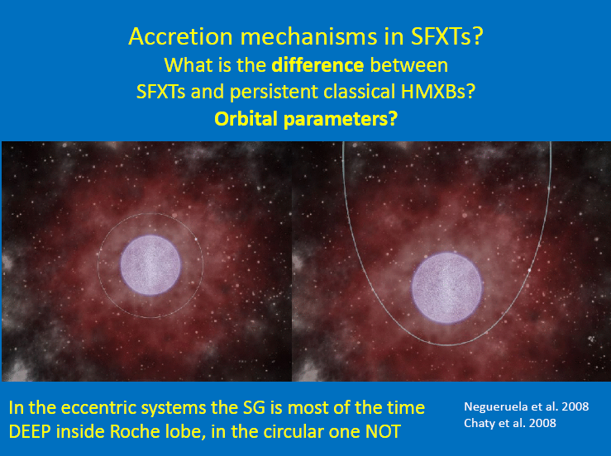

Slide 19
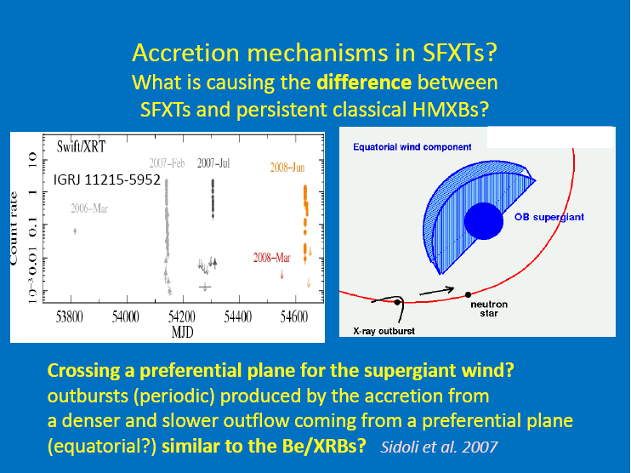

Slide 20
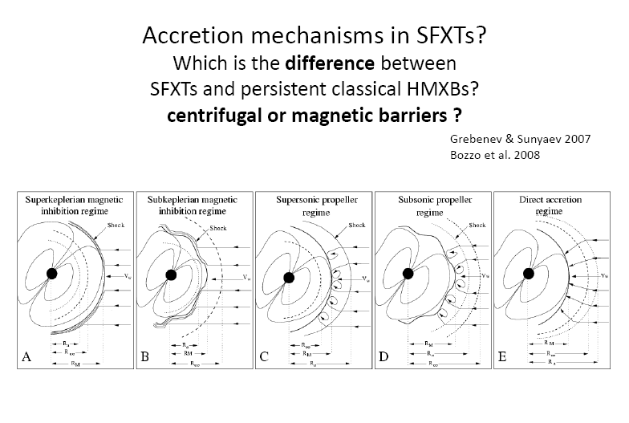

Slide 21
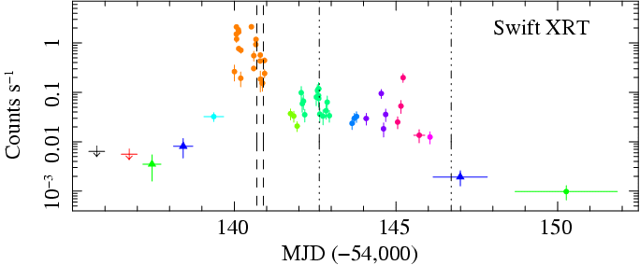
Latest RESULTS on SFXTs
IGRJ 11215-5952
is the first SFXTs with PERIODIC OUTBURSTS
(every ~165 days, likely the orbital period of the system) Sidoli et al. 2006
Romano et al. 2007, 2009
4th International MAXI Workshop, Aoyama, Tokyo, Japan - 2010, December 1 N. 21

Slide 22
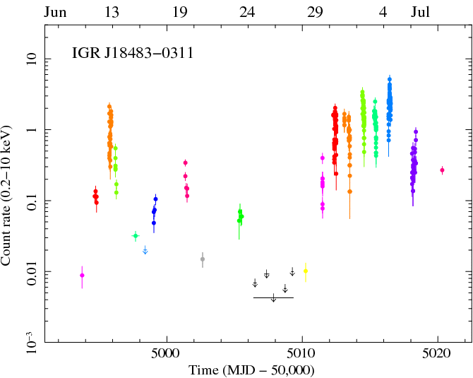
The periodic SFXT IGRJ18483-0311:
one outburst every 18.5 days
Swift/XRT observations of one entire orbital period
2009
June-July
Romano et al. 2009
An intermediate object between SFXTs and persistent HMXBs ??
4th International MAXI Workshop, Aoyama, Tokyo, Japan - 2010, December 1 N. 22

Slide 23
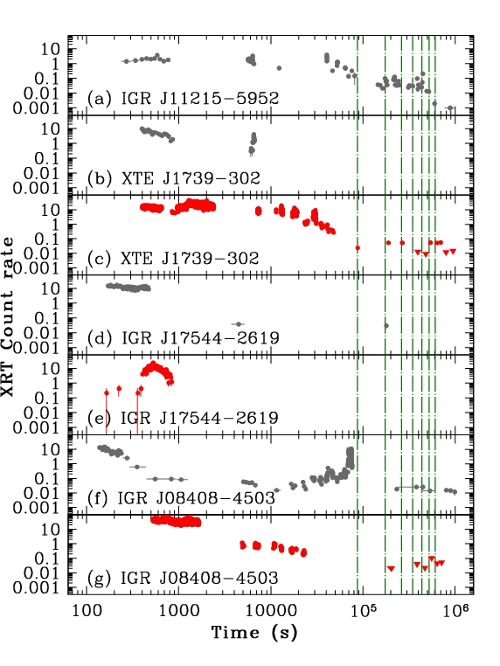
IGRs SFXTs
bright outbursts
monitored with
Swift / XRT
(0.3-10 keV)
The outburst duration
is a few days, and it is
composed by several
short (a few hours)
flares
Sidoli et al. 2008, 2009
4th International MAXI Workshop, Aoyama, Tokyo, Japan - 2010, December 1 N. 23

Slide 24
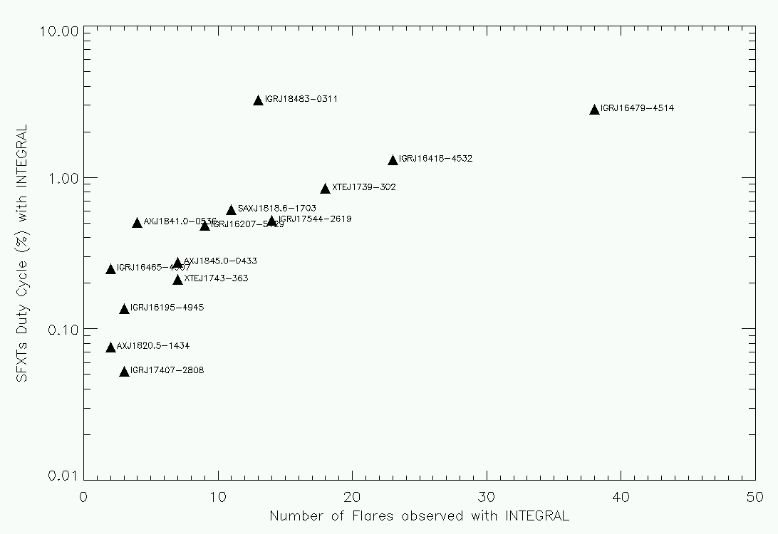
%
SFXTs duty cycle observed
with INTEGRAL (after 7 years)
data are taken from Ducci, Sidoli & Paizis, MNRAS in press (arXiv 1006.3256)
4th International MAXI Workshop, Aoyama, Tokyo, Japan - 2010, December 1 N. 24

Slide 25
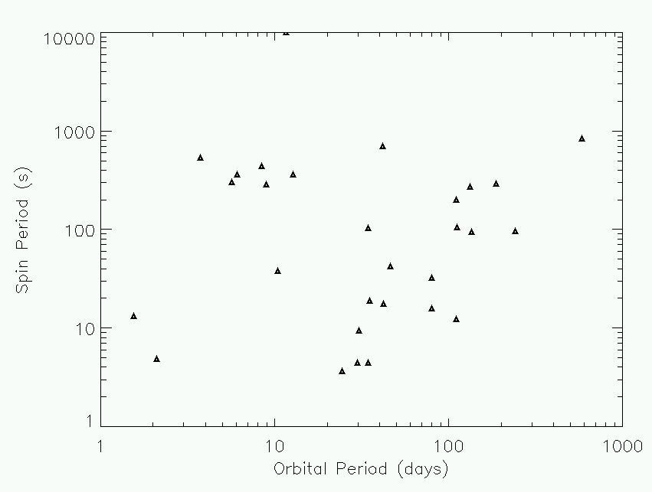
Galactic HMXBs in the Corbet diagram from Liu et al. 2001, pre-INTEGRAL version
Be X-ray
Transients
Wind-fed
SuperGiantXBs (persistent)
RLO HMXBs
4th International MAXI Workshop, Aoyama, Tokyo, Japan - 2010, December 1 N. 25

Slide 26
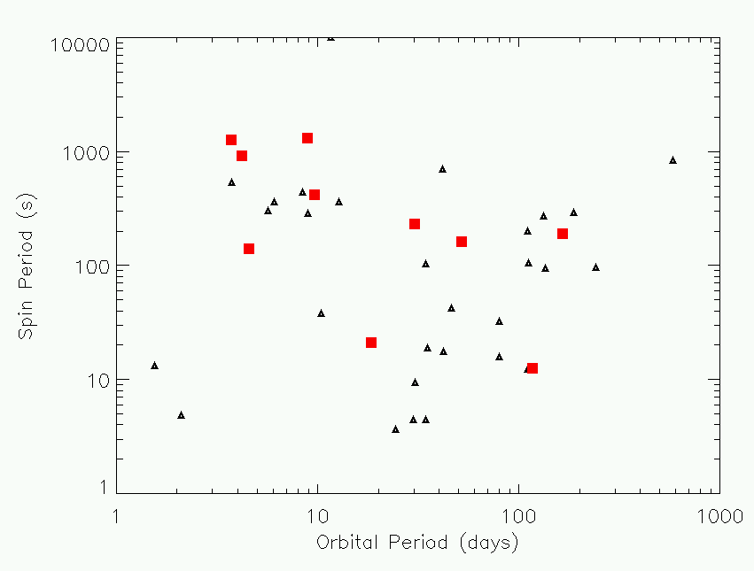
New Galactic IGRs HMXBs in the Corbet diagram
4th International MAXI Workshop, Aoyama, Tokyo, Japan - 2010, December 1 N. 26

Slide 27
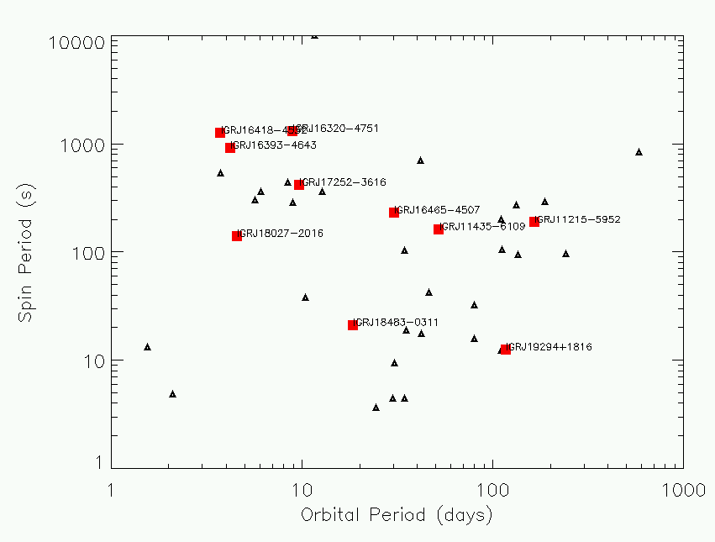
New Galactic IGRs HMXBs and SFXTs in the Corbet diagram
SFXTs
4th International MAXI Workshop, Aoyama, Tokyo, Japan - 2010, December 1 N. 27

Slide 28
New Galactic IGRs HMXBs and SFXTs in the Corbet diagram
SFXTs
Orb from few to
few hundred days
other SFXTs
with known Porb:
IGR J17544-2619
XTEJ1739-302
IGR J16479-4514
SAXJ1818.6-1703
4th International MAXI Workshop, Aoyama, Tokyo, Japan - 2010, December 1 N. 28

Slide 29
The “mistery” of SFXTs:
SFXTs are HMXBs hosting optical counterparts similar
to traditional systems (SGXBs like Vela X-1) with
persistent X-ray emission
BUT
they display transient X-ray emission
with flaring activity on short timescales
and extreme dynamic ranges
What is the link between SFXTs and Persistent SGXBs?
How do they form?
Are there different paths and evolutionary histories?
4th International MAXI Workshop, Aoyama, Tokyo, Japan - 2010, December 1 N. 29

Slide 30
SFXTs: what do we need ?
Census of the Galactic population
SFXTs true duty cycle
Survey their behaviour on all timescales..and
Discover new periodicities: pulse and orbital periods
Accurate modelling of the broad band spectra on
short timescale (~100 s or less) to detect variability of absorbing
column and spectral hardness and
possibly detect cyclotron lines and measure B field ( so far only a hint of
a line at 3 keV, IGRJ18483)...Are there magnetars in SFXTs?
Spectra of the quiescent state
Census of the Galactic population
SFXTs true duty cycle
Survey their behaviour on all timescales..and
Discover new periodicities: pulse and orbital periods
Accurate modelling of the broad band spectra on
short timescale (~100 s or less) to detect variability of absorbing
column and spectral hardness and
possibly detect cyclotron lines and measure B field ( so far only a hint of
a line at 3 keV, IGRJ18483)...Are there magnetars in SFXTs?
Spectra of the quiescent state
4th International MAXI Workshop, Aoyama, Tokyo, Japan - 2010, December 1 N. 30

Slide 31
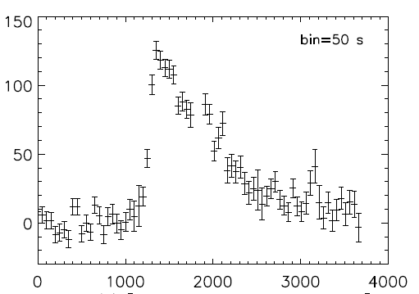
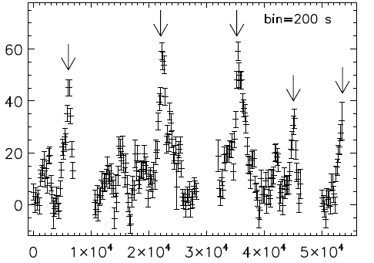
Future perspectives:
The 0.3-10 keV band, with excellent sensitivity (1.5 mCrab in 100s) + IRTis extremely important
The 2 types of observed flares (E>18 keV with IBIS) shows 2 different behaviur
  Multiple, consistent with accretion via a (temporary) disk
  FRED (magnetospheric accumulation + photoionisation instability)
  In both cases it is essential to measure the Nh vs time, with a large sky coverage and fast response
4th International MAXI Workshop, Aoyama, Tokyo, Japan - 2010, December 1 N. 31

Slide 32
Future perspectives:
  and, in particular:
    Nh vs time with flare intensity
    Nh variation along the orbital phase
    and the level of ionisation of the wind
    The hardness ratio during the flare to measure the matter condition, and:
      Different working (gated) mechanisms
      X-ray photoionisation role
      NS spin rate
      Mass loss rate
      Excentricity
      Magnetic field role (close/far from SG)
      Cyclotron lines for direct measurement of the magnetic field of the NS
      MAXI can do a lot of this measurements....
4th International MAXI Workshop, Aoyama, Tokyo, Japan - 2010, December 1 N. 32

Slide 33
Conclusions
Despite the large amount of observational data of new INTEGRAL IGRs
identified with Galactic HMXBs there are still several open issues:
- SFXTs accretion mechanism
- Link between SFXTs and persistent HMXBs
- SFXTs evolutionary paths and their formation,
HMXBs evolution and population synthesis...
MAXI can help to solve this puzzle!
Thanks!

