Slide 1
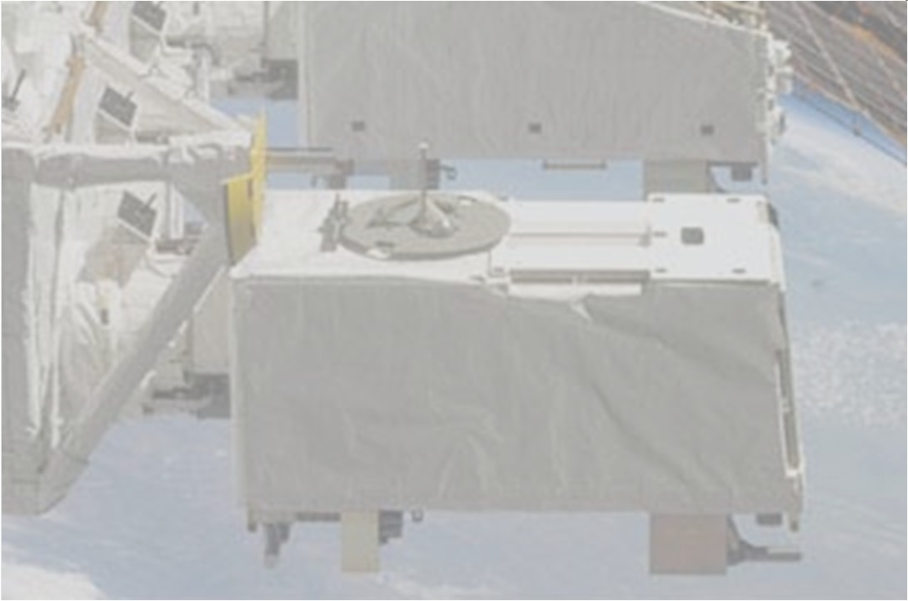
Binary pulsars observed with MAXI
T.Mihara, T. Yamamoto, M. Sugizaki (RIKEN)
M. Nakajima (Nihon-u)
M. Morii, R. Usui, N. Kawai (Tokyo Tech)
and the MAXI team

Slide 2
Contents
X-ray binary pulsars in the MAXI homepage
MAXI spectra in super orbital phases of LMC X-4
Be outburst of A0535+262 : giant/normal flares
RXTE and Suzaku follow up observations
  of GX 304-1

Slide 3
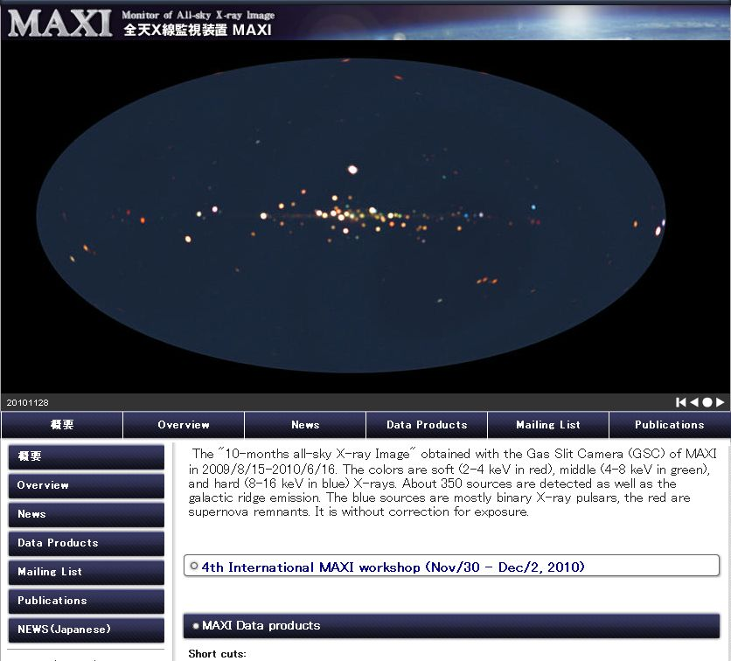

MAXI homepage
Her X-1
2S 1417-624
GX 301-2
GX 1+4
Cen X-3
maxi.riken.jp
239 sources
are monitored.
Blues are
binary pulsars.
Light curves
Vela X-1
A0535+26
X Per
EXO 2030+375
4U1626-67
SMC X-1
LMC X-4

Slide 4
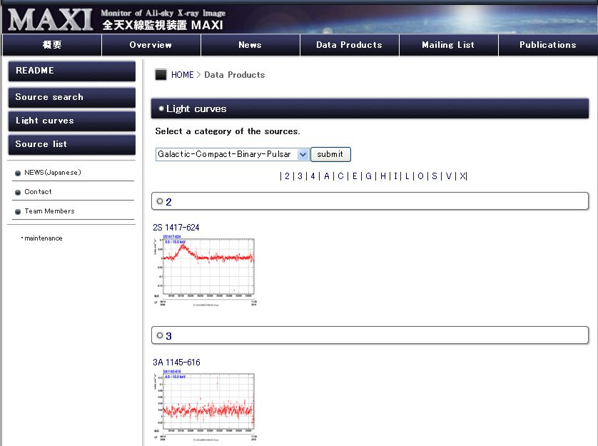
MAXI monitors
One-day averaged light curves
from the start (2009.8.15) till now.
28 sources are monitored.
20 sources are bright (>20mCrab)
and detected.
（GSC 5σ detection 15 mCrab/day）

Slide 5
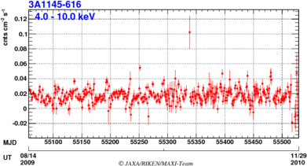
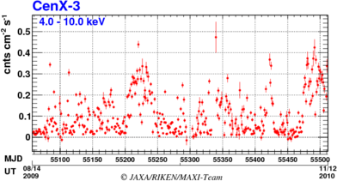
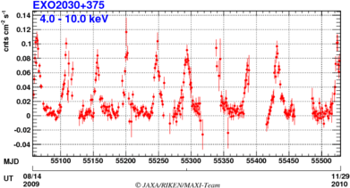
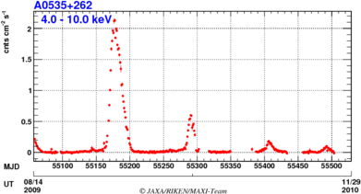
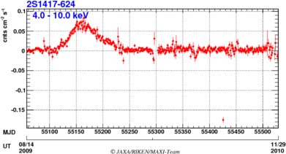
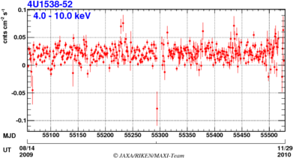
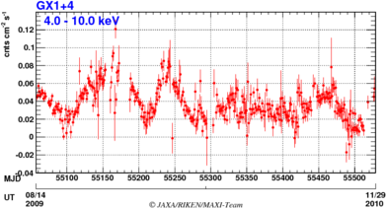
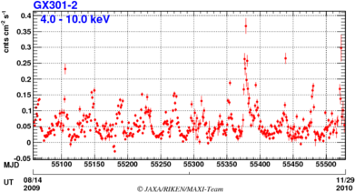
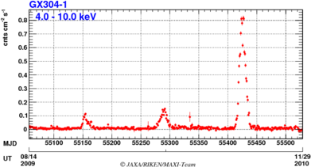
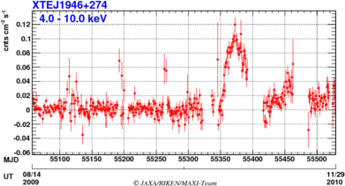
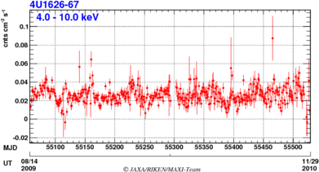
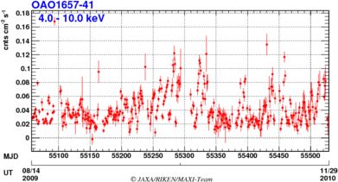
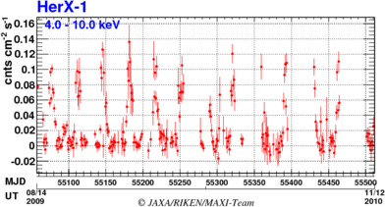
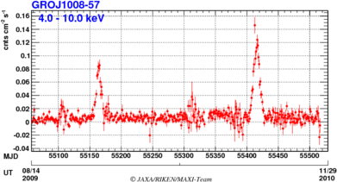
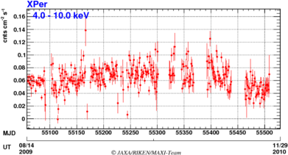
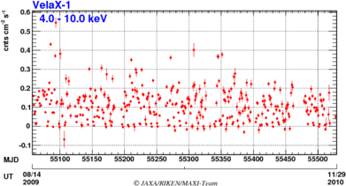
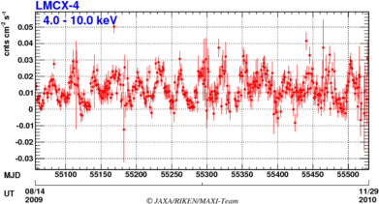
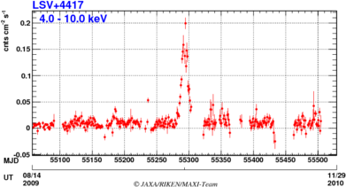
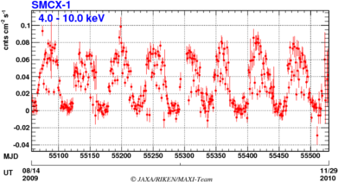
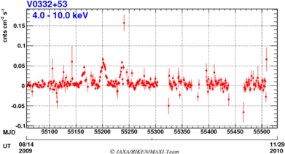
LC
3A1145-616
800 mC in one pulse peak
Cen X-3
EXO2030+375
A0535+262
2S1417+624
300 mC
100 mC
2000 mC
20 mC
SX
70 mC
4U1538-52
GX1+4
GX301-2
GX304-1
XTE J1946+274
80 mC
150 mC
800 mC
20 mC
SX
100 mC
4U1626-67
OAO1657-41
Her X-1
GRO J1008-57
80 mC
100 mC
120 mC
30 mC
X Per
Vela-1
LMC X-4
LS V +44 17
400 mC
150 mC
X
70 mC
25 mC
SMC X-1
V0332+53
Persistent stable
Persistent variable
80 mC
60 mC
S
Orbital / super orbital
Be outbursts

Slide 6
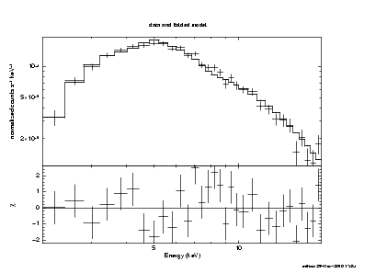
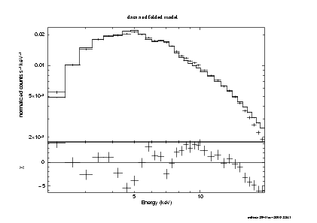
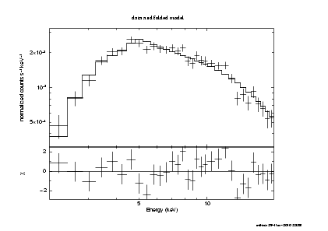
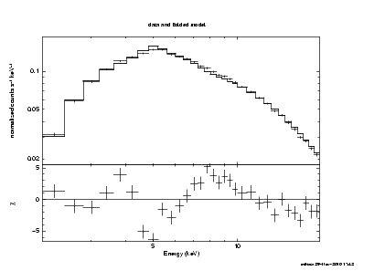
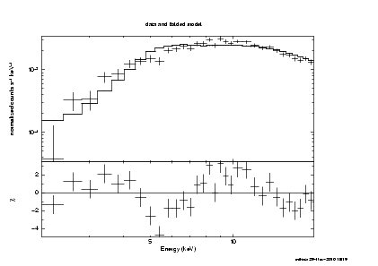
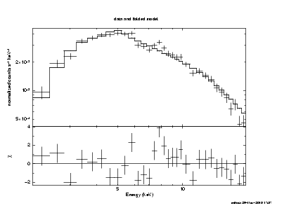
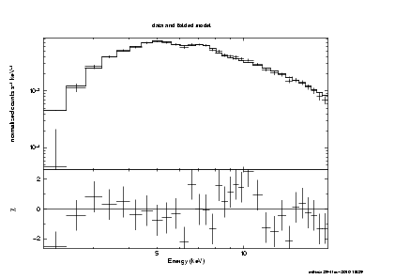
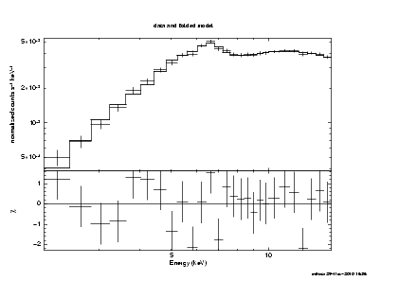
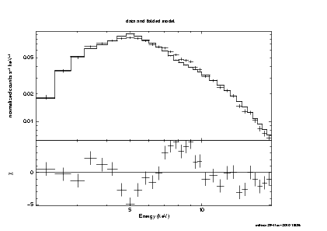
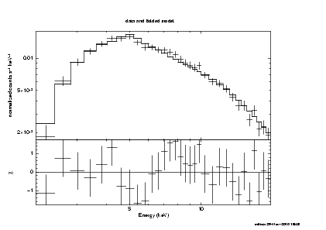
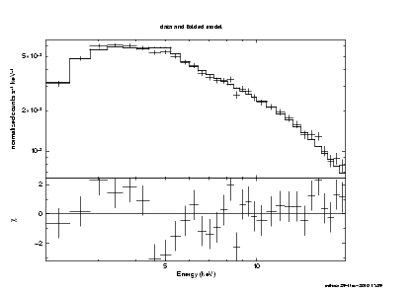
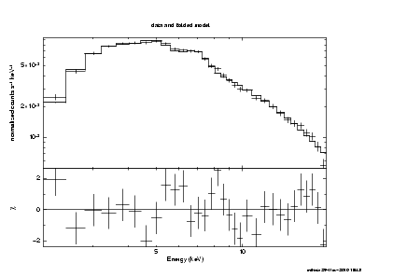
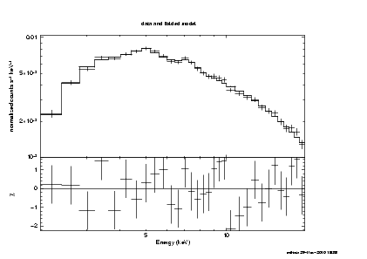
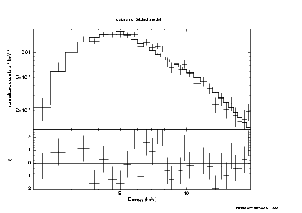
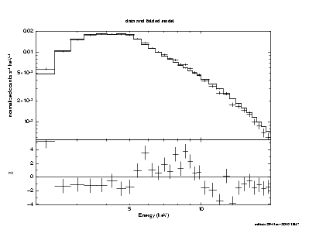
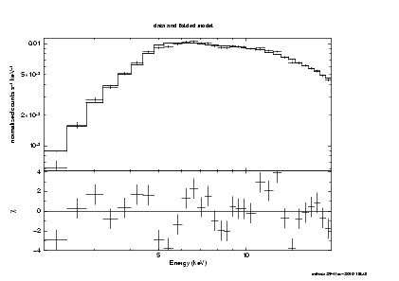
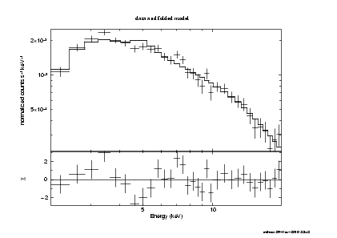
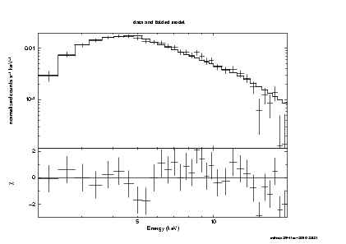
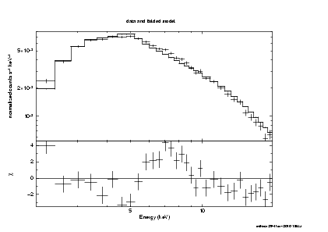
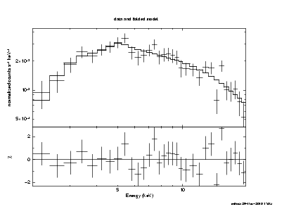
spectra
3A1145-616
Cen X-3
EXO2030+375
A0535+262
2S1417+624
(pc)
(pc)
↑
Iron line
4U1538-52
GX1+4
GX301-2
(pc)
GX304-1
XTE J1946+274
↑
Iron line
↑
Iron line
(pc)
4U1626-67
OAO1657-41
Her X-1
GRO J1008-57
↑
Iron line
↑
Iron line
Power-law
(partial covering)
model
2-20keV
Integrated for
1.2yr MAXI obs.
X Per
Vela-1
LMC X-4
LS V +44 17
↑
Iron line
Persistent stable
SMC X-1
V0332+53
Persistent variable
Orbital / super orbital
Be outbursts

Slide 7
Persistent stable I(mCrab) Nh(e22 ) Γ Fe
3A1145-616 20 6, 36 2.0 -
4U1538-52 20 4 1.1 -
4U1626-67 30 0 1.0 -
X Per 70 5 2.0 -
Power-law (partial covering) model
Number
Persistent variable Imax
Cen X-3 300 4 1.2 o
GX 1+4 80 11 1.4 o
OAO1657-41 80 4 1.4 o
Vela-1 400 8 0.2 o
Orbital / super orbital
EXO2030+375 100 4 0.7 -
GX 301-2 150 6, 107 0.25 o (EW~300eV)
Her X-1 100 2 0.86 o
LMC X-4 25 0 1.1 -
SMC X-1 80 4 1.4 -
-2 4 10 20 40 100-
NH (e22)
Number
Be outbursts
A0535+262 2000 3,21 1.2 -
GX 304-1 800 4,25 1.8 -
GRO J1008-57 120 7 1.6 -
LS V +44 17 150 7 1.9 -
V0332+53 60 1.4 0.6 -
2S1417+624 70 18 0.1 -
XTE J1946+274 100 5 1.2 -
0 0.5 1 1.5 2
Γ

Slide 8
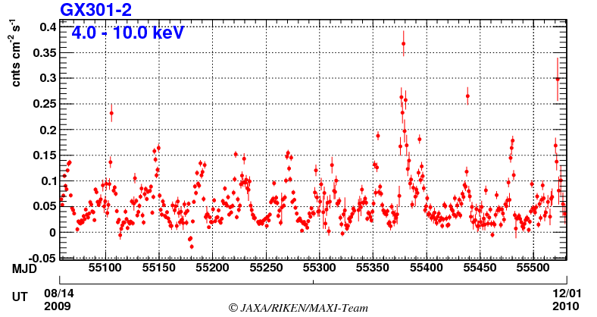
Irregular outburst of GX 301-2
Irregular apastron
outbursts
Regular periastron
outbursts
Fermi/GBM result:
At irregular apastron outbursts,
Spin up very quickly.
First spin up, then luminosity increases.

Slide 9
A0535+262 outbursts
P-20 Nakajima
2008.9
2009.8
2010.10
MAXI/GSC 2-20 keV
MAXI observation start
1.0
MJD=55051
precursor
Crab Unit.
Dotted lines denote periastron passage.
0.1
0.01
Swift/BAT 15-50 keV
1.0
Crab Unit.
0.1
0.01
54800
55000
55200
55400
Folded lightcurve
MJD
Swift/BAT
・ The current activity has started since Sep. 2008 .
・ Prior to MJD=55051, the periodic normal outburst at periastron passage.
・ At MJD=55051, the source exhibited the double peaked outburst.
Porbit = 110.2 day
Epoch = 53397.9(MJD)
Crab Unit.
Orbital Phase

Slide 10
Folded light curves of A0535+262
Swift/BAT
MAXI/GSC
Porbit = 110.2 day
Epoch = 53397.9(MJD)
Crab Unit.
Crab Unit.
Porbit = 110.2 day
Epoch = 53397.9(MJD)
Orbital Phase
Orbital Phase
・ The current activity has started since Sep. 2008 .
・ Prior to MJD=55051, the periodic normal outburst at periastron passage.
・ At MJD=55051, the source exhibited the double peaked outburst.
After MJD=55051,
・ the giant/normal outburst after the periastron passage.
・ The periodicity has changed. 110 → 115 d.
・ Precursor events appeared before the main outbursts.

Slide 11
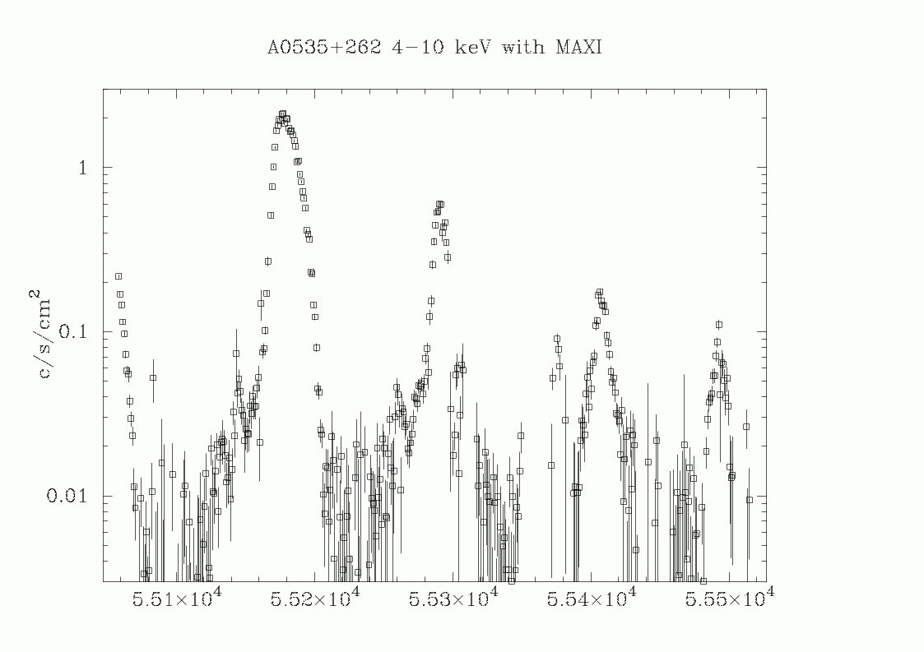
Giant/normal outburts, precursors
Giant peak lags 11d, 20d, 29d after periastron
and become smaller.
Porb = 110.2 d
periastron
Pre-cursors 30 d before the giant peak.
Back to Normal outbursts
since 55375.
τ=144 d
55100 55200 55300 55400 55500
MJD

Slide 12
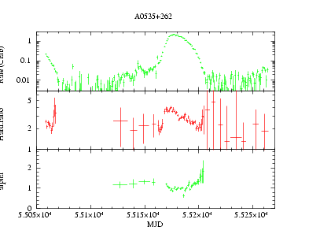
Hardness change in the giant flare of A0535+262
periastron
Pre-cursors have hard spectra.
Giant burst starts hard.
or
Normal burst is hard.
and giant burst starts in soft.
Then it becomes harder.
At the end of giant burst,
it jumps up to soft.
Hardness change means
changes of powerlaw index.
Flux
Hardness
Powerlaw index

Slide 13
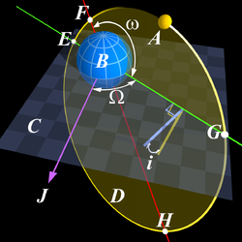
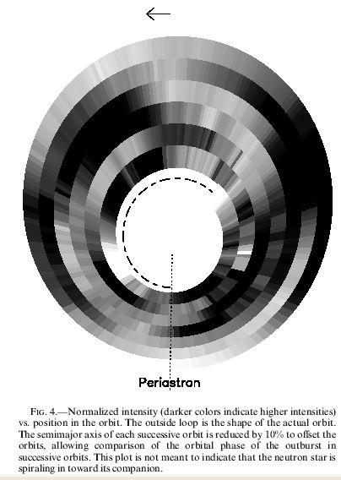
Flare period and orbital period
MAXI flare [day] orbit [day] difference [d]
A0535+262 115 110.2 5
GX304-1 136 132.5 3.5
P13 Yamamoto
Previous examples
XTE J1946+274 incri. is small Wilson+2003
random 169.2
EXO 2030+375 Wilson+2002 peri. pass= flare time
  shorter by 2.5 day (6 day after peri. -> before peri )
  m=1 dense wave of Be disk with period of 900 days

Slide 14
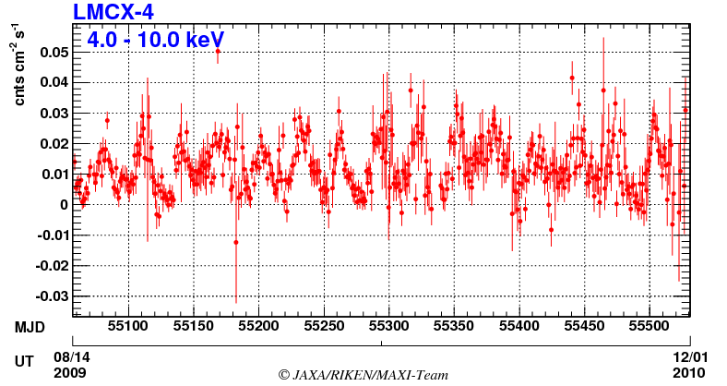
LMC X-4
Ps = 13.5 sec, Porb = 1.4 day
Super orbital period = 30.27 day
Flares (10Ledd) lasting ~1000s : once in several days

Slide 15
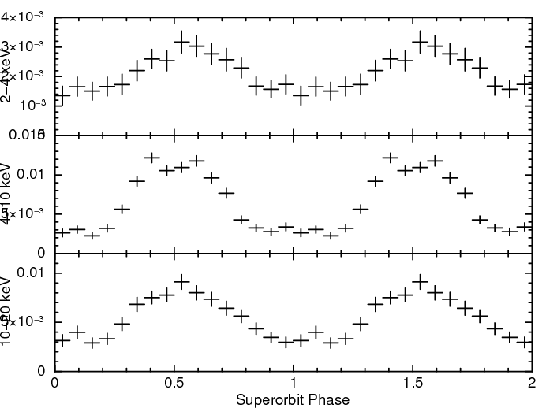
Super orbital folded Light curve
OFF
2-4 keV
4-10 keV
ON
OFF
ON
10-20 keV

Slide 16










Phase resolved spectra
1
2
3
4
5
6
7
8
9
N_{H}
Γ
F(abs)
F(dire)
F(sum)
Partial covering model
Super orbital phase

Slide 17



Two flares were detected in one-year
~10Ledd
2009-12-03
Lasted for
about 1 day
Flat spectrum
Γ=1.2
(Normally Γ～２)
Eclipses

Slide 18
MAXI trigger and Follow up observations
LS V +44 17 2010/3/31 ATel #2527 P18 Usui
  RXTE → absorption dip in the pulse profile
V0332+53 2010/2/10 Atel #2427
  Suzaku → no detection with PIN, no pulsation with XIS
GX 304-1 2010/8/7 ATel #2779
  Suzaku, RXTE → cyclotron detection at 54 keV
A0535+262 2010/3
  Suzaku, RXTE

Slide 19



Historical light curve of GX 304-1
Ariel
HEAO-1
Copernicus
No detection
< ~20 mCrab
1978 1979
Time

Slide 20


Cyclotron resonance with RXTE and Suzaku
2010 August
Outburst
X-ray spectra of GX 304−1 observed by RXTE and Suzaku on August 13-14
2009/08/15
2010/12/01
Energy
Model | A₁ | α₁ | A₂ (×10⁻⁵) | kT (keV) | E_{a} (keV) | W₁ | D₁ | χ²_{ν}
NPEX | 2.22 | 0.98 | 118.6 | 6.3 | ー | ー | ー | 2.78(238)
NP×CY | 0.60 | 0.43 | 51.5 | 7.4 | 53.7 | 9.9 | 0.73 | 1.13(235)
One of the highest B

Slide 21


Cyclotron energy-luminosity relation
56
νFν
54.4 keV
50.5 keV
Ea [keV]
ratio
48
0.5
1
2
10³⁷Lx₁₀₋₁₀₀ (~ 0.65Lx₃₋₁₀₀)
Energy [keV]
Suggests a positive correlation E_{a} - L_{x}
Positive relation : Her X-1, (A0535+26) P-23 Klochkov
Negative relation : 4U0115+63, V0332+53

Slide 22
Summary
MAXI monitors 28 X-ray binary pulsars, daily.
Light curves and spectra of bright 20 sources
  Persistent stable 4
  Persistent variable 4 (Iron line 4)
  Orbital / super orbital 5 (Iron line 2)
  Be outbursts 7
Spectra in super orbital phases ー LMC X-4
Be orbital period and flaring period differ.
  A0535+262, GX 304-1
RXTE and Suzaku follow up observations
  GX 304-1

