Slide 1
Magnetars, X-ray Pulsars, and Related Objects
K. Makishima (U-Tokyo)
M. Sasano, K. Nakajima, T. Nakano, H. Nishioka, T. Yuasa, S. Yamada, K. Nakazawa, J.S. Hiraga (U-Tokyo),
T. Enoto (Stanford),
Y.E. Nakagawa, T. Mihara (RIKEN),
Bamba (ISAS), T. Sato (Tokyo Metro-U/ISAS),
Y. Terada, T. Kohzu, and T. Yasuda (Saitama-U)

Slide 2
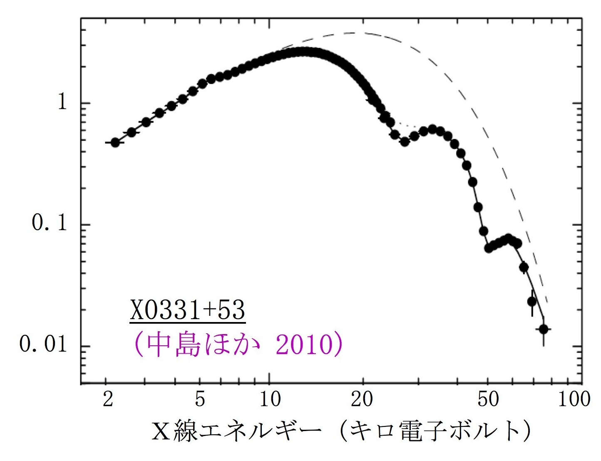
1. Magnetic Fields of NSs
Rotation-Powered Pulsars
Accretion-Powered Pulsars
-10
-12
-14
-16
-18
-20
Measure cyclotron resonance scattering feature (CRSF) at E_{a}=11.6 B₁₂ keV (Makishima +99),
Talk by Santangelo
10¹⁴G
10²yr
E_{mag}＞E_{rot}
10¹²G
Log Pdot (s/s)
10⁴yr
fundamental
10⁶yr
2nd harmonic
10¹⁰G
E_{a}=28 keV B=2.4e12G
10⁸yr
A pulsar spins down spending its rot. energy into mag. dipole radiation
10¹⁰yr
X0331+53 (Nakajima +10)
5
10⁸G
©A.Reisenegger
-3 -2 -1 0 1
Log Period (sec)
Energy (keV)

Slide 3
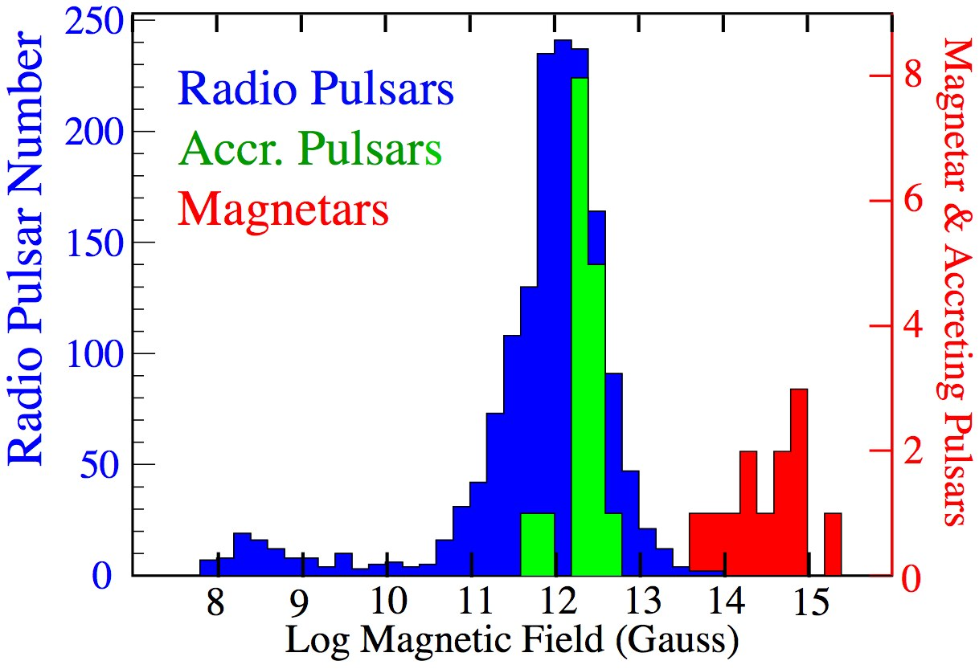
2. Puzzles to be Solved
Does the MF decay gradually from 10¹² G down to B=10⁸ G, or make transitions? (Makishima +99).
What sustain these strong MF? Super-conducting vortices, or nuclear ferro-magnetism? (ibid.)
B=B_{c}
Do magnetars really have B=10¹⁴⁻¹⁵ G, and are they really emitting X-rays by spending their MF ?
Is there a gap at B~10¹³ G in the MF distribution?
How can we search for hidden magnetars?
Do the SNRs associated with magnetars have any peculiariry? → [P-30] Nakano
3

Slide 4
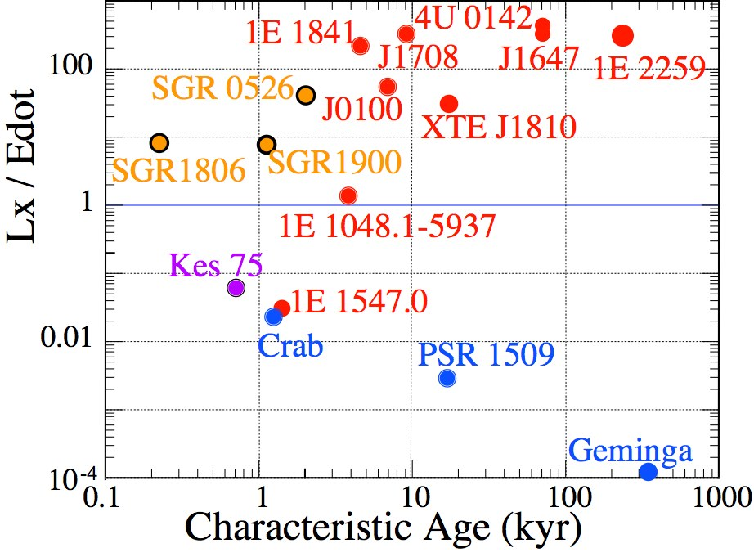
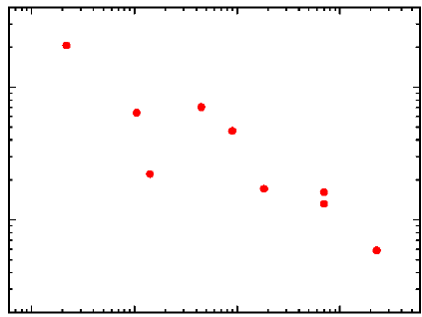
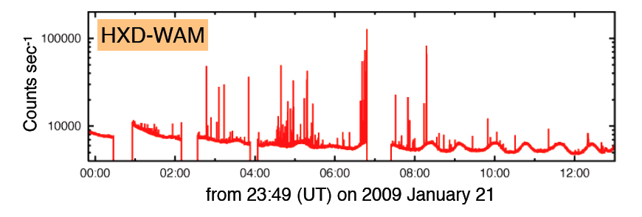
3.Are Magnetars Magnetically Powered?
(Thompson & Duncan +95)
⑤X-ray luminosity ≫ spin-down luminosity
①~20 objects in our Galaxy and Magellanic clouds.
②P=2–10 s, large P-dot→B＞B_{cr}
③No evidence of accretion.
④No or weak radio emission.
15
14
⑥Evidence of m.f. decay, 1e34 erg/s
Log Mag. Field (G)
⑦Sporadic emission of short bursts–magnetic en. release?
B_{cr}
Enoto+10a
0.1 1 10 100
Characteristic Age (kyr)
1 day
4

Slide 5
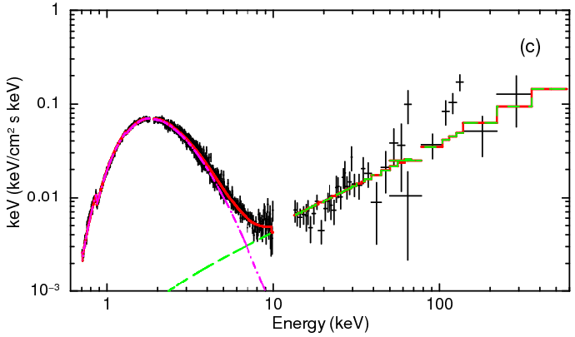
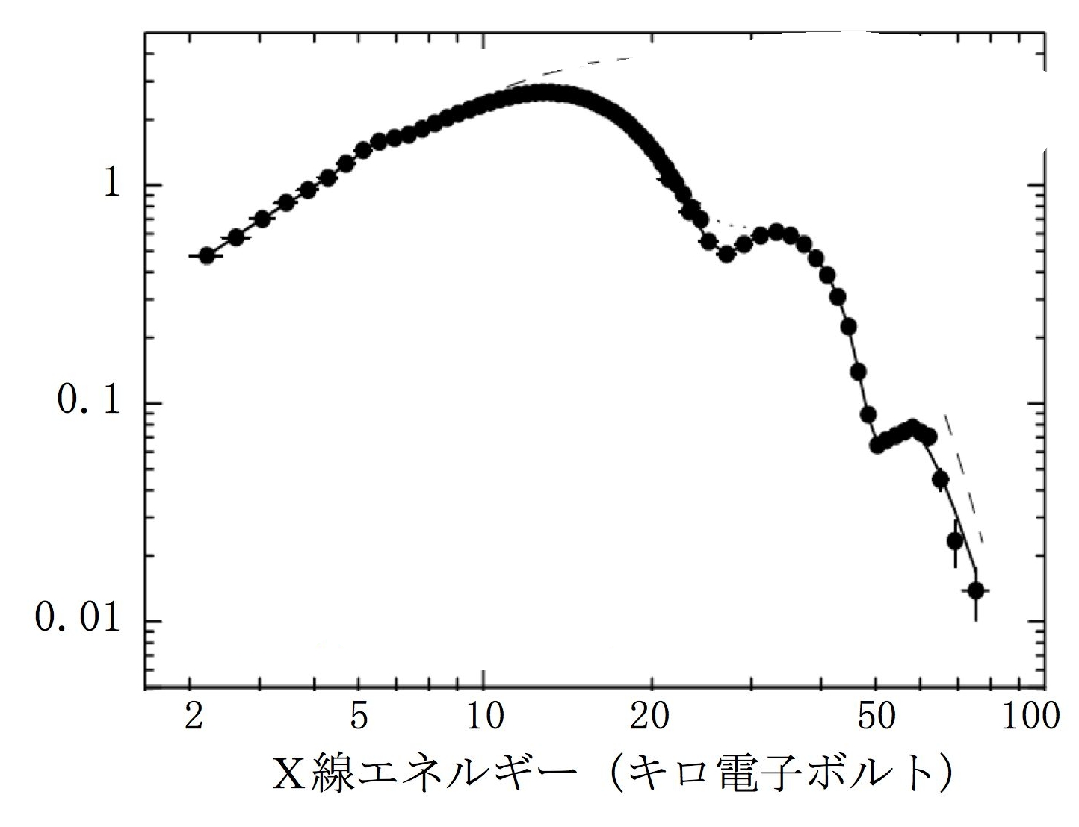
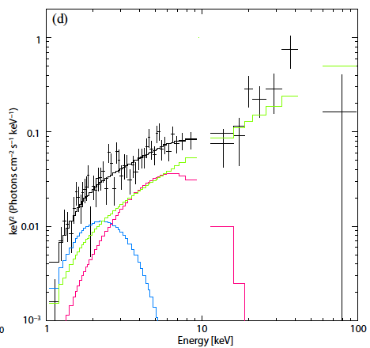
4a. Suzaku Wide-Band Spectra of Magnetars
Isolated NS
MAXI monitoring of magnetars→ [P29] Nakagawa
MeV bursts with Suzaku →
[P-31] Yasuda
X0331+53
4U 0142+61 persistent
(Enoto+10d)
Following a pioneering study with INTEGRAL (Kuiper+ 06), wide-band magentar studies with Suzaku revealed their unusual spectra →extraordinary physical condition
(Nakagawa +11)
Summed short Bursts from SGR 0501+45

Slide 6
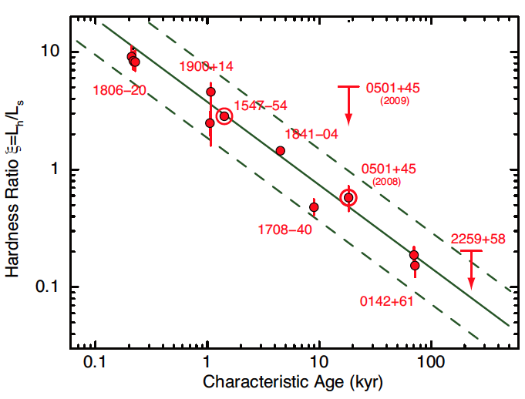
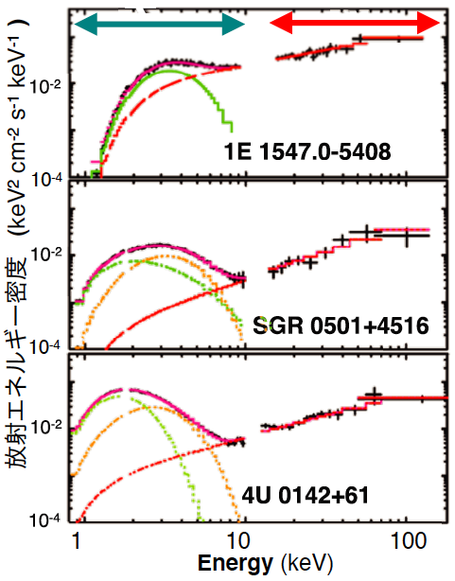
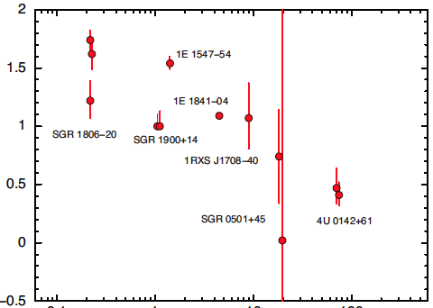
4b. Spectral Evolution of Magnetars
(Enoto PhD, Enott+10c)
10
HR
τ=1.2 kyr
1
・All show characteristic 2-component spectra.
・The hard component is extremely hard, Γ〜1.
・Older objects have weaker, yet harder, hard tail.
・These unusual properties → supporting the high MF hypothesis.
τ=20 kyr
0.1
Hardness Ratio (HR) ≡ f_{hard} (1-60)/f_{soft} (1-20)
２
0.1 1 10 100
Characteristic Age τ(kyr)
1
τ=75 kyr
０
Hard comp. Γ
0.1 1 10 100
Characteristic Age τ(kyr)

Slide 7
5. Is there a gap at B~10¹³ G in MF distribution?
＊Is initial MF continuously distributed over 10¹²⁻¹⁵ G?
＊Are there any magnetar descendents with B~10¹³ G ?
Mangetars have life times of only ~10⁵ yr → more aged ones with declined activity would hardly be observable.
But if such an object form a binary, it will;
- spin down via prop.effect w/o emission while P < P_{equil}
- emerge as an accreting HMXB after P > P_{equil}
◇ To search transient X-ray pulsars for CRSFs at >50 keV →an excellent MAXI subject, talk by Mihara,
[P-12] Yamamoto (GX 304-1, 4.7×10¹² G)
◇ To investigate SFXT (Supergiant Fast X-ray Transient), a new class of highly variable HMXBs recognized through INTGRAL observations. talk by Ubertini.
7

Slide 8
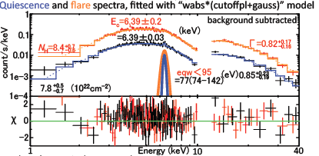
6a. SFXTs and their MAXI and Suzaku view
SFXTs (supergiants + strongly magnetized NSs)
have long pulse periods (several tens to several thousands).
exhibit 2-4 orders of mag. variability on tens of minutes.
show hard absorbed X-ray spectra with modest Fe-K line.
are good candidates for magnetar descendents.
1.54 hr pulse period
4U 2206+543 MAXI
[P-15] Sasano : Suzaku study of AXJ161929-4945
・A flare lasting ~8 ks detected.
・No increase in N_{H} during the flare.
・Fe-K line EW ↓ during the flare.
・Fe-K line became possibly broad.
Popular “clumpy stellar wind” scenario unlikely in this case
8

Slide 9
6b. Magnetically Gated Accretion in SFXTs
(e.g., Bozzo +08)
Flare component
Persistent componet
Free fall time (sec)
Stellar wind
100
200
500
1000
Co-rotation
Magnetic pressure
B = 10¹³G
P=1000 s
2×10³⁶
10¹⁴G
L_{x}=2×10³⁵ erg/s
Pressure (dyn/cm²)
2×10³⁴
10⁻⁵ M₀/yr
Ram pressure
Mdot=10⁻⁶ M₀/yr
Magnetic pressure
Gated accretion with a MF B~10¹³ G is consistent with;
-The long pulse periods
-Time scale of flare onset
-Constant N_{H}, decrease of Fe-K line EW, and possible line broadening during flares.
10⁻⁷ M₀/yr
gravity
P=100 s
10¹²G
Radius from the NS (cm)
NSs in SFXTs may be mangetar descendents.
9

Slide 10
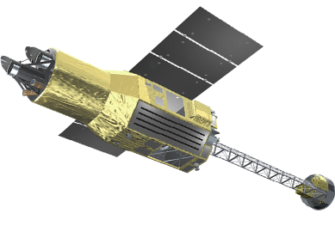
7. ASTRO-H and GEMS
Both scheduled for launch in 2014
ASTRO-H (Japan+US+ESA+..)
Micro-calorimeter: 0.5-10 keV, energy resolution〜0.1% ⇒ SFXT line Doppler
Hard X-ray Super-Mirror + Hard X-ray Imager：5〜80 keV imaging spectroscopy ⇒ magnetar continuum
Soft Gamma-ray Detector：Compton camera, 60~600 keV ⇒e⁺e⁻ annihilation structure
Standard X-ray Mirror + CCD
GEMS (Gravity and Extreme Magnetism Explorer)
The first soft X-ray polarimetry mission developed under US-Japan collaboration. Trying to measure the expected polarization of magnetars.

Slide 11
Conclusion
Do magnetars really have B=10¹⁴⁻¹⁵ G, and are they emitting X-rays by spending their MF ?
Very likely to be yes.
Is there a gap at B~10¹³ G in the MF distribution?
Still unclear, but magnetar descendents are suspected to lurk among SFXTs (and similar objects, e.g., GX 301-2), characterized by slow rotation and high variability.
・New clues expected from MAXI, Suzaku, ASTRO-H and GEMS
11

