Slide 1
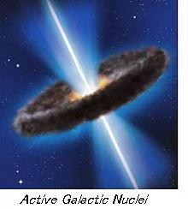
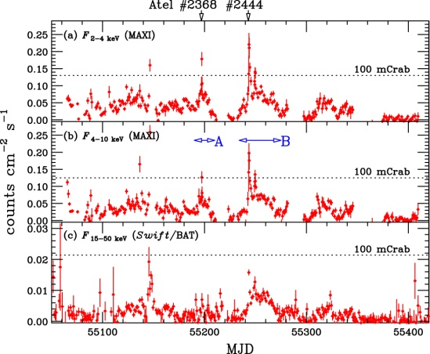
MAXI observation of Blazars
Naoki Isobe, Yoshihiro Ueda (Kyoto University)
Kousuke Sugimori, Nobuyuki Kawai (Tokyo Tech.)
Hitishi Negoro (Nihon Univ.)
Mutsumi Sugizaki, Masaru Matsuoka (RIKEN)
On behalf of the MAXI team
Isobe et al. 2010 PASJ letter (arXive:1010.1003)

Slide 2
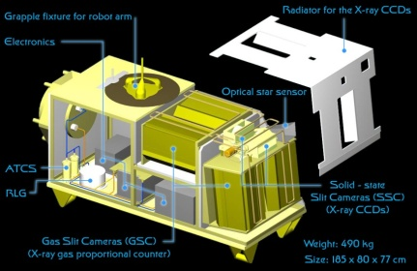
Blazars
A class of AGNs with a relativistic jet pointing to our line of sight.
Non-thermal radiation from radio to γ-ray frequencies
Synchrotron
Inverse Compton
Rapid and high-amplitude intensity variation
As a probe of jet dynamics, particle acceleration associated with jet
MAXI has a great potential for long-term monitor of blazars
Jet
FSRQs
LBLs
HBLs
MAXI
FSRQ : Flat Spectrum Radio Quasars
LBL : Low-freq. peaked BL Lac objects
HBL : High-freq. peaked BL Lac objects
(e.g., Fosatti et al. 1998)

Slide 3
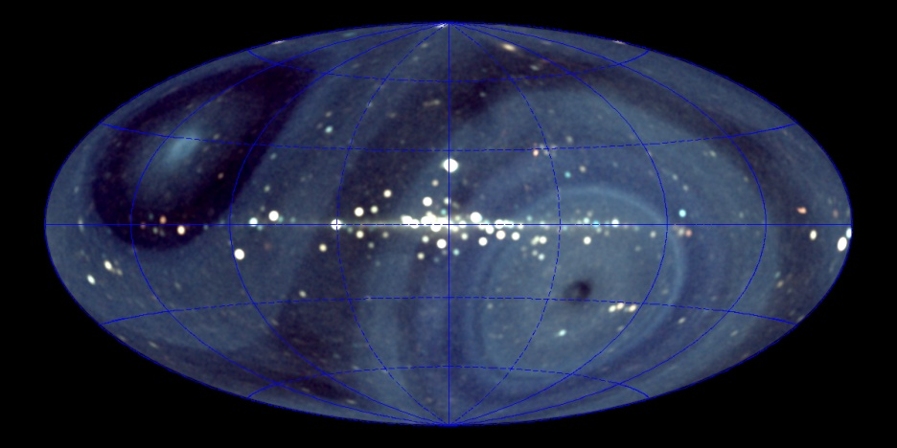
MAXI lightcurve of Mrk 421
A nearby HBL at a redshift of z = 0.031
First and brightest extragalactic Very High Energy γ-ray source
Synchrotron peak is located at the X-ray band
Extensively studied in X-ray band
Ginga (Makino et al. 1992)
ASCA (e.g., Takahashi et al. 1996)
Suzaku (Ushio et al. 2009)
etc,
X-ray flares frequently reported with Swift or RXTE (e.g., Tramacere et al. 2009)
Flare@2010 Jan. 01
(ATEL 2368)
Flare@2010 Feb. 16
(ATEL 2444)
F_{2-4 keV}
100 mCrab
F_{4-10 keV}
100 mCrab
55100
55200
55400
55500
2009
Sep. 01
2009
Dec. 01
2010
Mar. 01
2010
Jun. 01
2010
Sep. 01

Slide 4
MWL lightcurve of Mrk 421
2010 Jan. 01
ATEL2368
2010 Feb. 16
ATEL2444
Radio telescope
@Yamaguchi Univ.
8.4 GHz
Kamimura et al.
Sasada et al.
Kanata telescope
Optical
SSC 0.7 – 1.7 keV
100 mCrab
GSC 2 – 4 keV
GSC 4 – 10 keV
2009 Nov. 10(ATEL2292)
Swift/BAT 15-50 keV
(http://heasarc.gsfc.nasa.gov/docs/swift/results/transients/BAT_detected.html)
Fermi 0.1 – 300 GeV
(http://fermi.gsfc.nasa.gov/ssc/data/policy/LAT_Monitored_Sources.html)
55100
55200
55400
55500

Slide 5
Strong flares from Mrk 421 detected with MAXI
VHE γ-ray flare with VERITAS (ATEL 2443, Ong et al.)
2010 January
2010 February
6 hour
average
MAXI GSC
2-10 keV
Swift/BAT
15-50 keV
daily
HR1
F₄₋₁₀ / F₂₋₄
HR2
F₁₅₋₅₀ / F₂₋₄
120±10 mCrab
(MJD = 55197.4)
164±17 mCrab
(MJD = 55243.6)
(c.f., 130 mCrab at 2008 June; Donnarumma et al. 2009 )

Slide 6
X-ray spectrum of Mrk 421 during the strong flares
MAXI spectra at the flare peaks
Γ =2.5
Γ =2.0
3 day average
Γ=3
HR2 = F₁₅₋₅₀ / F₂₋₄
Preliminary
Γ=2
HR1 = F₄₋₁₀ / F₂₋₄
2
Energy [keV]
10
Photon index of Γ = 2-2.5 in the MAXI GSC energy range
A spectral softening toward the Swift/BAT energy range
Synchrotron peak
around the MAXI range

Slide 7
Physical parameters associated with the flares
2010 January
2010 February
Decay : t_{d} = 2.5 x 10⁴ s
t_{d} ～ τ_{cool}
τ_{cool} = 1.5 x 10³ s B^{-3/2} E_{keV}^{-1/2} δ^{-1/2}
⇒B = 0.045 G (δ/10) ^{-1/3}
Consistent with the previous results from SED
(B = 0.036 – 0.44 G; Kino et al. 2002)
Rise : t_{r} < 2 x 10 ⁴ s
t_{r} > light crossing time
⇒ R < c τ_{crs} δ / (1+z)
～ 6 x 10¹⁵ cm (δ/10)
Decay : t_{d} = 1.4 x 10⁵ s
⇒B = 0.015 G (δ/10) ^{-1/3}
a week B field region ?
a superposition of 10⁴ s flares ?
(Tanihata et al. 2004)
Rise : t_{r} < 1.3 x 10 ⁵ s
⇒ R < c τ_{crs} δ / (1+z)
～ 4 x 10¹⁶ cm (δ/10)

Slide 8
Spectral evolution associated with the flares
Hard
Hard
100 mCrab
(Tanihata et al. 2004,
Tremacere et al. 2009)
Γ = 2.0
Synchrotron Peak [keV]
HR2 = F₁₅₋₅₀ / F₂₋₄
Γ = 2.5
F₂₋₁₀ [counts s⁻¹ cm⁻²]
Peak flux [ergs s⁻¹ cm⁻²]
B : magnetic field
γ_{p} : peak electron Lorents factor
δ : beaming factor
V : volume, Ne : electron number density
Peak Energy ～B γ_{p} ² δ
Peak Flux～ B² γ_{p}^{2(2-Γp)} δ^{2+Γp} N_{e} V

Slide 9
MAXI Blazars
1.2 years
2-4 keV
4-8 keV
8-16 keV
17 HBLs, 2 LBLs, 7 FSRQs, 8 Radio Galaxies
(available at the MAXI web: http://maxi.riken.jp/top/)

Slide 10
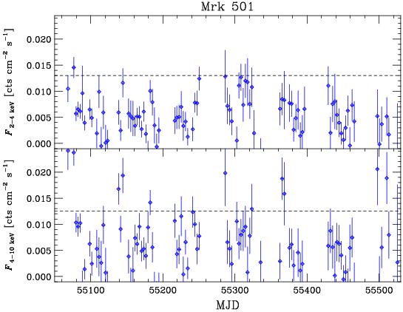
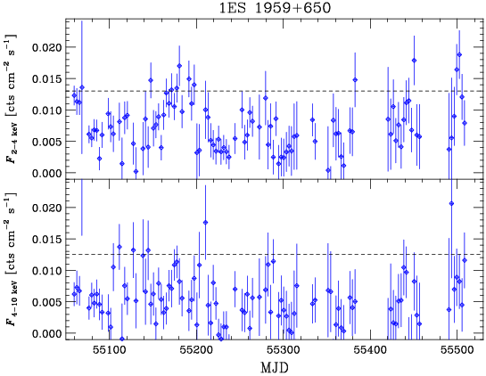
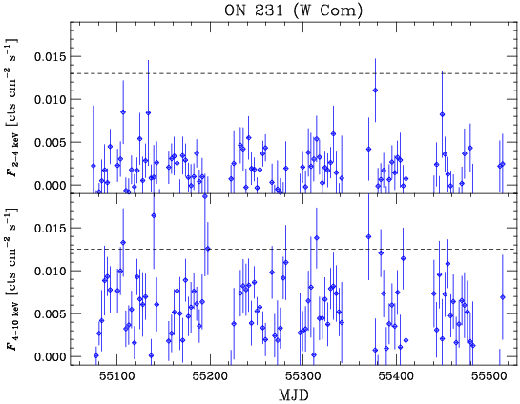
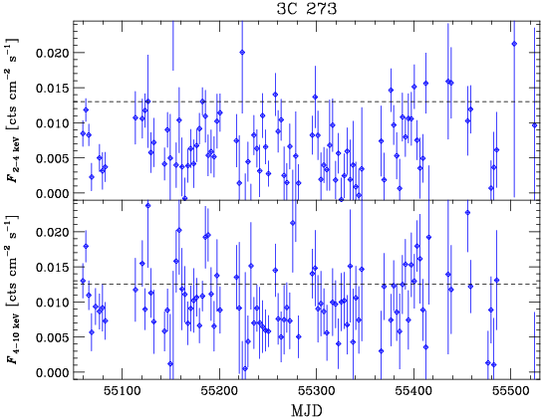
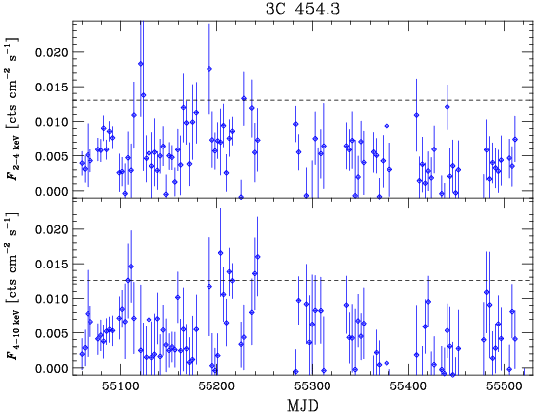
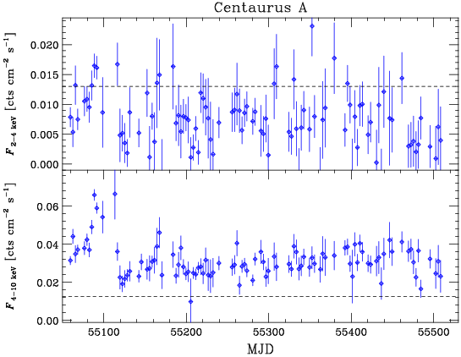
MAXI Lightcurve of Blazars
Mrk 501 (HBL)
1ES 1959+650 (HBL)
ON 231/W Com (LBL)
10 mCrab
10 mCrab
2009 Oct. 1
2010 Jan. 1
Oct. 1
Nov. 1
3C 273 (FSRQ)
3C 454.3 (FSRQ)
Centaurus A (RG/SeyII)
AGILE flare (ATEL2376)
Fermi flare
(ATEL2534)
AGILE flare (ATEL2995)
Fermi flare (ATEL2168)
Fermi flare (ATEL2534)
Fermi flare (ATEL2168)
AGILE flare (ATEL2326)

Slide 11
Summary
MAXI is an ideal observatory for long-term X-ray monitoring observation of blazars.
MAXI has detected two strong X-ray flares from the HBL Mrk 421 on 2010 January and February.
The flux in the February flare is the highest ever reported from the object
From the shape of the MAXI lightcurve, the magnetic field associated with the flares were estimated
B = 0.045 G for 2010 January
B = 0.015 G for 2010 February
a superposition of several flare with a timescale of 10⁴ s ?
The MAXI spectrum was found to hardest, when the flux is one third of the peak of the flare.
difficult to be interpreted within a simple one-zone framework.

