Slide 1
Scientific research ?
Getting results from limited information.

Slide 2
Astrophysical view
Seyfert2!
Dark Energy??
.
Universe
Blazar?
Galaxy formation ..
Cosmic-ray
Acceleration ….

Slide 3
Time domain
10⁴
+ BH trasients
+ NS transient
+ Super Nova
+ Classical Nova
+ Flaring stars
+ AGN long term variability
10²
1
Variability (day)
10^{–2}
Pulsars
GRBs / SRFs
10^{–4}
10^{–9}
10^{–6}
10^{–3}
1
10³
Observational duration (day)
~ 5yr

Slide 4
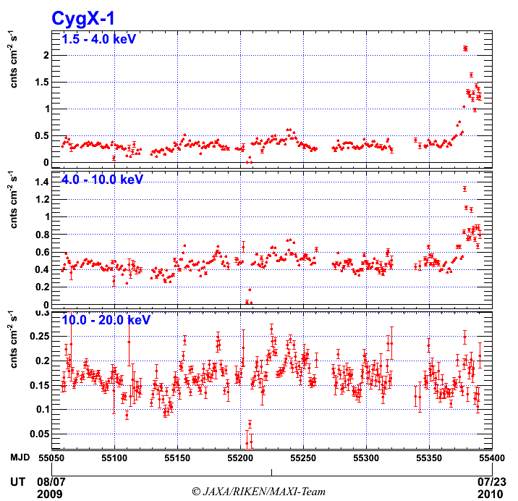
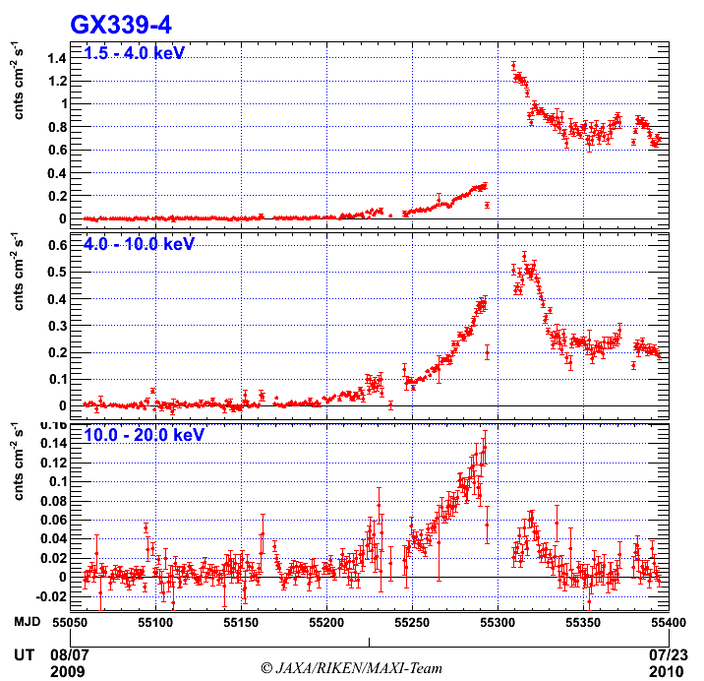
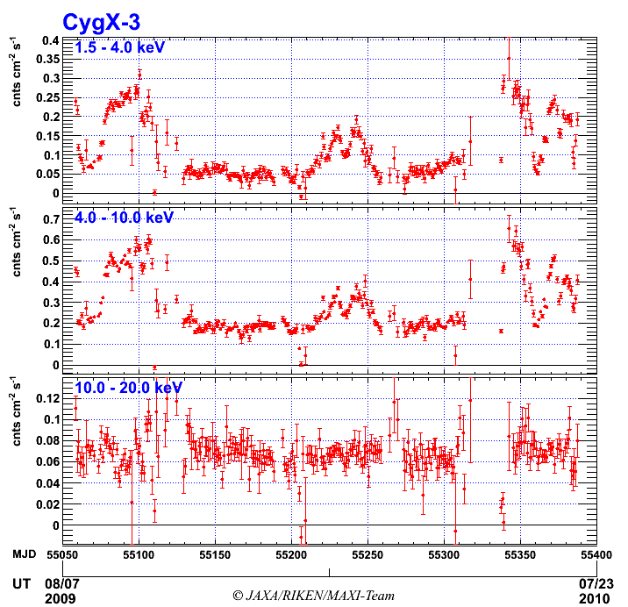
Black hole candidates New Activity, Spectral Transition
ATEL#2711
Soft X-ray increase
ATEL#2380
Beginning of new activity
ATEL#2404, #2635
State transition
Cyg X-1
GX 339-4
Cyg X-3
2-4 keV
4-10 keV
10-20 keV
~ 1yr
O-07: Negoro, YO-04amaoka, P-01 Nakahira, P-07Shidatsu

Slide 5
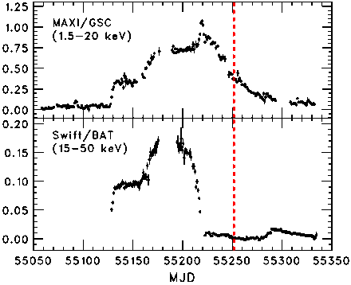
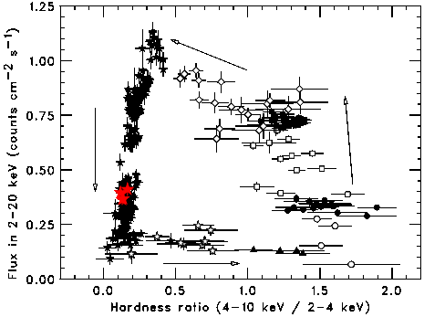
Suzaku observation of XTE J1752-223
Suzaku
observation
Details of observations
ObservationDate 2010-02-24 04:58:00
– 2010-02-25 04:27:24 (UT)
Total exposure 41 ksec
ＸＩＳ Exposure 0.5 ksec (XIS 1),
6.1 ksec (XIS 0,3)
Observation direction HXD nominal
ＸＩＳ mode
Full window 0.1s burst option (XIS 1)
1/4 window 0.3s burst option (XIS 0.3)
Suzaku observed
“High/Soft state”
High/Soft
Low/hard

Slide 6
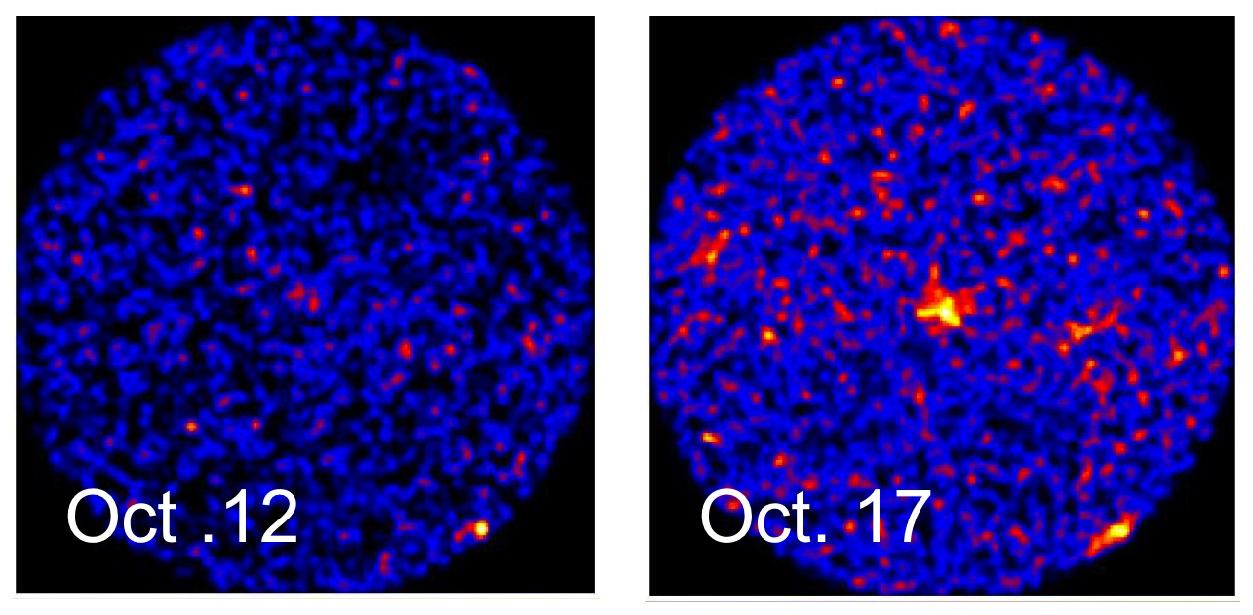
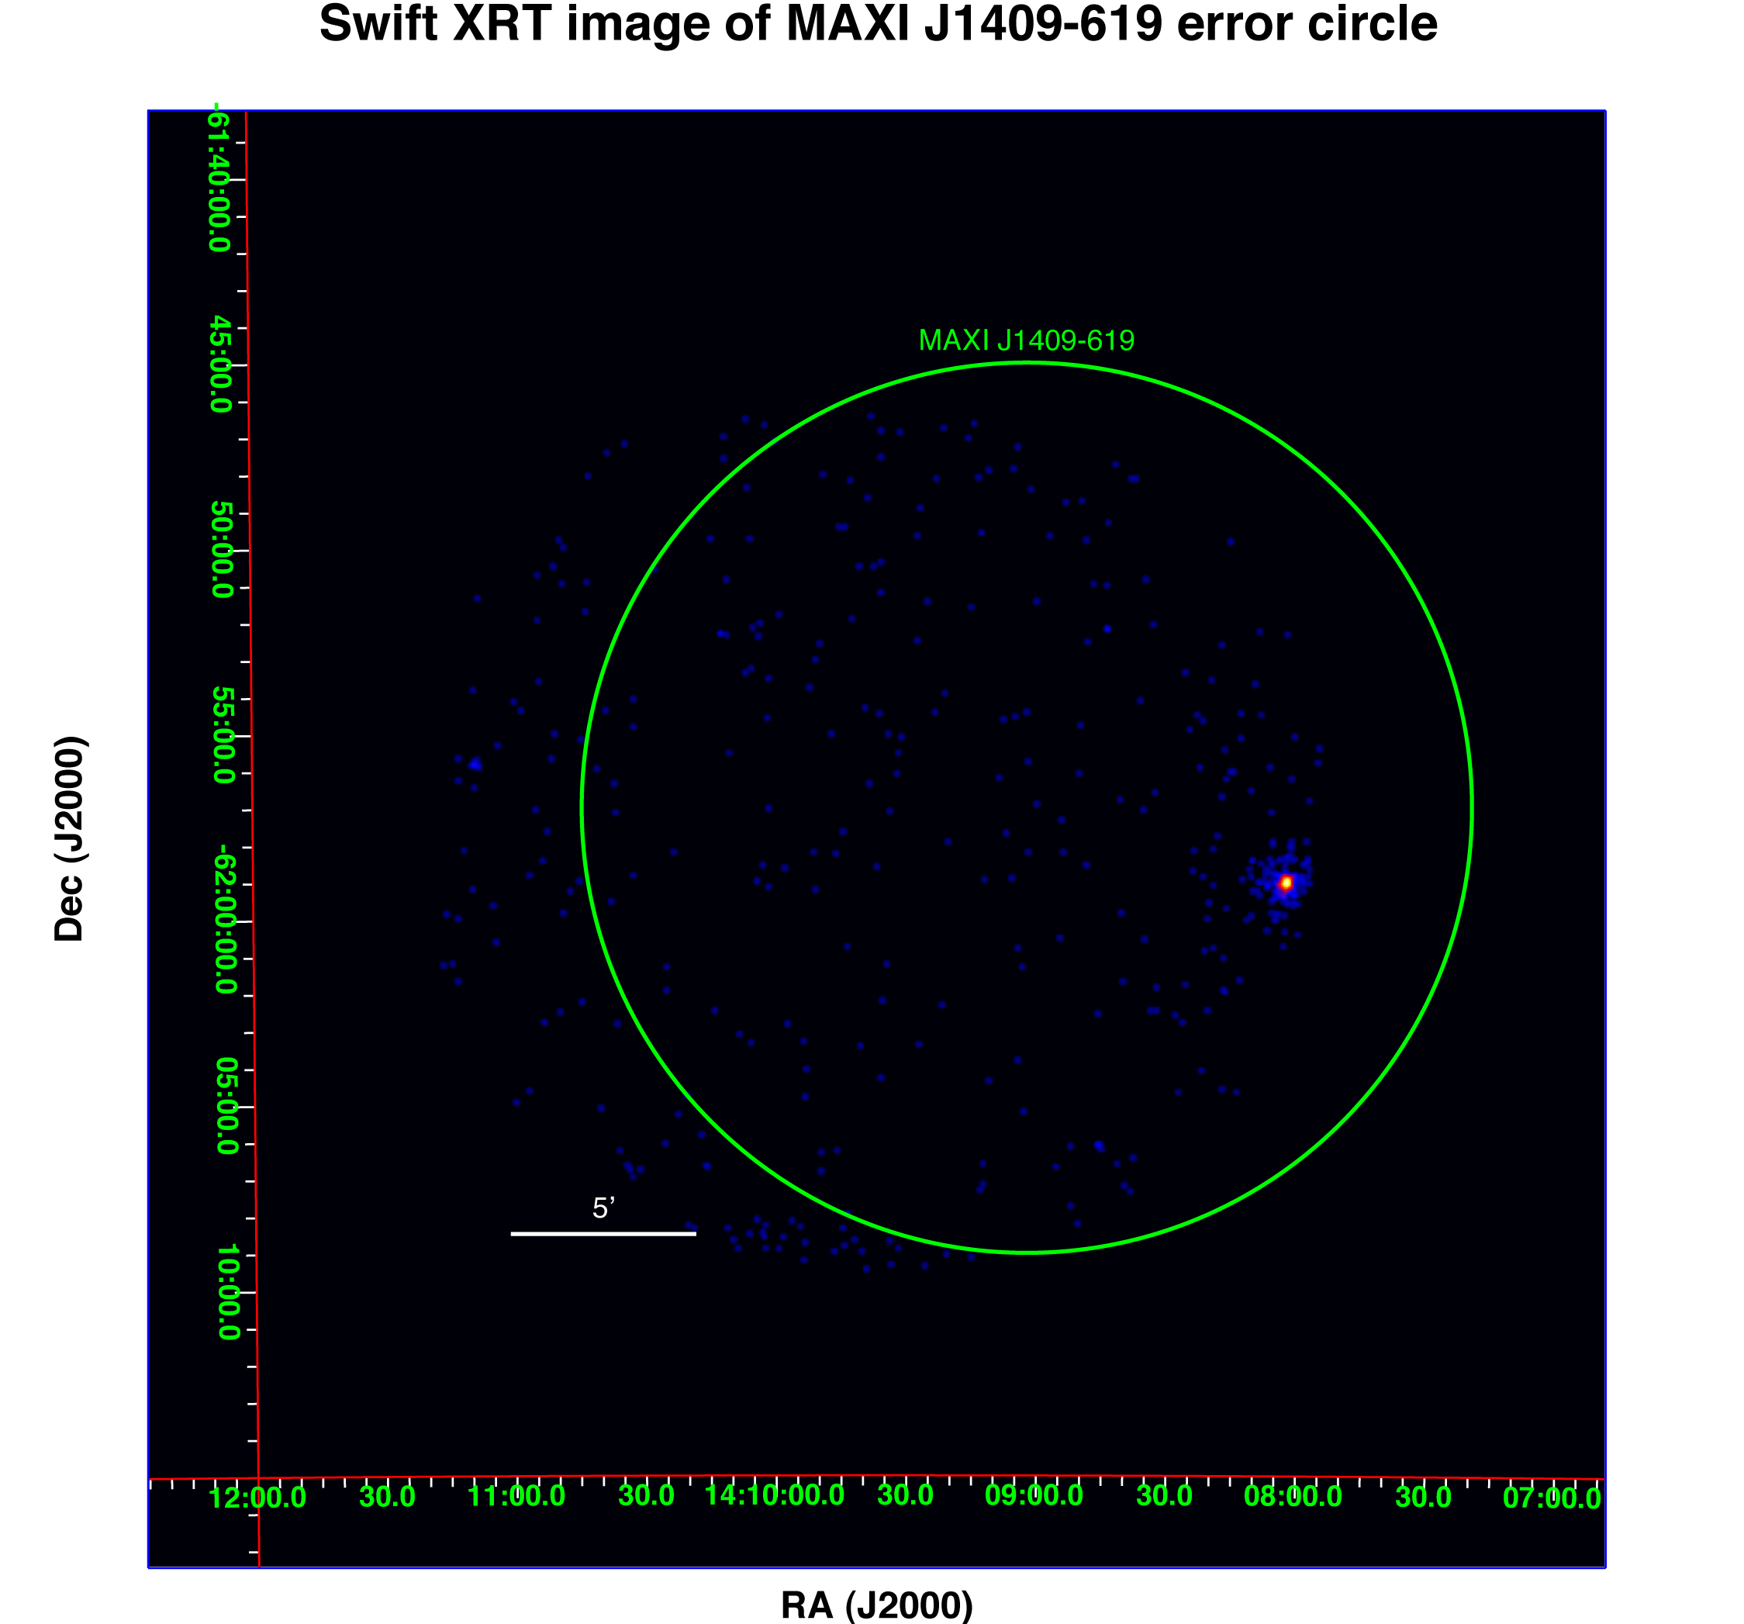
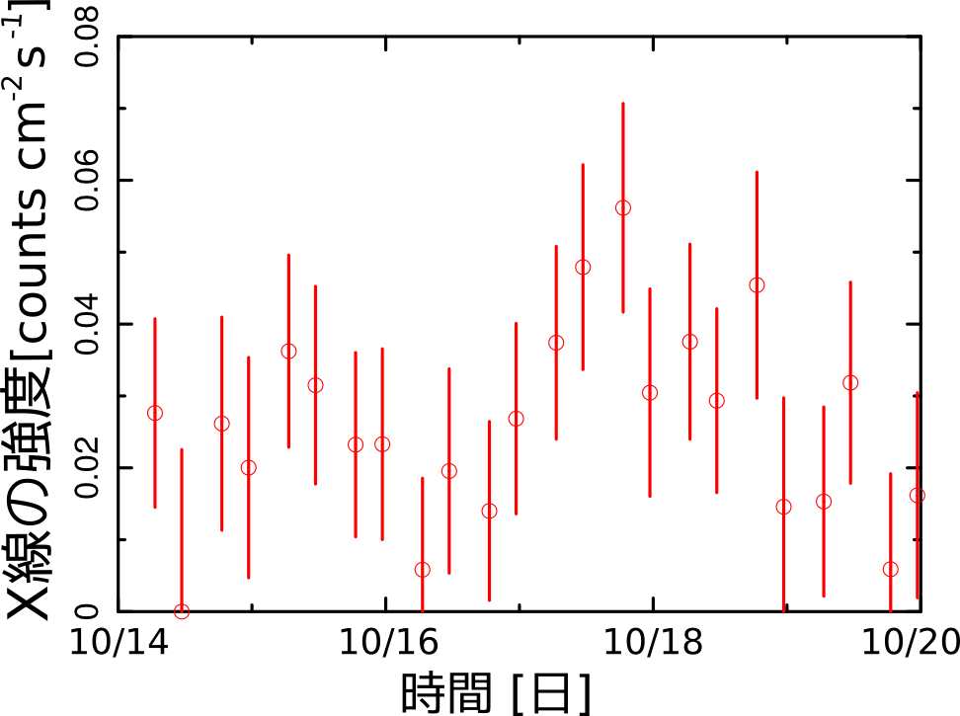
MAXI J1409-619 confirmed and accurately localized by Swift
Swift XRT Oct. 21
MAXI detection of outbursts
X-ray count rate
Date
O-07 Kennea

Slide 9
Time domain
10⁴
We have expected and already learned:
+ BH trasients
+ NS transient
+ Super Nova
+ Classical Nova
+ Flaring stars
+ AGN long term variability
10²
Collaboration &
Coordinate observation
With other observatories
Is crucially important!!
1
Variability (day)
10^{–2}
Pulsars
GRBs / SRFs
10^{–4}
10^{–9}
10^{–6}
10^{–3}
1
10³
Observational duration (day)
~ 5yr

Slide 10
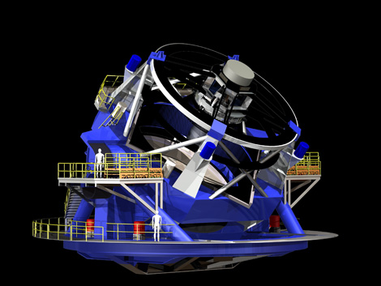
Time domain
10⁴
We have already learned:
+ BH trasients
+ NS transient
+ Super Nova
+ Classical Nova
+ Flaring stars
+ AGN long term variability
10²
Collaboration &
Coordinate observation
With other observatories
Is crucially important!!
Swift
Fermi
INTEGRAL
1
Variability (day)
10^{–2}
CRTS
PTF
LSST
Pulsars
GRBs / SRFs
10^{–4}
10^{–9}
10^{–6}
10^{–3}
1
10³
Observational duration (day)
~ 5yr

Slide 11
MAXI project started more than 1.5 decades ago! 2nd MAXI Workshop in 2001

Slide 12
We got old ….
Mihara

Slide 13
Prof Matsuoka was young ….
Many thanks to Prof. Matsuoka for his hard work and elaborations !!!

Slide 14
This workshop partially supported by Aoyama Gakuin University Research Institute and Society for Promotion of Space Science.
We thank to Dr. Kohama, Ms. Takahashi, Mr. Adachi, and Ms. Konagai.
The organizers would thank to all the participants for coming.

